Slide 1


Company Profile
"Innovation Pulsates Through Our Firm, Inspiring Us to Continuously Rethink Conventions and Develop Solutions that Forge the Future of Structural Consultancy."

Slide 2


Welcome To
AN ISO 9001-2015 CERTIFIED COMPANY
"Dedicated to Excellence, We Deliver Superlative Services to Our Esteemed Clients. With Unwavering Commitment, Our Team Ensures the Delivery of Top-notch Design, Detailed Drawings, Comprehensive Architectural, Project Management, and Audit Services that Surpass Your Expectations. We Gratefully Acknowledge Your Choice in Choosing Us."

Slide 3


About Us
Since April 2014, Prasanna S. Joshi started his practice as a professional structural consultant. Later in 2022, he established and started his practice by name of M/s 1.5 Gamma Consultants Pvt. Ltd.

Slide 4
About Us
M/s 1.5 Gamma Consultants Pvt. Ltd. has continued to strive towards becoming a complete multi-disciplinary practise offering our Clients the specialist individual attention and solutions required by an ever-changing project environment.
M/s 1.5 Gamma Consultants Pvt. Ltd. sees teamwork on every project as the key success element and is responsible for creating this environment. The over-all project manager is duty- bound in ensuring efficient and regular communication to all stakeholders and at all levels.

Slide 5
Our Mission
Our Mission is to Provide Outstanding Services Across Our Professional Disciplines, Upholding Statutory Practices, Codes of Conduct, and Integrity. By Nurturing Our Team and Establishing a Premier Platform, We Aim to Serve the Built Environment, Especially Our Esteemed Clients, with Excellence and Dedication.

Slide 6

Our Vision
01
We aspire to empower individuals and businesses, driving transformative change and unlocking their full potential.
Our vision is to grow our multi-disciplinary team in order to offer a broad spectrum of specialist Engineering, Consulting and Project Management Consulting services to become our Clients' preferred Service Provider choice through excellence and efficiency in all aspects of the project life cycle.
02
With a strong commitment to sustainability, Whether it is a Commercial & Residential Building project, Infrastructure project or Industrial Project, M/s 1.5 Gamma Consultants Pvt. Ltd. aims to become leading service provider that will exceed expectations and set new standards!
03

Slide 7

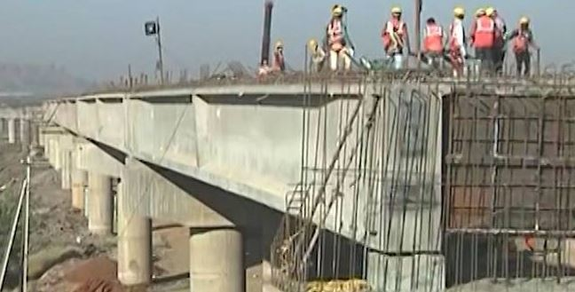
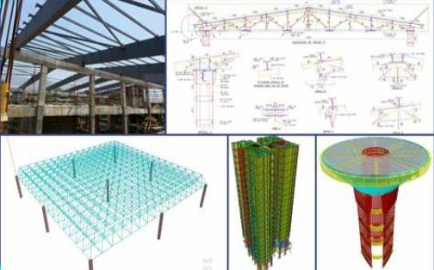
Our Services
Architectural Services
Infrastructure Designing
Peer Review
The firm’s core principle is to blend beauty with utility designs.
    Highway Bridges
    Box Culverts
    Design of Road Pavements
    WTP/ESR
    We also undertake peer review & value engineering work for analysis and design carried out by other consultants

Slide 8
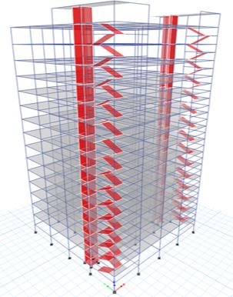
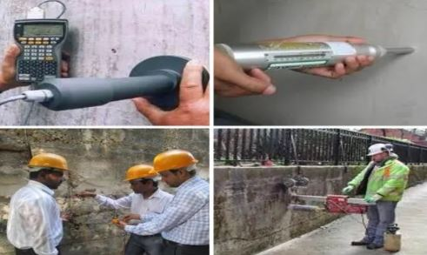

Our Services
Structural Design
Engineering
Project Management
Consultancy
Structural Audit
We analyse and design all types of residential and commercial buildings using finite element software
    Our experienced team do a preliminary technical survey of a building to assess its general health as civil engineering structure.
    Pre-Tendered Activities
    Post Tender Activities
    Supervision during execution

Slide 9

Our Company
Process
Our company employs a highly efficient and streamlined process to deliver our products/services to clients. We follow a methodical approach that ensures each step of our process is executed with precision and attention to detail.

Slide 10


Best Service For Our Client
We offer a range of services to meet our customers' needs, including customized solutions, timely delivery, and dedicated customer support.

Slide 11


Our Company
Timeline
"Fueled by a Passion for Innovation and Excellence, Our Objective is to Provide Exceptional Services, Generating Sustainable Value for Our Clients Over the Long Term."

Slide 12

Our Goals
01
02
03
Driven by innovation and excellence, our goal is to deliver high-quality services.
Our goals are to innovate continuously and deliver exceptional cleint services to drive long-term success
We strive to achieve sustainable growth and make a positive impact on the world through our services

Slide 13

100+
50Lac +
5000+
Projects Completed
Total Square Ft Executed
Satisfied Clients

Slide 14
Our Team

Slide 15

Our Team
Prasanna Joshi
Director, M.Tech Structures
Gopal Garad
Director, M.Tech Structures
Ashish Manwal
Director, Principal Architect
Total technical Staff
20 Nos.

Slide 16
Organization Chart

Slide 17
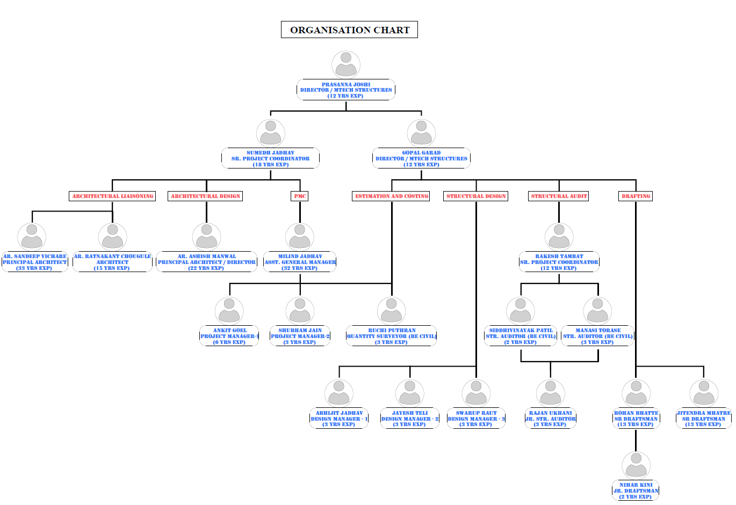

Slide 18
Valuable Clients

Slide 19









Slide 20
REGISTERED ORGANIZATION

Slide 21
SR. NO. | ORGANISATION | REGISTRATION/VENDOR NO.
1 | MUNICIPAL CORPORATION OF GREATER MUMBAI | STR/J/840008322
2 | THANE MUNICIPAL CORPORATION | TMCB/R/2023/APL/00277
3 | NAVI MUMBAI MUNICIPAL CORPORATION | NMMCC/R/2024/APL/00199
4 | PANVEL MUNICIPAL CORPORATION | CARPC/R/2024/APL/00719
5 | NASHIK MUNICIPAL CORPORATION | 445866 DT.01/02/2020
6 | MAHARASHTRA STATE | STATE/R/2023/APL/07192
7 | AI ENGINEERING SERVICES LTD. | NA
8 | CENTRAL PUBLIC WORK DEPARTMENT | NA
LIST OF REGISTERED ORGANISATIONS

Slide 22
SR. NO. | ORGANISATION | REGISTRATION/VENDOR NO.
9 | DAMAN PLANNING DEVELOPMENT AUTHORITY-DIU-DAMAN | DMN/PDA/SEOR1[C-01]/2024/80
10 | THE INSTITUTION OF ENGINEERS | AM163164-3
11 | VEERMATA JIJABAI TECHNOLOGICAL INSTITUTE | NA
12 | MAHANAGAR TELEPHONE NIGAM LTD. | SP16347
13 | ENGINEERING PROJECTS (INDIA) LTD. | NA
14 | RELIANCE INDUSTRIES LTD. | 3764139
15 | UPL LIMITED | NA
16 | 70 EVENT MEDIA GROUP | NA
17 | ACG PAM PHARMA TECHNOLOGIES PVT. LTD. | GAM008
LIST OF REGISTERED ORGANISATIONS

Slide 23
ARCHITECTURAL
PROJECTS

Slide 24
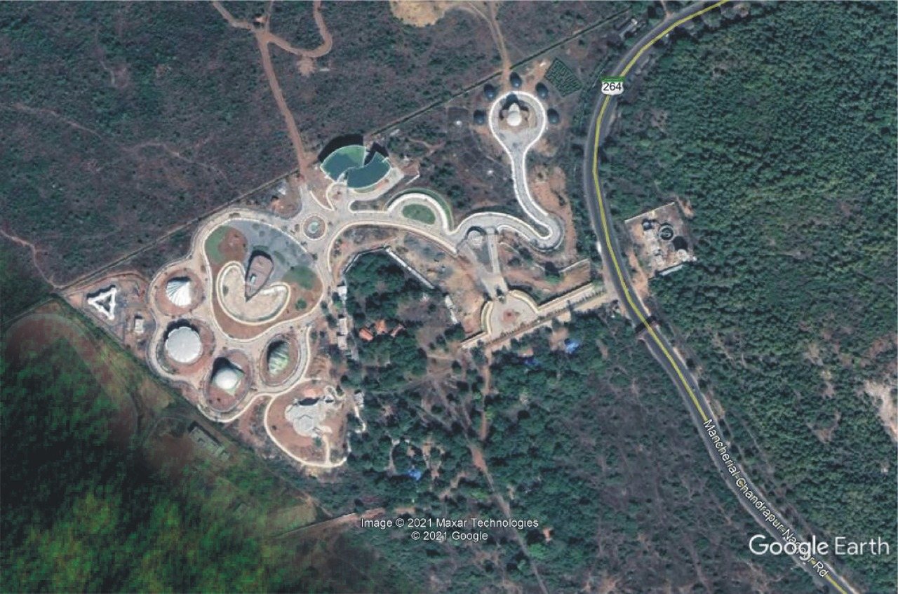
Botanical Garden for Forest Department, New Chanda, Chandrapur
1 | PROJECT NAME: | BOTANICAL GARDEN FOR FOREST DEPARTMENT, NEW CHANDA, CHANDRAPUR
2 | CLIENT NAME: | M/S 360 DESIGN CONCEPT PVT LTD. AND FOREST DEPARTMENT, CHANDRAPUR
3 | LOCATION: | NEW CHANDA, CHANDRAPUR
4 | BRIEF DESCRIPTION: | DESIGN OF UNIQUE SHAPE BUILDINGS FOR OFFICE, EXHINITIONS, MUSEUM, AQUARIUM, BUTTERFLY GARDEN, TICKET COUNTER AND LANDSCAPE ANCILLARY STRUCTURES
5 | YEAR OF SERVICE: | 2019-2023
6 | SCOPE OS SERVICE | STRUCTURAL DESIGN AND TENDER
7 | VALUE OF WORK | 155 CR

Slide 25
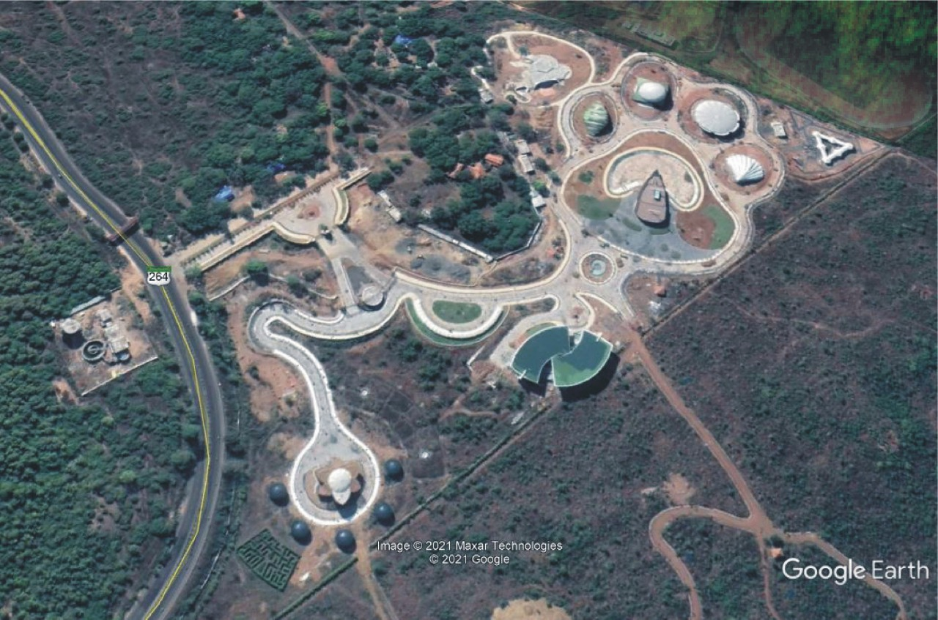
Botanical Garden for Forest Department, New Chanda, Chandrapur

Slide 26
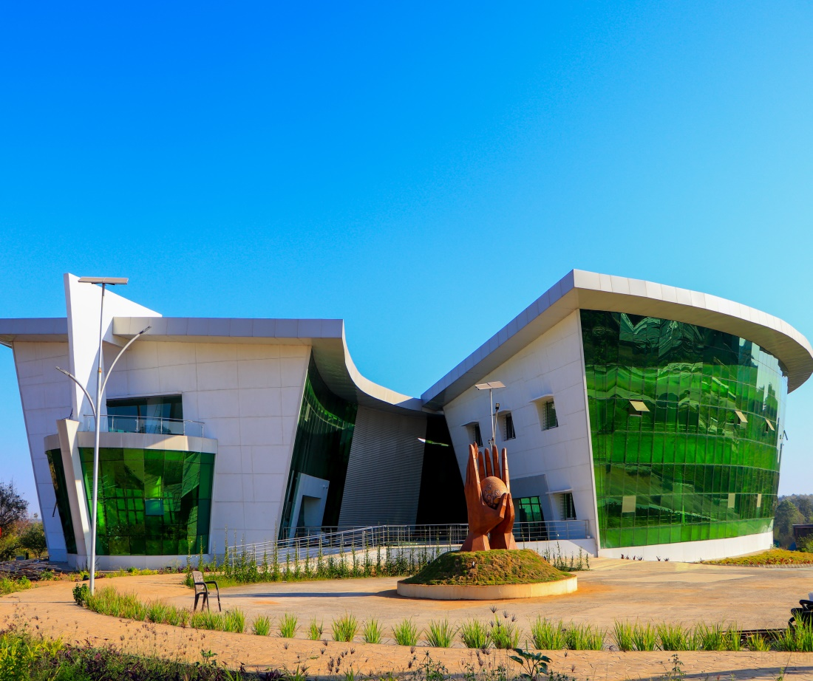
1 | PROJECT NAME: | OFFICE AND NBRI BUILDING, BOTANICAL GARDEN, CHANDRAPUR
2 | CLIENT NAME: | M/S 360 DESIGN CONCEPT PVT LTD AND FOREST DEPARTMENT, NEW CHANDA, CHANDRAPUR
3 | LOCATION: | NEW CHANDA, CHANDRAPUR
4 | BRIEF DESCRIPTION: | ADMINISTRATIVE BUILDING COMPRISING OF BASEMENT + GRD + 1 FLOOR
5 | YEAR OF SERVICE: | 2019-2023
6 | SCOPE OS SERVICE | STRUCTURAL DESIGN AND TENDER
7 | VALUE OF WORK | 6.42 CR

Slide 27
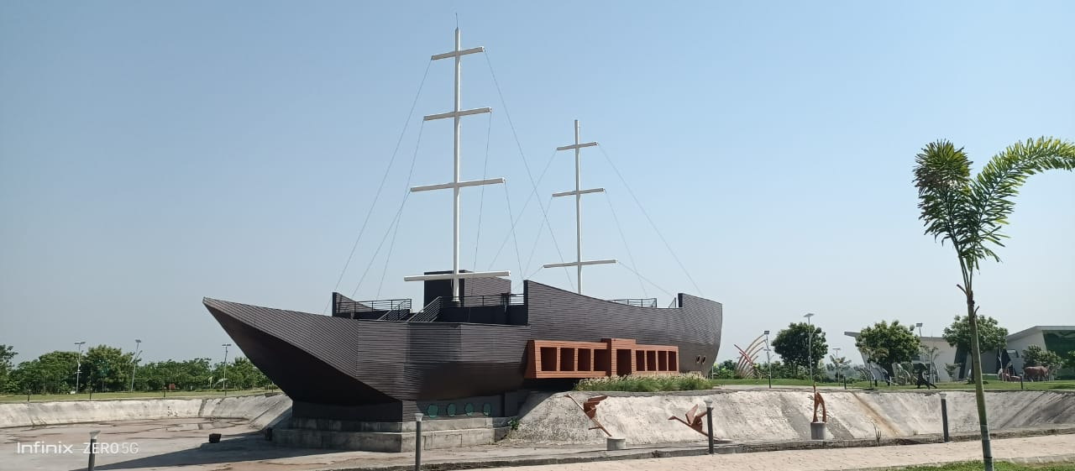
1 | PROJECT NAME: | CAFETERIA BUILDING, BOTANICAL GARDEN, CHANDRAPUR.
2 | CLIENT NAME: | M/S 360 DESIGN CONCEPT PVT LTD AND FOREST DEPARTMENT, NEW CHANDA, CHANDRAPUR
3 | LOCATION: | NEW CHANDA, CHANDRAPUR
4 | BRIEF DESCRIPTION: | UNIQUE BOAT SHAPE ASSEMBLY BUILDING COMPRISING OF BASEMENT + GRD + 1 FLOOR
5 | YEAR OF SERVICE: | 2019-2023
6 | SCOPE OS SERVICE | STRUCTURAL DESIGN AND TENDER
7 | VALUE OF WORK | 9.56 CR

Slide 28
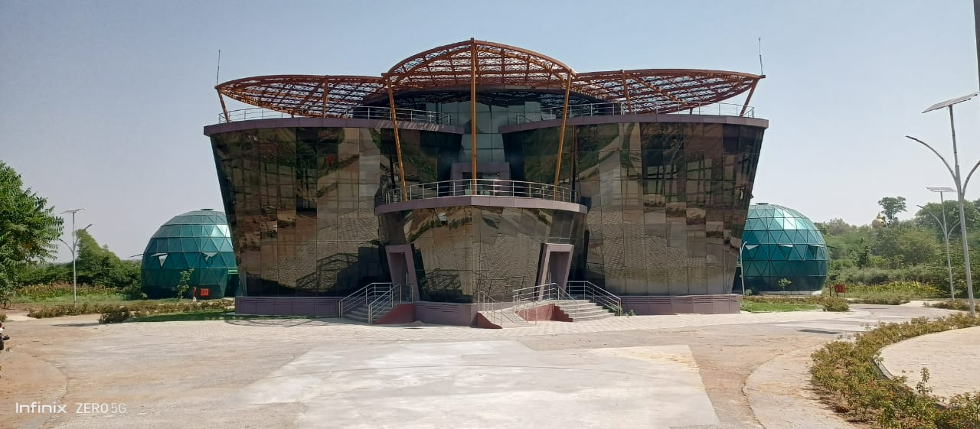
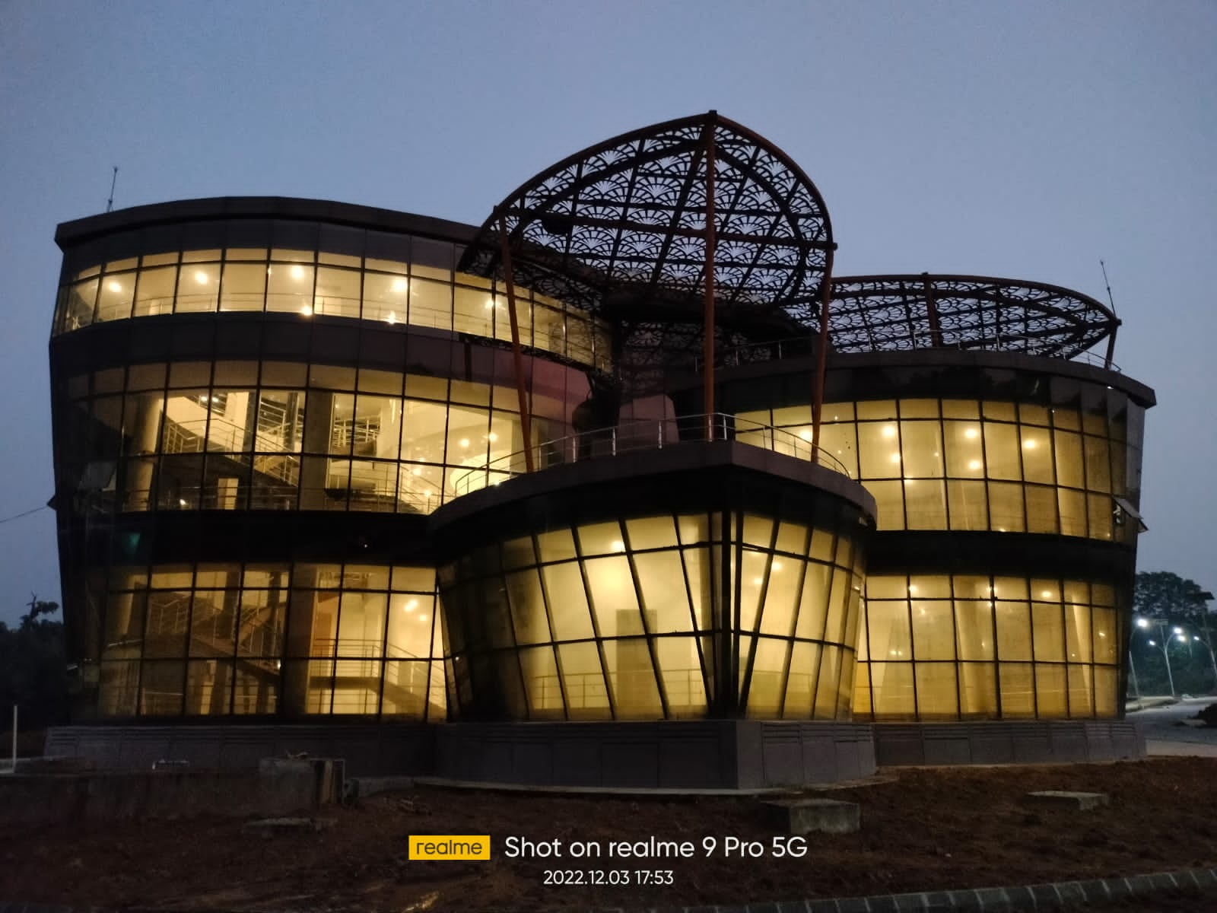
1 | PROJECT NAME: | EXHIBITION BUILDING, BOTANICAL GARDEN
2 | CLIENT NAME: | M/S 360 DESIGN CONCEPT PVT LTD AND FOREST DEPARTMENT, NEW CHANDA, CHANDRAPUR
3 | LOCATION: | NEW CHANDA, CHANDRAPUR
4 | BRIEF DESCRIPTION: | UNIQUE SHAPE ASSEMBLY BUILDING COMPRISING OF GRD + 1 FLOOR
5 | YEAR OF SERVICE: | 2019-2023
6 | SCOPE OS SERVICE | STRUCTURAL DESIGN AND TENDER
7 | VALUE OF WORK | 3.05 CR

Slide 29
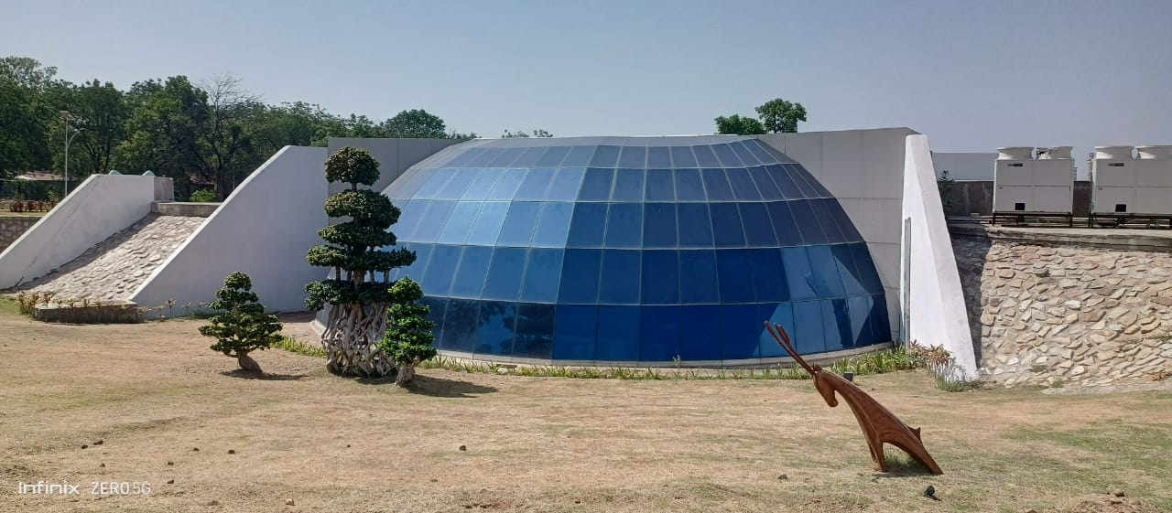
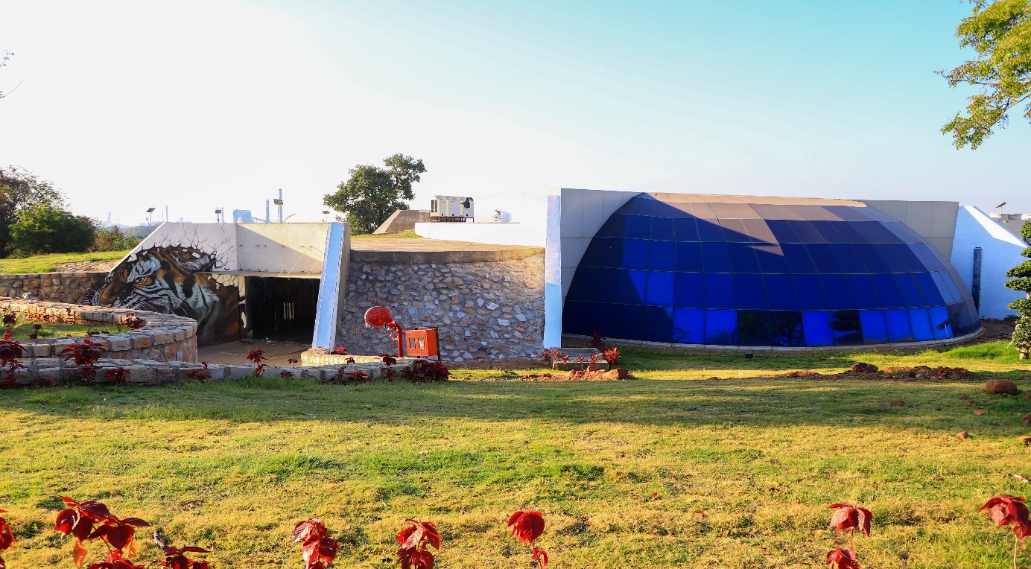
1 | PROJECT NAME: | UNDERGROUND MUSEUM BOTANICAL GARDEN
2 | CLIENT NAME: | M/S 360 DESIGN CONCEPT PVT LTD AND FOREST DEPARTMENT, NEW CHANDA, CHANDRAPUR
3 | LOCATION: | NEW CHANDA, CHANDRAPUR
4 | BRIEF DESCRIPTION: | UNDERGROUND MUSEUM COMPRISING OF BASEMENT + GROUND FLOOR
5 | YEAR OF SERVICE: | 2019-2023
6 | SCOPE OS SERVICE | STRUCTURAL DESIGN AND TENDER
7 | VALUE OF WORK | 3.45 CR

Slide 30
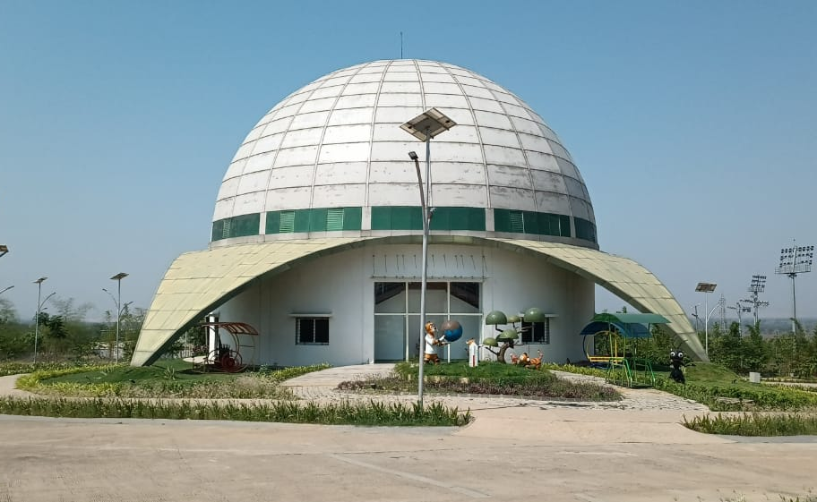
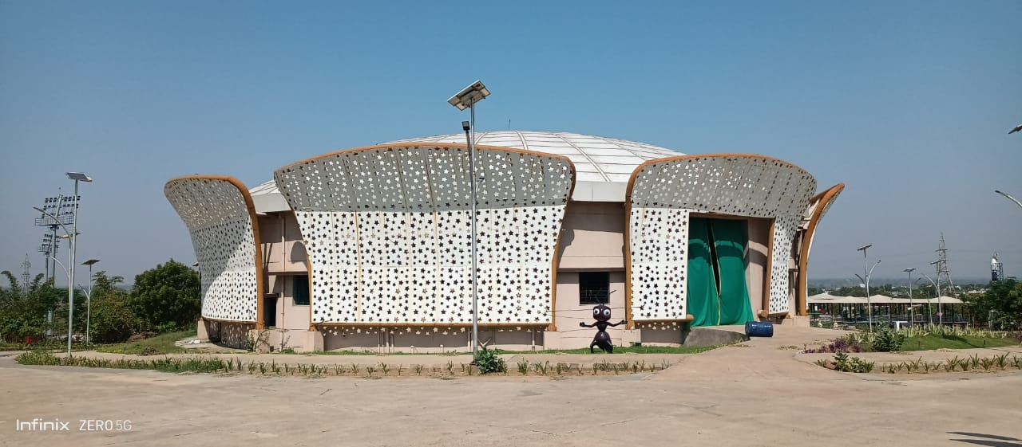
1 | PROJECT NAME: | AUDITIORIUM & SCIENCE CENTRE BUILDING, BOTANICAL GARDEN
2 | CLIENT NAME: | M/S 360 DESIGN CONCEPT PVT LTD AND FOREST DEPARTMENT, NEW CHANDA, CHANDRAPUR
3 | LOCATION: | NEW CHANDA, CHANDRAPUR
4 | BRIEF DESCRIPTION: | UNIQUE SHAPE ASSEMBLY BUILDING (2 NO.S) COMPRISING OF GRD + 2 FLOORS
5 | YEAR OF SERVICE: | 2019-2023
6 | SCOPE OS SERVICE | STRUCTURAL DESIGN AND TENDER
7 | VALUE OF WORK | 8.92 CR

Slide 31
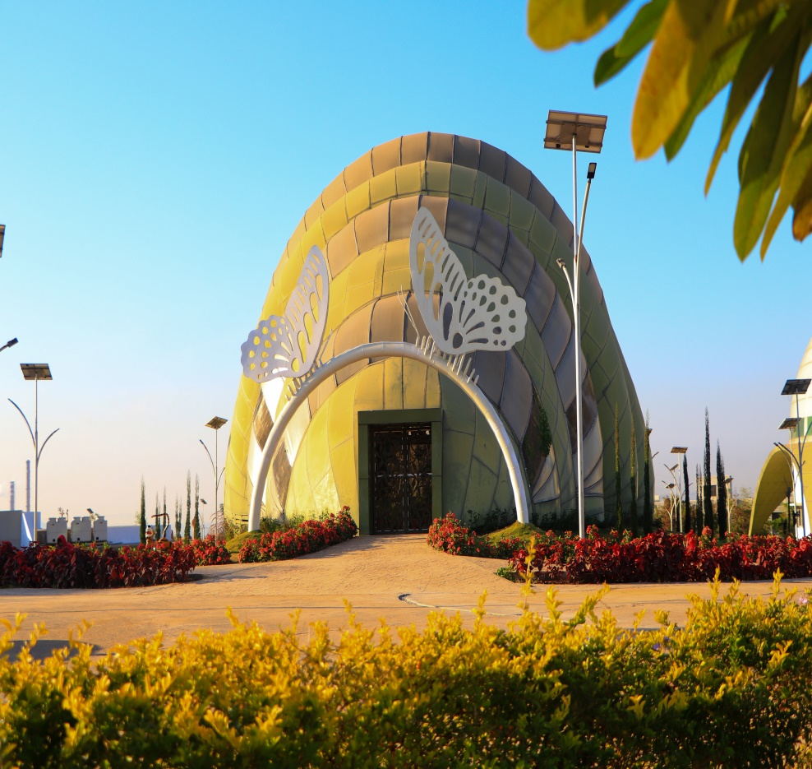
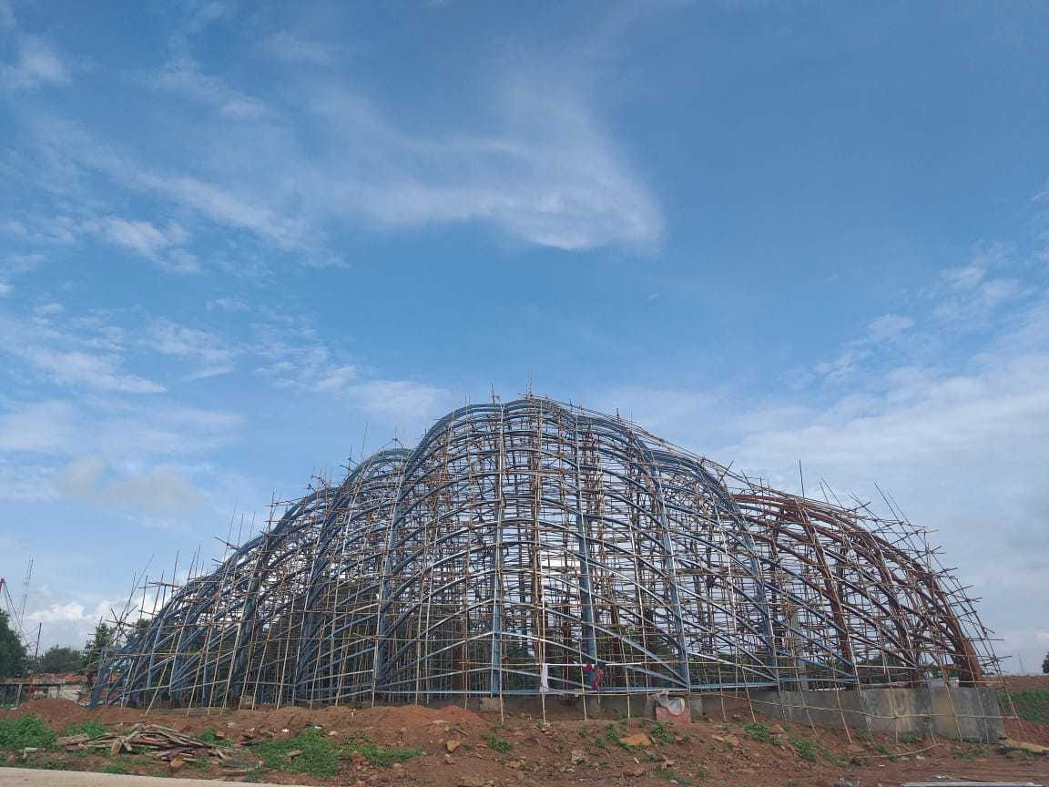
1 | PROJECT NAME: | BUTTERFLY GARDEN, BOTANICAL GARDEN
2 | CLIENT NAME: | M/S 360 DESIGN CONCEPT PVT LTD AND FOREST DEPARTMENT, NEW CHANDA, CHANDRAPUR
3 | LOCATION: | NEW CHANDA, CHANDRAPUR
4 | BRIEF DESCRIPTION: | UNIQUE SHAPE STEEL STRUCTURE, BUTTERFLY GARDEN
5 | YEAR OF SERVICE: | 2019-2023
6 | SCOPE OS SERVICE | STRUCTURAL DESIGN AND TENDER
7 | VALUE OF WORK | 5.50 CR

Slide 32
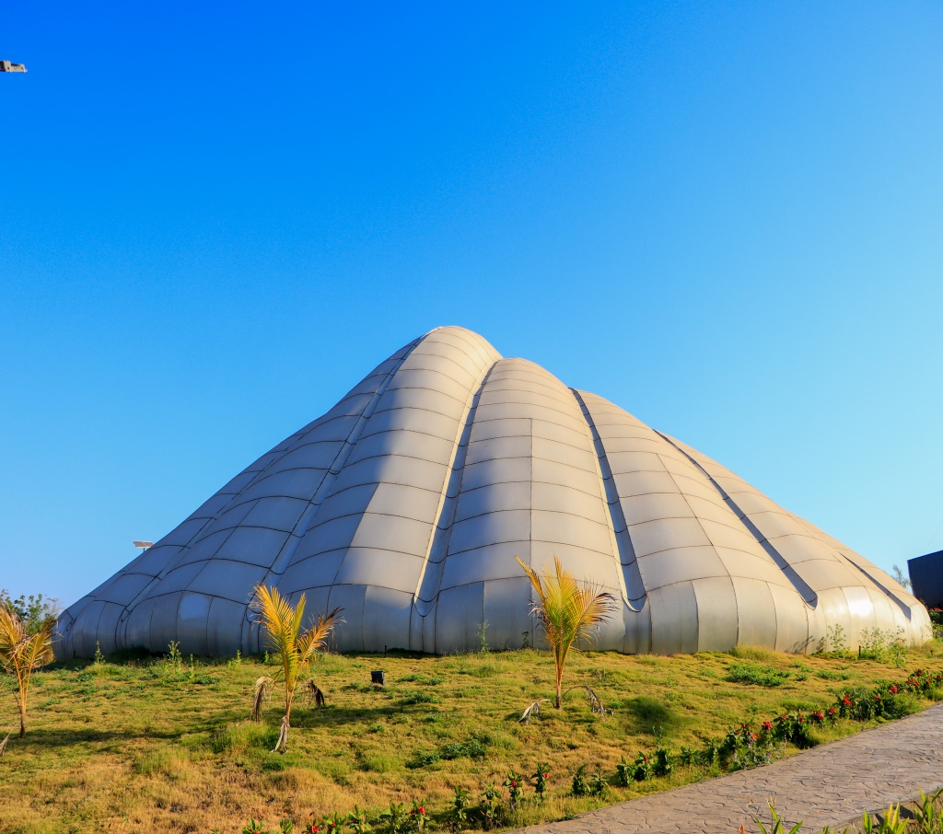
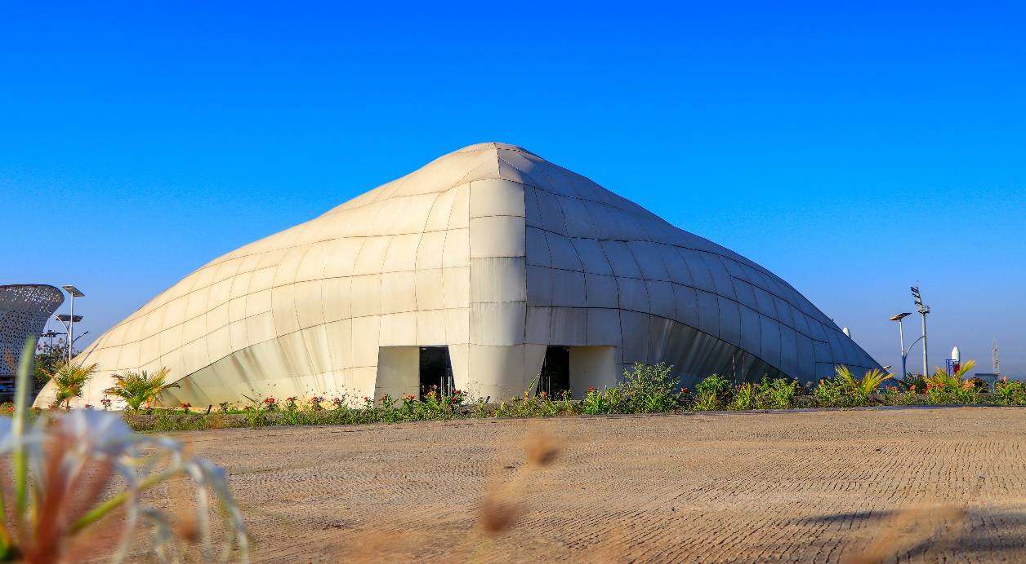
1 | PROJECT NAME: | AQUARIUM, BOTANICAL GARDEN
2 | CLIENT NAME: | M/S 360 DESIGN CONCEPT PVT LTD AND FOREST DEPARTMENT, NEW CHANDA, CHANDRAPUR
3 | LOCATION: | NEW CHANDA, CHANDRAPUR
4 | BRIEF DESCRIPTION: | UNIQUE SHAPE GRD +1 AQUARIUM STRUCTURE
5 | YEAR OF SERVICE: | 2019-2023
6 | SCOPE OS SERVICE | STRUCTURAL DESIGN AND TENDER
7 | VALUE OF WORK | 6.50 CR

Slide 33
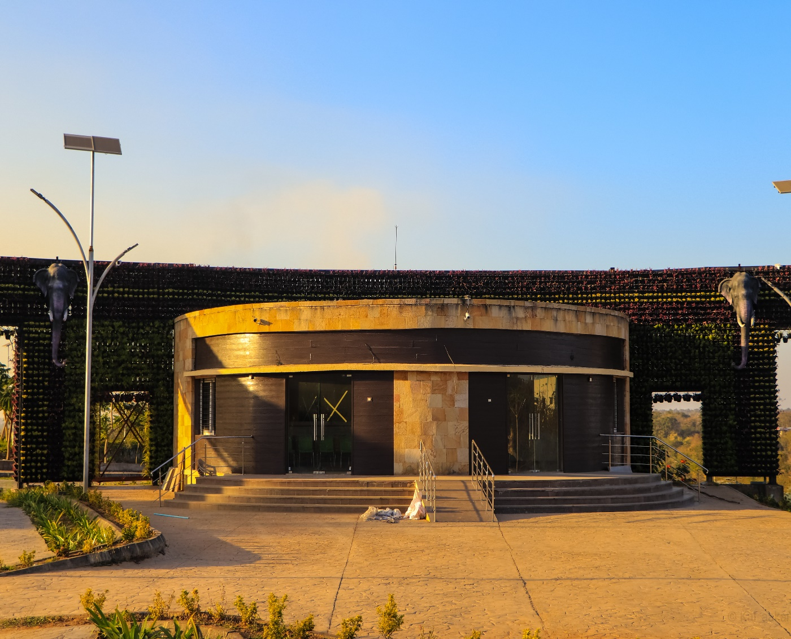
1 | PROJECT NAME: | TICKET COUNTER, BOTANICAL GARDEN
2 | CLIENT NAME: | M/S 360 DESIGN CONCEPT PVT LTD AND FOREST DEPARTMENT, NEW CHANDA, CHANDRAPUR
3 | LOCATION: | NEW CHANDA, CHANDRAPUR
4 | BRIEF DESCRIPTION: | UNIQUE SHAPE GRD STRUCTURE
5 | YEAR OF SERVICE: | 2019-2023
6 | SCOPE OS SERVICE | STRUCTURAL DESIGN AND TENDER
7 | VALUE OF WORK | 3.50 CR

Slide 34
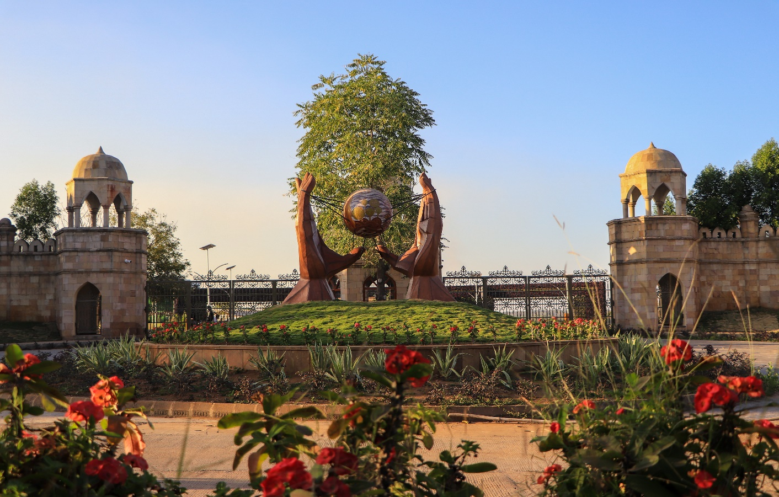
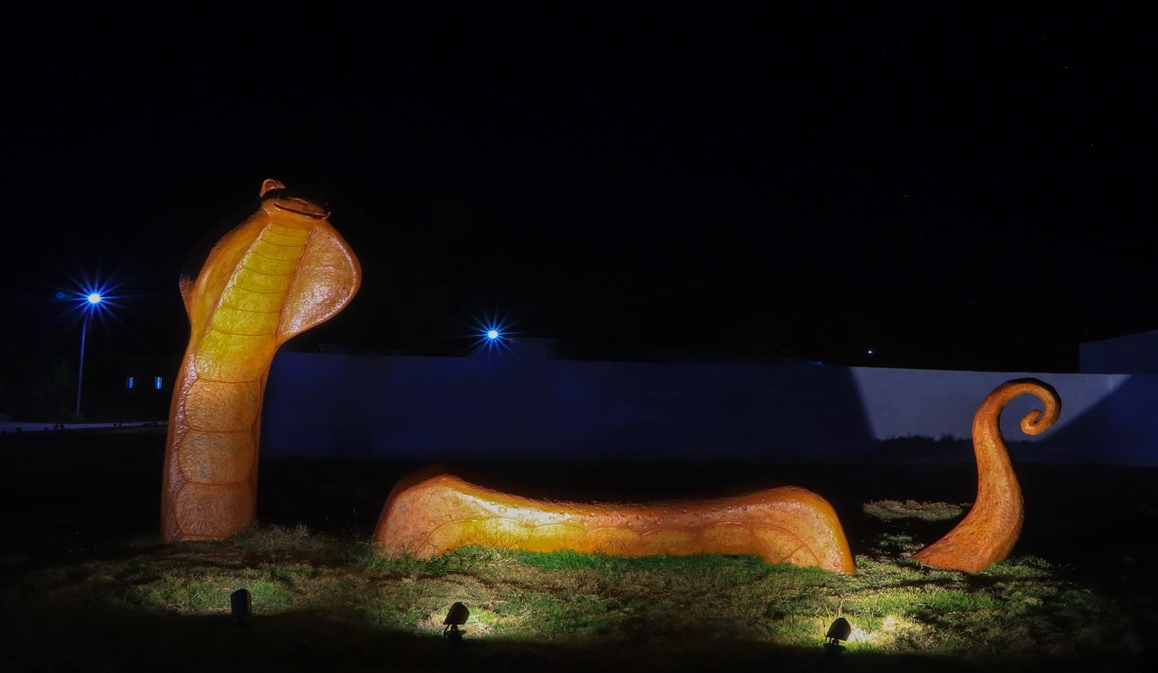
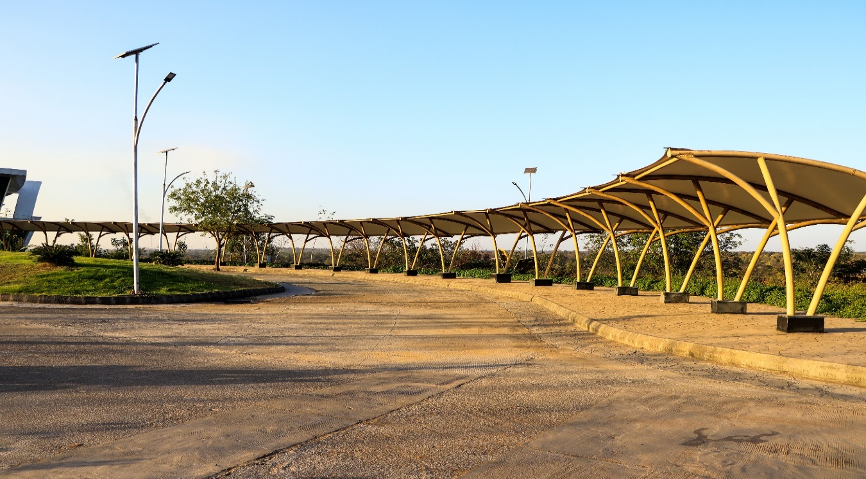

Slide 35
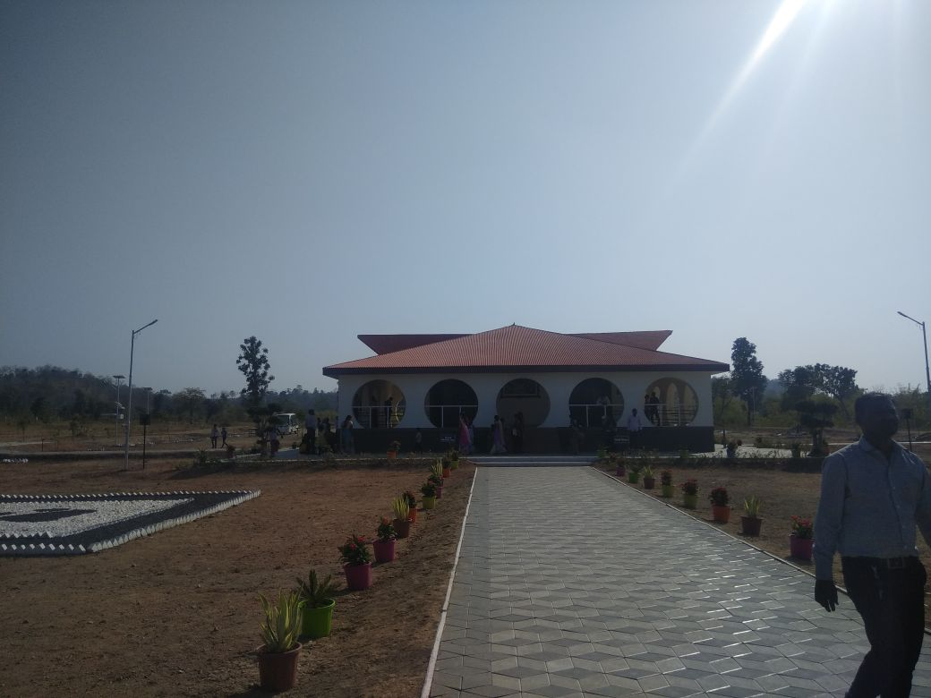
 | PROJECT NAME: | ECO PARK, POMBHURNA, CHANDRAPUR

Slide 36
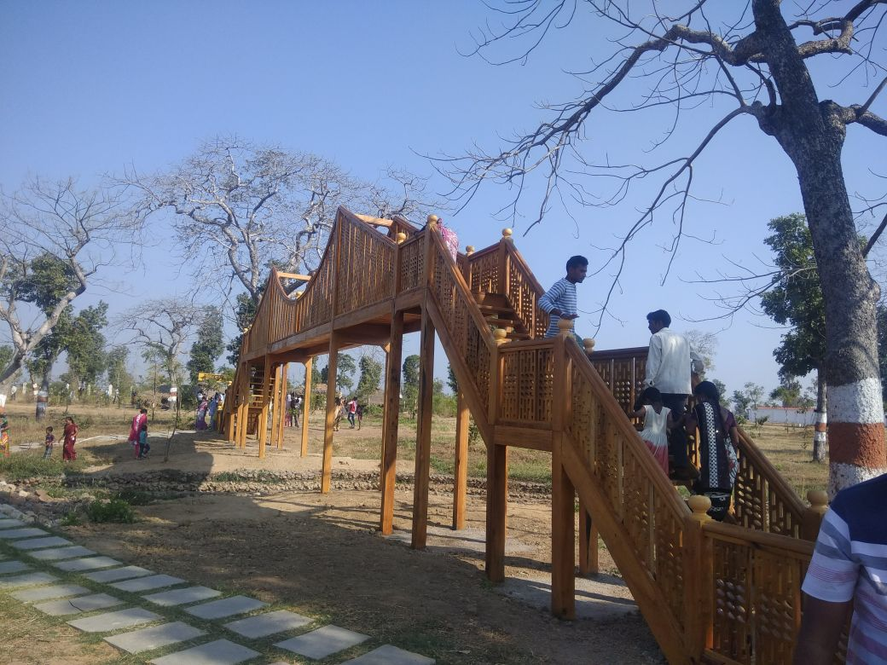
 | PROJECT NAME: | ECO PARK, POMBHURNA, CHANDRAPUR

Slide 37
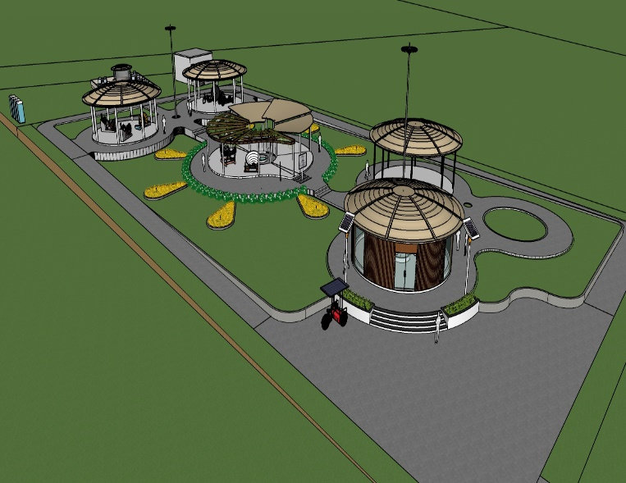
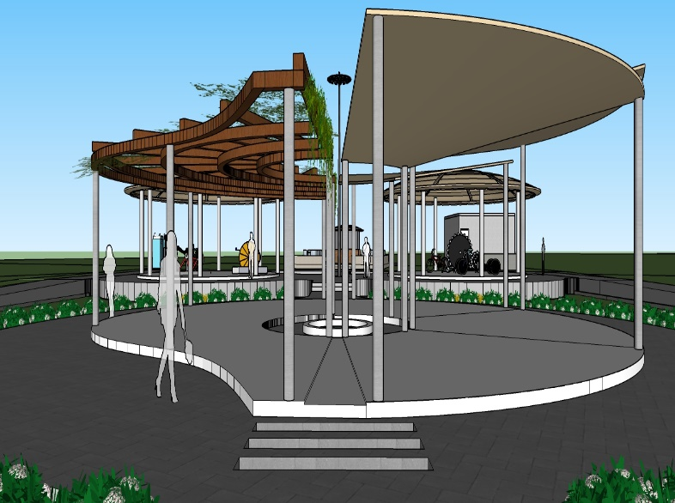
 | PROJECT NAME: | Energy Park, Vadgaon, Yavatmal, Maharashtra

Slide 38
BUNGALOW PROJECTS

Slide 39
SR. NO. | PROJECT NAME | ADDRESS | ROLE
1 | MR. KHAIRNAR AND SONAWANE BUNGALOW | MALEGAON | ARCHITECTUAL + STRUCTURAL DESIGN
2 | MR. NITIN MAHALE AND MR. VIKAS PATIL BUNGALOW | SOYGAON, MALEGAON | ARCHITECTUAL + STRUCTURAL DESIGN
3 | GUEST HOUSE AT POMBHURNA | POMBHURNA, CHANDRAPUR | ARCHITECTUAL + STRUCTURAL DESIGN
4 | MR. JAYESH THAKUR BUNGALOW | VIRAR, VASAI | ARCHITECTUAL + STRUCTURAL DESIGN
5 | ROW HOUSE AT MALEGAON | MALEGAON | ARCHITECTUAL + STRUCTURAL DESIGN
6 | MR. BHILLORE BUNGALOW | NASHIK | ARCHITECTUAL + STRUCTURAL DESIGN
7 | AVINASH HOUSE | PUNE | ARCHITECTUAL + STRUCTURAL DESIGN
8 | MR. KHOCHARE BUNGALOW | MURBAD, THANE | ARCHITECTUAL + STRUCTURAL DESIGN
LIST OF BUNGALOW PROJECTS

Slide 40
SR. NO. | PROJECT NAME | ADDRESS | ROLE
9 | MR. SWAPNIL PRADHAN BUNGALOW | MURBAD, THANE | ARCHITECTUAL + STRUCTURAL DESIGN
10 | MR. GAJENDRA AHIRE BUNGALOW | NANDURBAR | ARCHITECTUAL + STRUCTURAL DESIGN
11 | MR. JUNGARE BUNGALOW | MHOPADA, RAIGAD | ARCHITECTUAL + STRUCTURAL DESIGN
12 | MR. NITIN MAHALE BUNGALOW | NASHIK | ARCHITECTUAL + STRUCTURAL DESIGN
13 | MR. RAJIV HATHMODE BUNGALOW | RAIGAD | ARCHITECTUAL + STRUCTURAL DESIGN
14 | MR. RAUT BUNGALOW | NASHIK | ARCHITECTUAL + STRUCTURAL DESIGN
15 | MR. SHELKE FARM HOUSE | PANVEL | ARCHITECTUAL + STRUCTURAL DESIGN
16 | MR. WAGHMARE | NASHIK | ARCHITECTUAL + STRUCTURAL DESIGN
LIST OF BUNGALOW PROJECTS

Slide 41
SR. NO. | PROJECT NAME | ADDRESS | ROLE
17 | MR. SUKINKAR BUNGALOW | NASHIK | ARCHITECTUAL + STRUCTURAL DESIGN
18 | MR. KHADSE BUNGALOW | WASHIM | ARCHITECTUAL + STRUCTURAL DESIGN
19 | MR. JOSEPH SEQUERIA BUNGALOW | MANGLORE, KARNATAKA | ARCHITECTUAL + STRUCTURAL DESIGN
20 | MR. RAHUL SURYAWANSHI BUNAGLOW | NASHIK | ARCHITECTUAL + STRUCTURAL DESIGN
21 | MR. DESHMUKH BUNGALOW | MURBAD, THANE | ARCHITECTUAL + STRUCTURAL DESIGN
LIST OF BUNGALOW PROJECTS

Slide 42
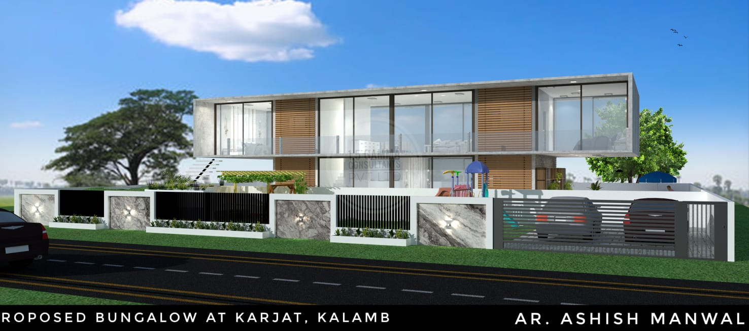
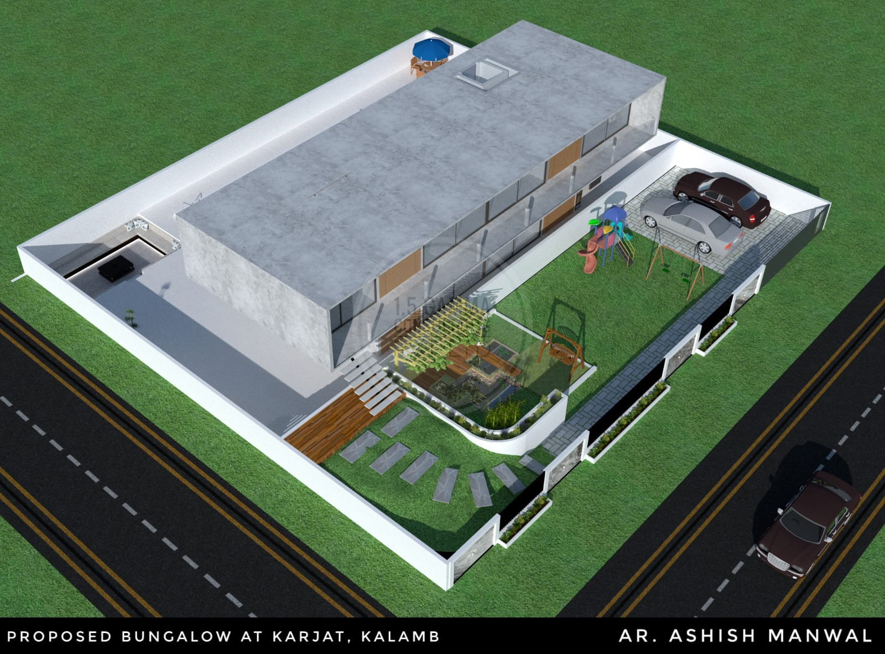
 | PROJECT NAME: | MR. GHUMATKAR BUNGALOW

Slide 43
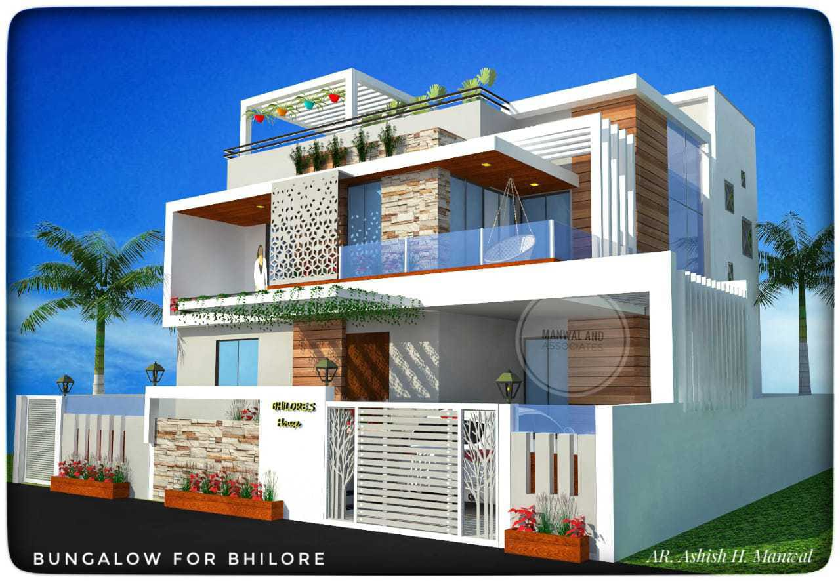
 | PROJECT NAME: | MR. BHILLORE BUNGALOW

Slide 44
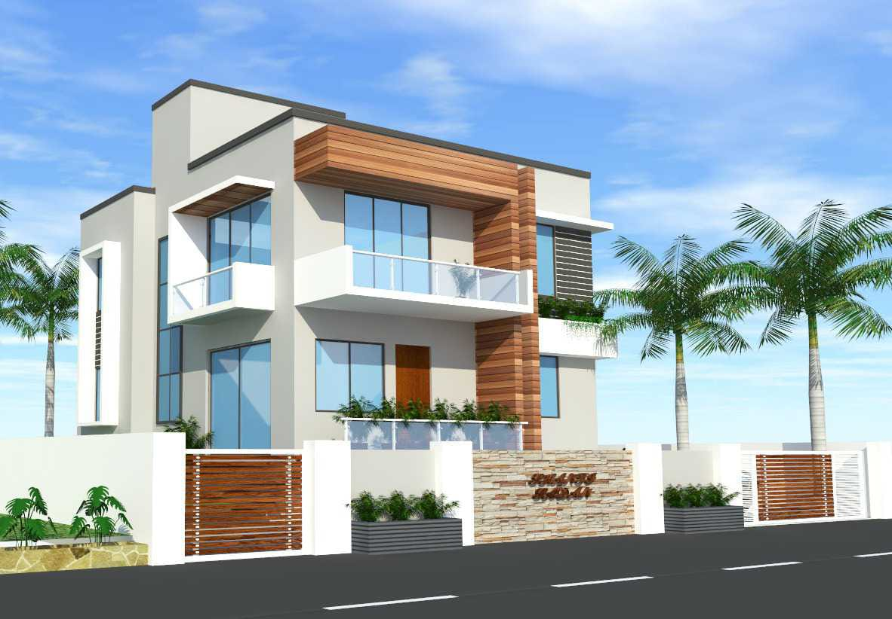
 | PROJECT NAME: | MR. JAYESH THAKUR BUNGALOW

Slide 45
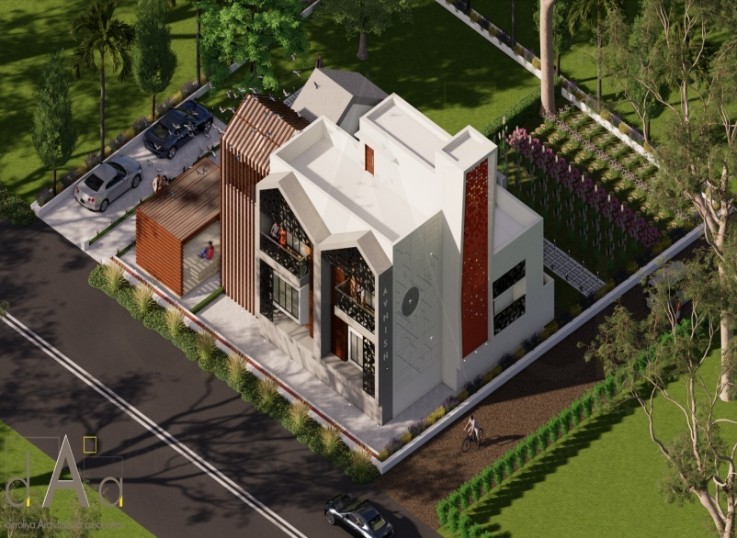
 | PROJECT NAME: | AVINASH HOUSE

Slide 46
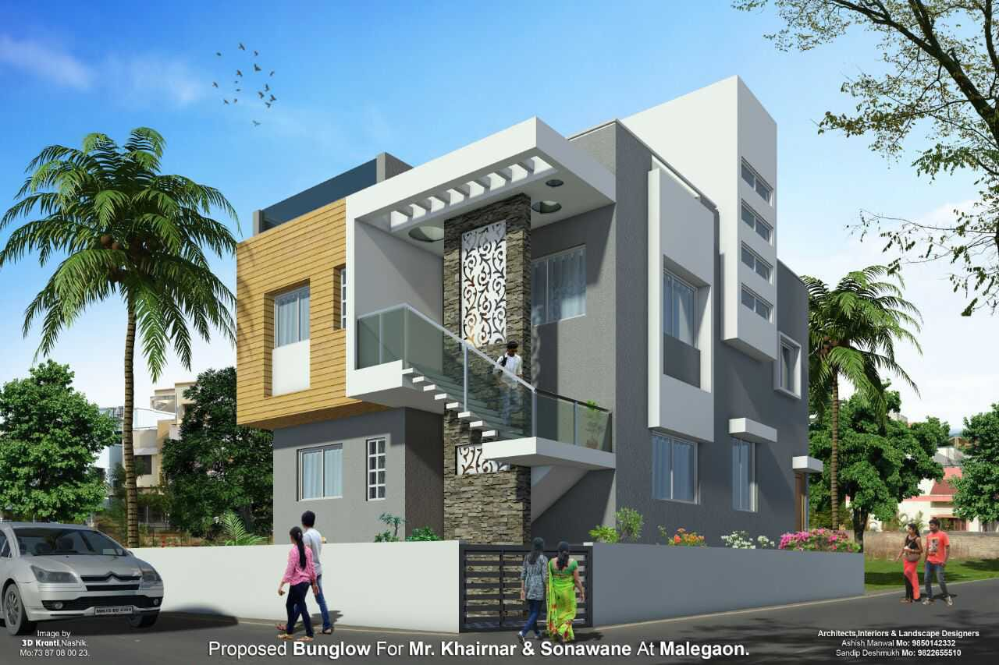
 | PROJECT NAME: | MR. KHAIRNAR AND SONAWANE BUNGALOW

Slide 47
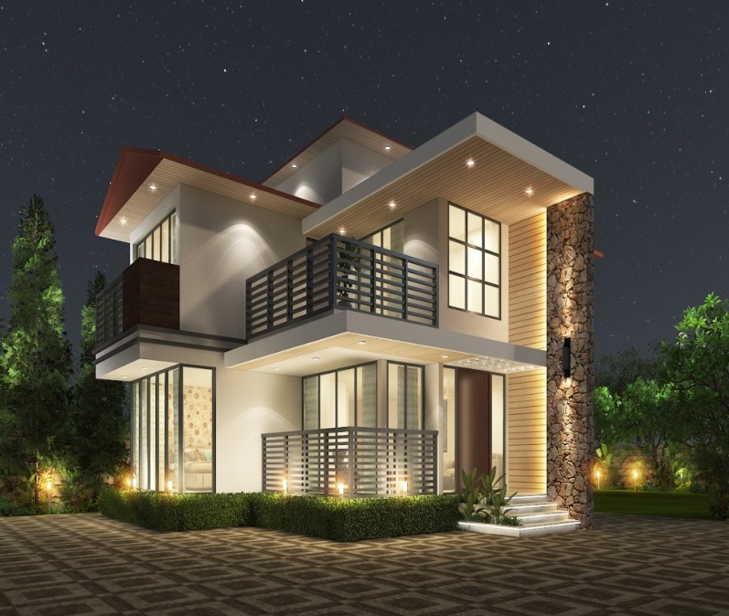
 | PROJECT NAME: | MR. KHOCHARE BUNGALOW

Slide 48
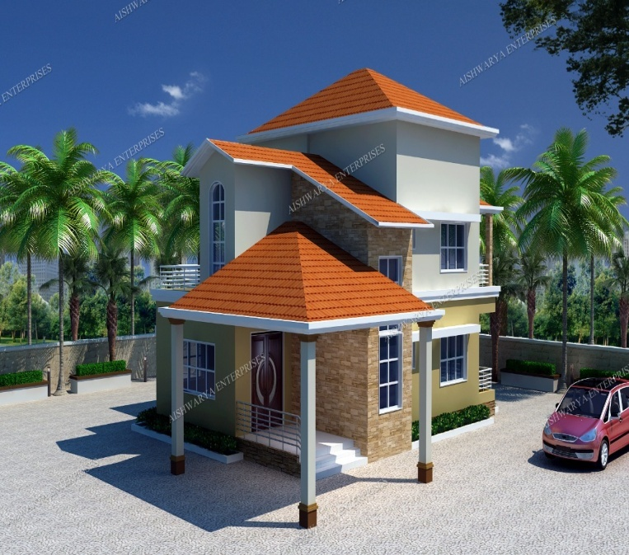
 | PROJECT NAME: | MR. SWAPNIL PRADHAN BUNGALOW

Slide 49
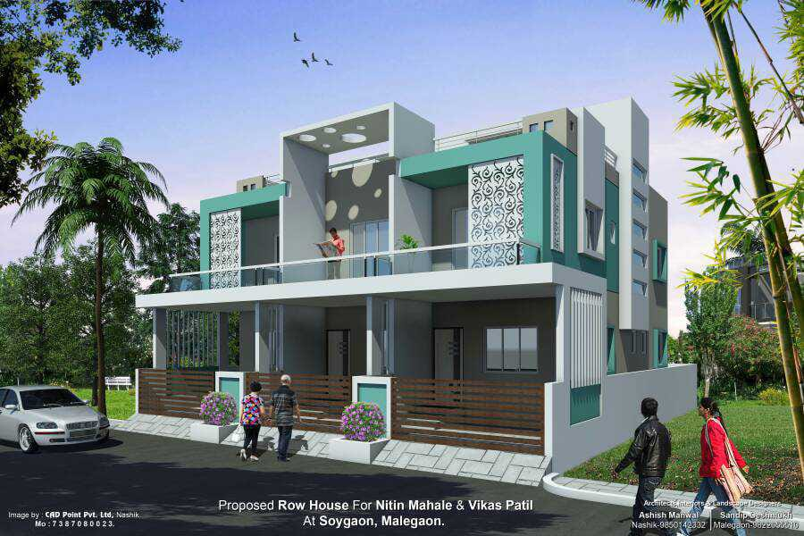
 | PROJECT NAME: | MR. NITIN MAHALE BUNGALOW

Slide 50
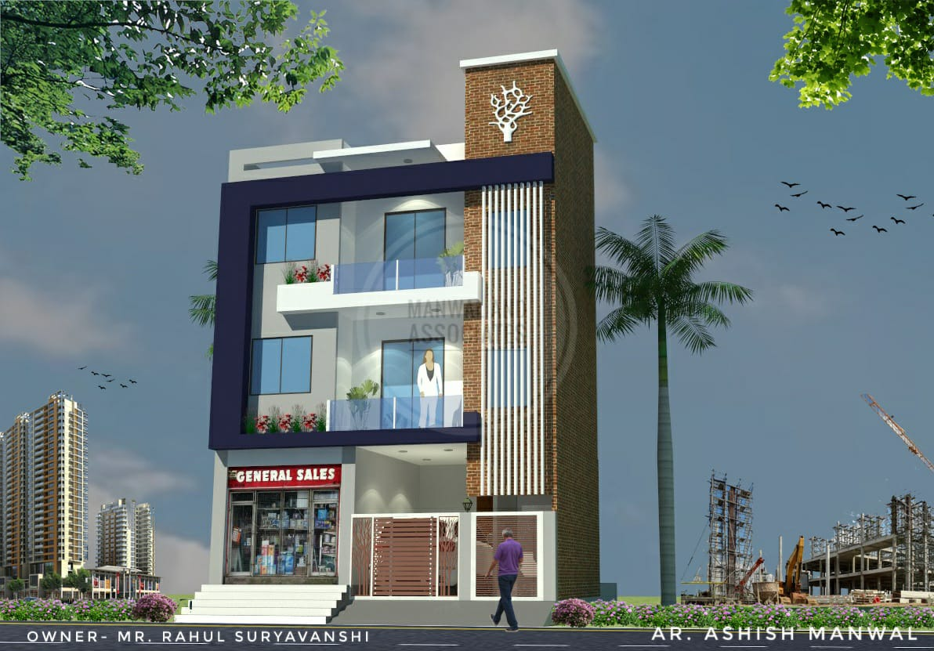
 | PROJECT NAME: | MR. RAHUL SURYAVANSHI BUNGALOW

Slide 51
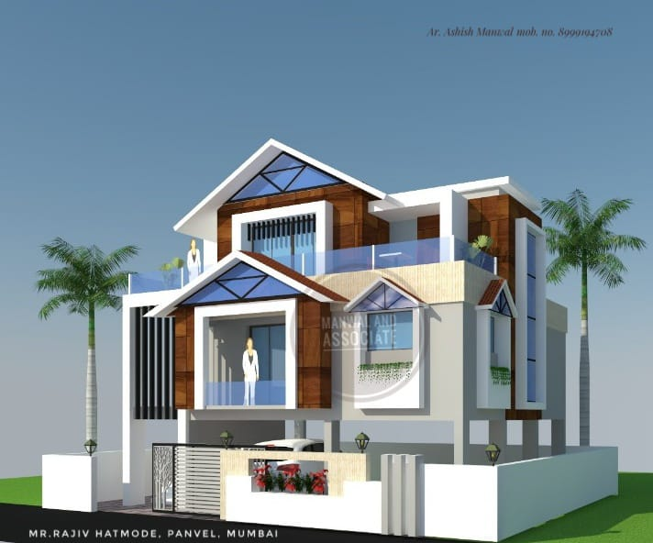
 | PROJECT NAME: | MR. RAJIV HATHMODE BUNGALOW

Slide 52
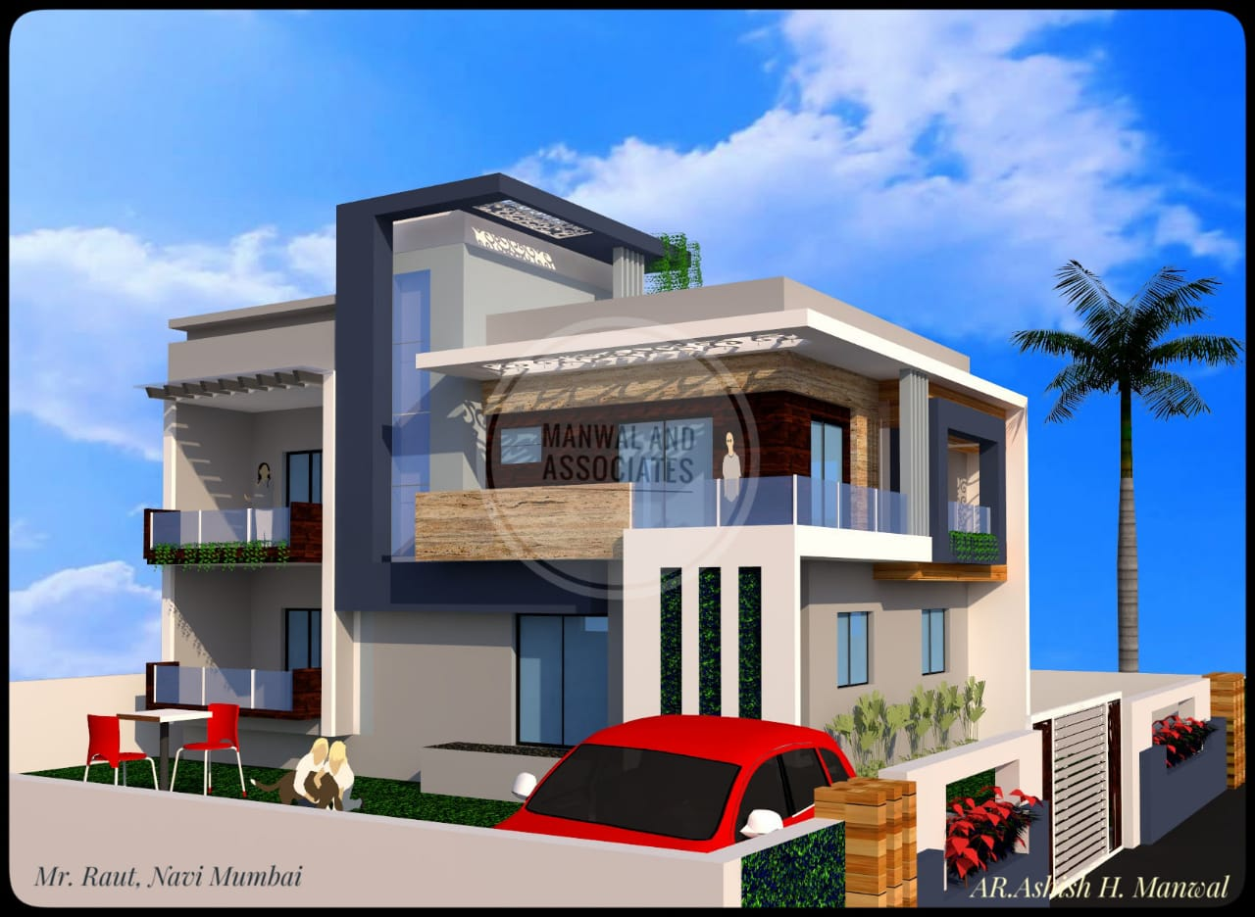
 | PROJECT NAME: | MR. RAUT BUNGALOW

Slide 53
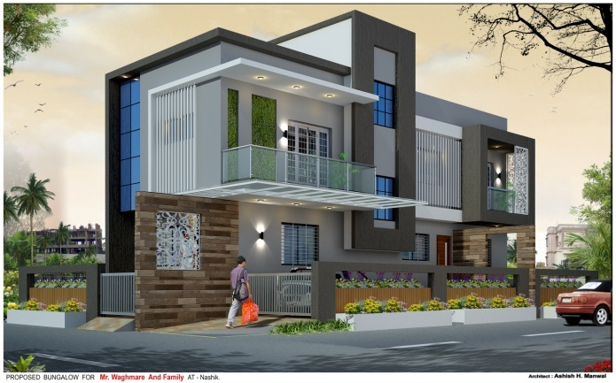
 | PROJECT NAME: | MR. WAGHMARE BUNGALOW

Slide 54
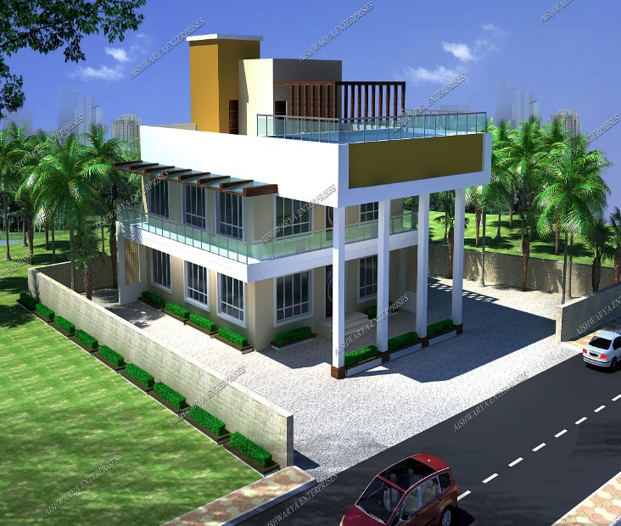
 | PROJECT NAME: | MR. DESHMUKH BUNGALOW

Slide 55
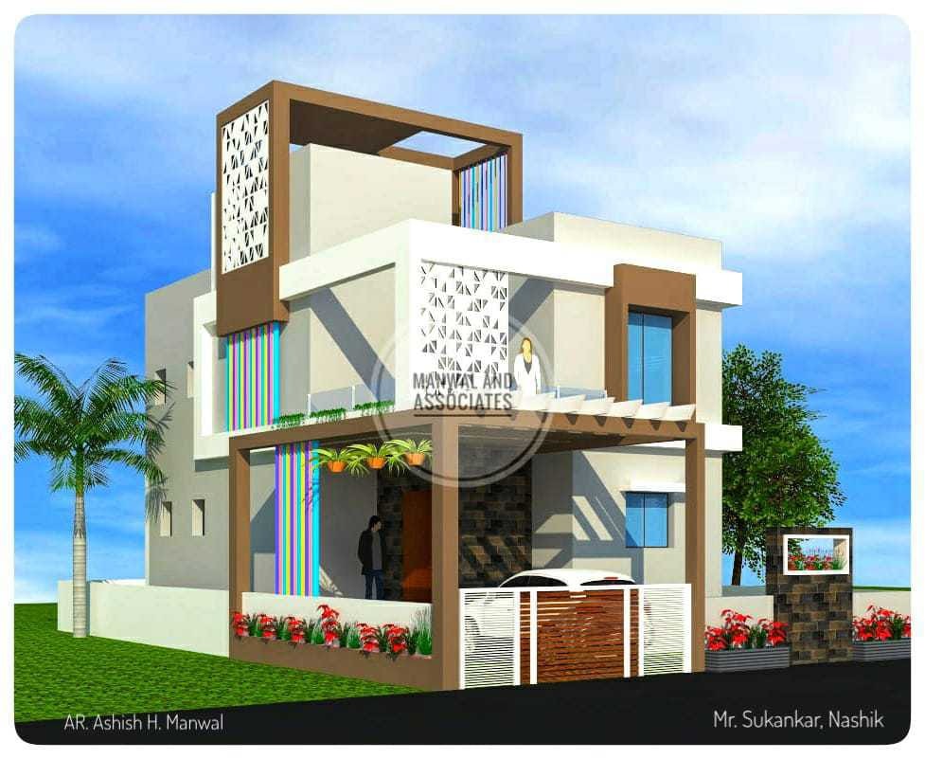
 | PROJECT NAME: | MR. SUKINKAR BUNGALOW

Slide 56
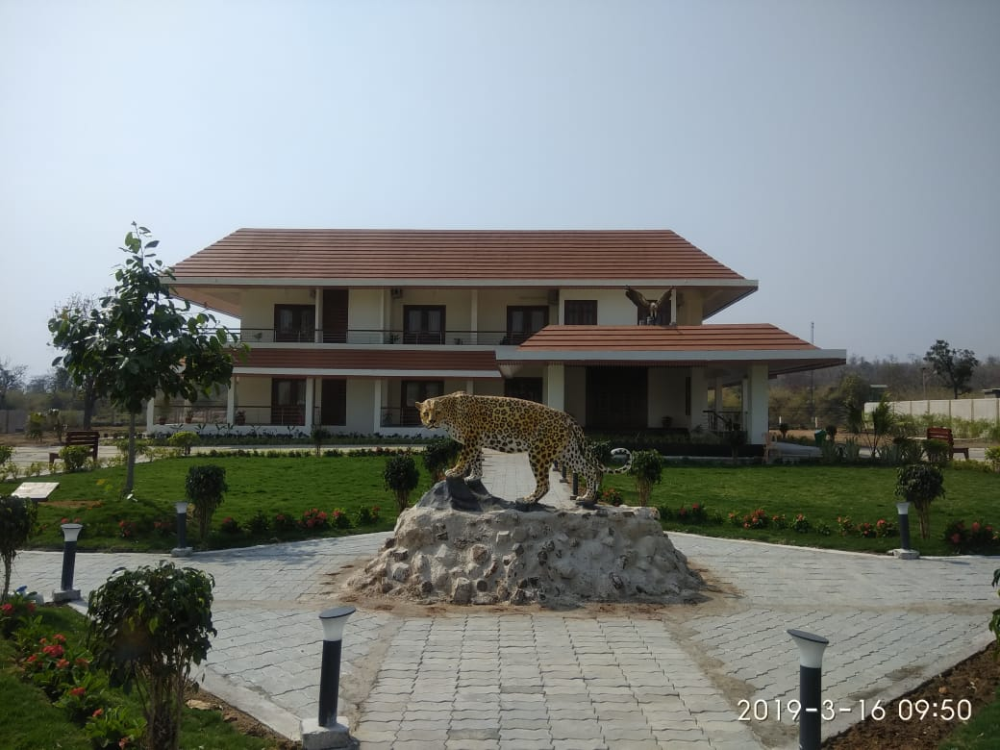
 | PROJECT NAME: | FOREST DEPARTMENT REST HOUSE POMBHURNA

Slide 57
INTERIOR DESIGNING PROJECTS

Slide 58
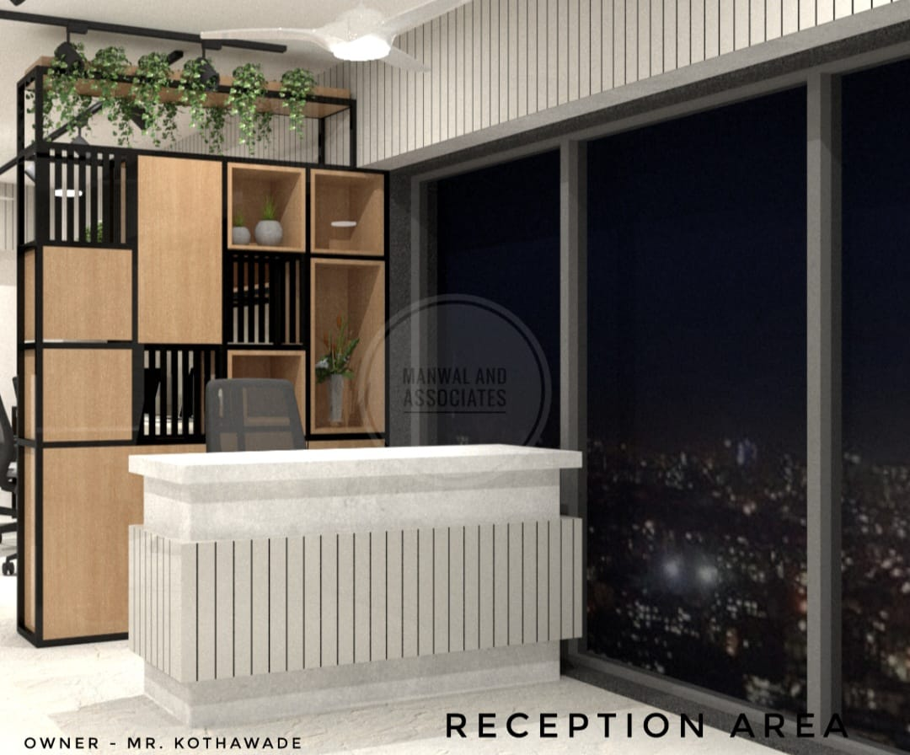
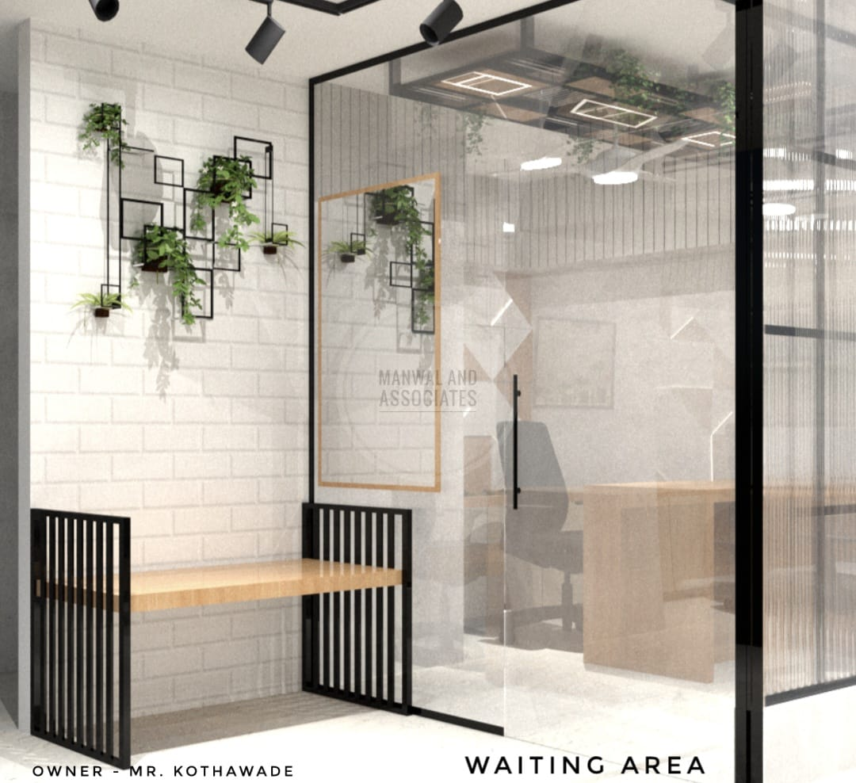
 | PROJECT NAME: | MR. KOTHAWADE OFFICE INTERIOR

Slide 59
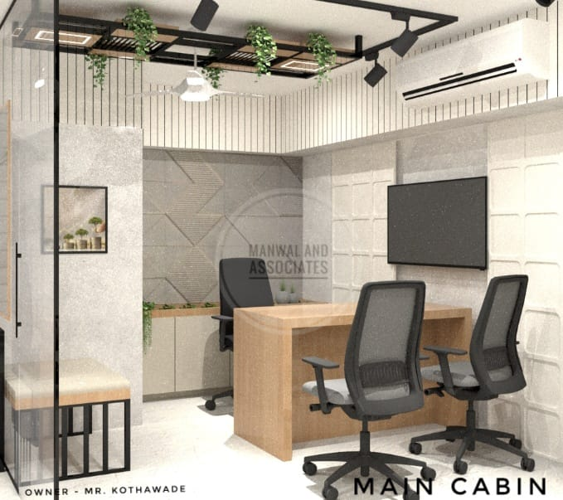
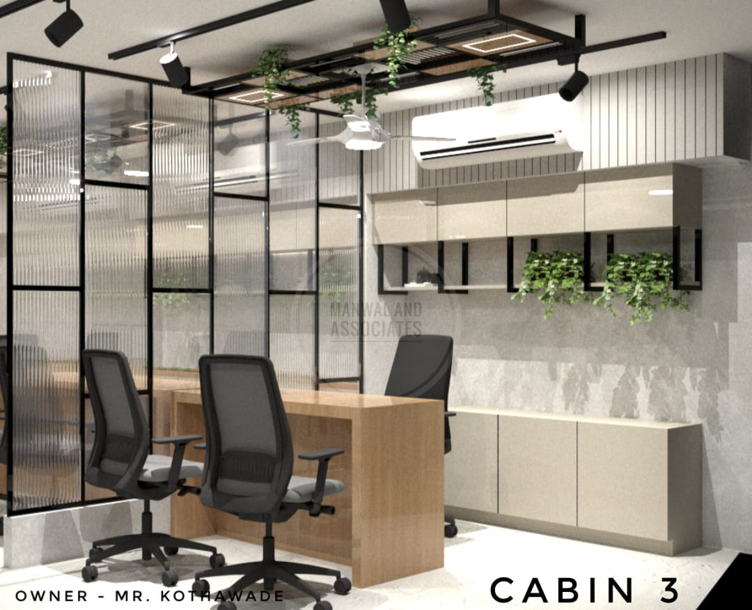
 | PROJECT NAME: | MR. KOTHAWADE OFFICE INTERIOR

Slide 60
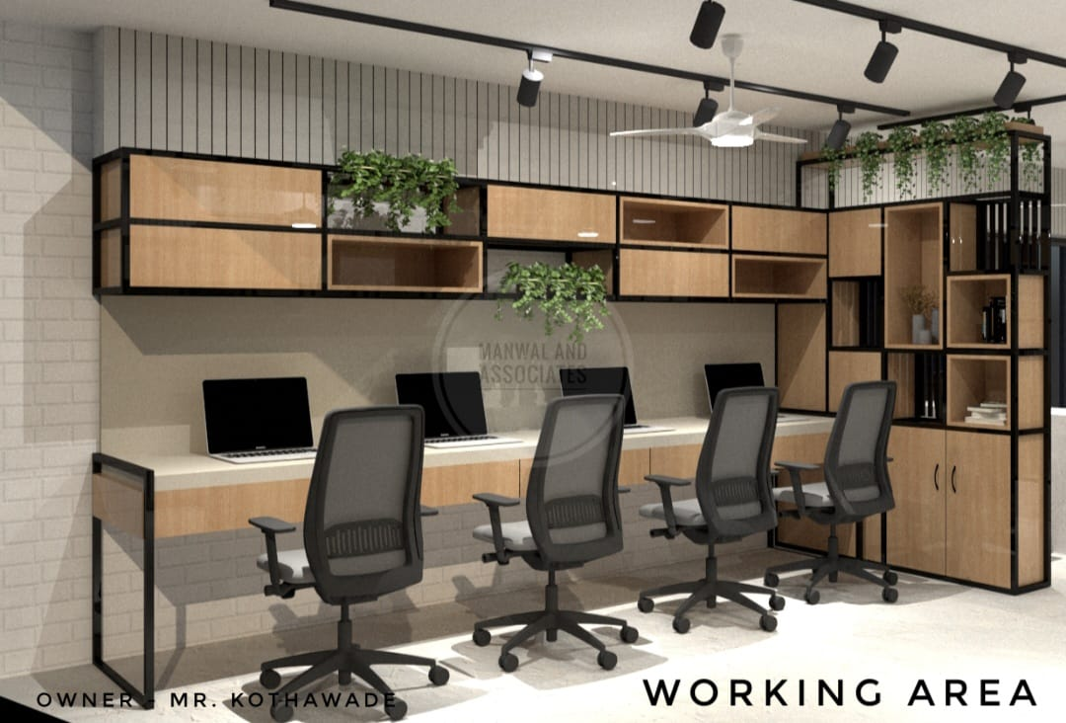
 | PROJECT NAME: | MR. KOTHAWADE OFFICE INTERIOR

Slide 61
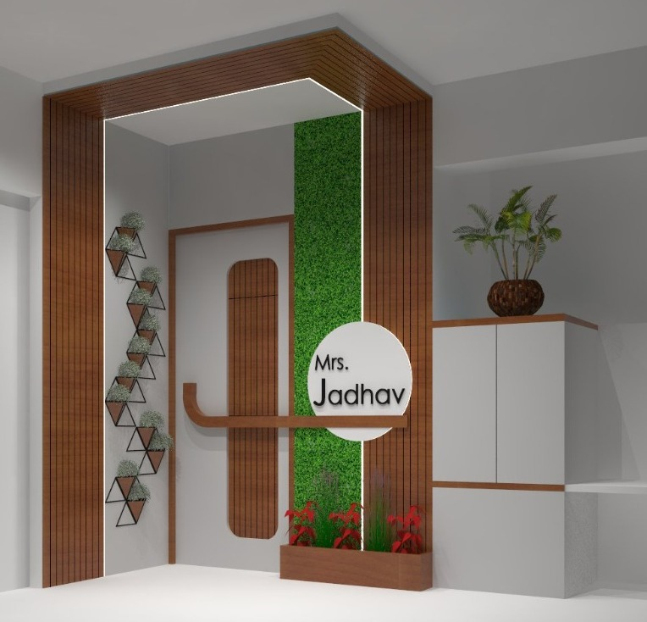
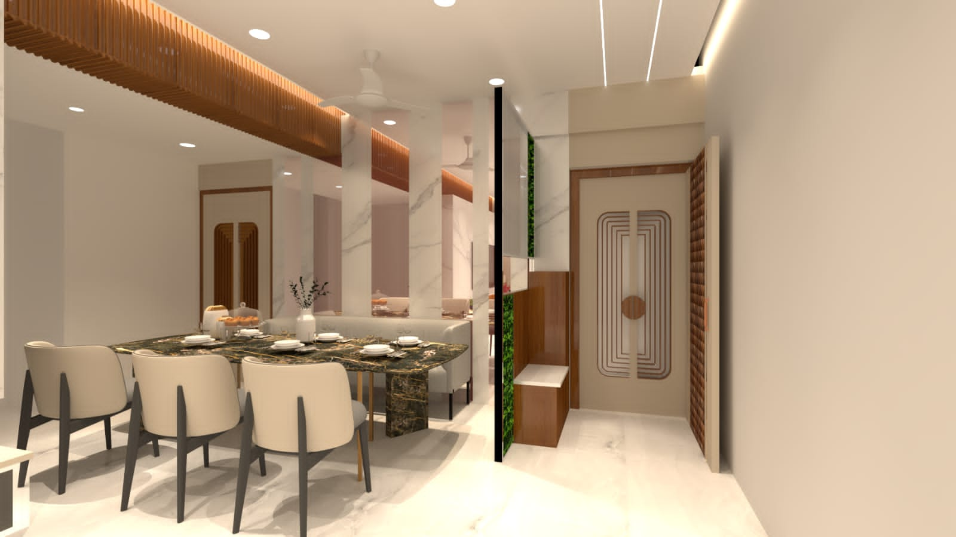
 | PROJECT NAME: | MRS. JADHAV RESIDENCE INTERIOR

Slide 62

 | PROJECT NAME: | GOVERNMENT OFFICE INTERIOR

Slide 63


 | PROJECT NAME: | GOVERNMENT OFFICE INTERIOR

Slide 64
 | PROJECT NAME: | GOVERNMENT OFFICE INTERIOR

Slide 65


 | PROJECT NAME: | MR. & MRS TIPORE

Slide 66


 | PROJECT NAME: | MR. & MRS TIPORE

Slide 67


 | PROJECT NAME: | MR. & MRS NIKHE

Slide 68

 | PROJECT NAME: | SALON

Slide 69


 | PROJECT NAME: | MR. AMOL GHUGE

Slide 70

Contact Us!
If you have any questions, please reach us
Contact Us
Mobile No:
+91 940 570 7774/ +91 836 998 5628
Working Address:
286/2274, Motilal Nagar No. 01, Near Siddharth Hospital, Goregaon (W), Mumbai - 400 104
Email ID:
prasannajoshi@gammaconsultants.in
gopalgarad@gammaconsultants.in
designteam@gammaconsultants.in
Website:
https://gammaconsultants.in/

