Slide 1
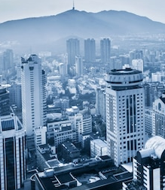

Company Profile
"Innovation Pulsates Through Our Firm, Inspiring Us to Continuously Rethink Conventions and Develop Solutions that Forge the Future of Structural Consultancy."

Slide 2


Welcome To
AN ISO 9001-2015 CERTIFIED COMPANY
"Dedicated to Excellence, We Deliver Superlative Services to Our Esteemed Clients. With Unwavering Commitment, Our Team Ensures the Delivery of Top-notch Design, Detailed Drawings, Comprehensive Architectural, Project Management, and Audit Services that Surpass Your Expectations. We Gratefully Acknowledge Your Choice in Choosing Us."

Slide 3


About Us
Since April 2014, we started our practice as a professional structural consultant. Later in 2022, we established and started our practice by name of M/s. 1.5 Gamma Consultants Pvt. Ltd.

Slide 4
About Us
M/s 1.5 Gamma Consultants Pvt. Ltd. has continued to strive towards becoming a complete multi-disciplinary practice offering our Clients the specialist individual attention and solutions required by an ever-changing project environment.
M/s 1.5 Gamma Consultants Pvt. Ltd. has sees teamwork on every project as the key success element and is responsible for creating this environment. The over-all project manager is duty-bound in ensuring efficient and regular communication to all stakeholders and at all levels.

Slide 5
Our Mission
Our Mission is to Provide Outstanding Services Across Our Professional Disciplines, Upholding Statutory Practices, Codes of Conduct, and Integrity. By Nurturing Our Team and Establishing a Premier Platform, We Aim to Serve the Built Environment, Especially Our Esteemed Clients, with Excellence and Dedication.

Slide 6

Our Vision
01
We aspire to empower individuals and businesses, driving transformative change and unlocking their full potential.
Our vision is to grow our multi-disciplinary team in order to offer a broad spectrum of specialist Engineering, Consulting and Project Management Consulting services to become our Clients' preferred Service Provider choice through excellence and efficiency in all aspects of the project life cycle.
02
With a strong commitment to sustainability, Whether it is a Commercial & Residential Building project, Infrastructure project or Industrial Project, M/s 1.5 Gamma Consultants Pvt. Ltd. aims to become leading service provider that will exceed expectations and set new standards!
03

Slide 7
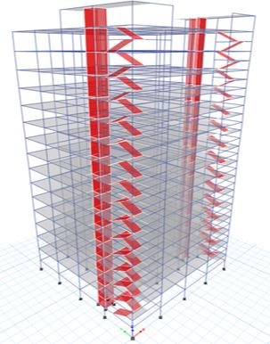
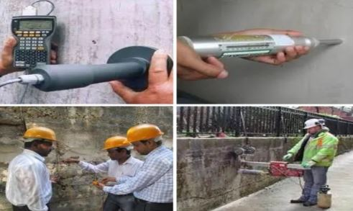

Our Services
Structural Engineering
Design
Structural Audit
PMC
(Project Management Consultancy)
We analyse and design all types of Residential, Commercial and Industrial buildings using finite element software
    Our experienced team do a preliminary technical survey of a building to assess General Health of Structure as Engineering Structure.
    Pre-Tendered and Post Tender Activities, Supervision and Management during execution.

Slide 8

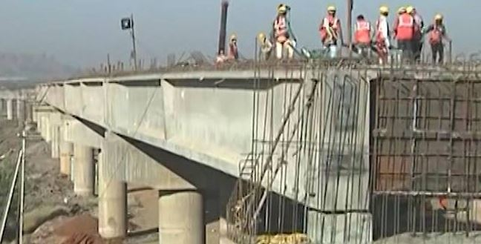
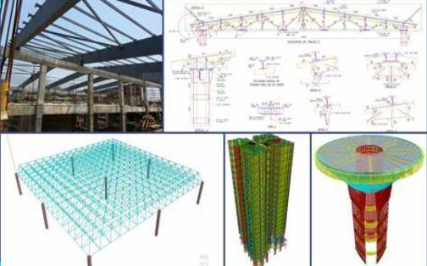
Our Services
Architectural Services
Infrastructure Designing
Peer Review
The firm’s core principle is to blend beauty with utility designs.
    Highway, Bridges, Road Pavements Design
    Box Culverts and WTP/ ESR.
    We also undertake Peer review & Value Engineering work for analysis of design carried out by other consultants

Slide 9

Our Company Process
Our company employs a highly efficient and streamlined process to deliver our products/ services to clients. We follow a methodical approach that ensures each step of our process is executed with precision and attention to detail.

Slide 10


Best Service For Our Client
We offer a range of services to meet our customers' needs, including customized solutions, timely delivery, and dedicated customer support.

Slide 11


Our Company Timeline
"Fueled by a Passion for Innovation and Excellence, Our Objective is to Provide Exceptional Services, Generating Sustainable Value for Our Clients Over the Long Term."

Slide 12

Our Goals
01
02
03
Our goals are to deliver High-quality Services, driven by Innovation and Excellence,
Our goals are deliver Exceptional Services to drive Long-term Success
We strive to achieve Sustainable Growth and make a Positive Impact through our services

Slide 13

100+
50Lac +
Sqft
5000+
Projects Completed
Total Built Up Area Executed
Satisfied Clients

Slide 14
Our Team

Slide 15

Our Team
Er. Prasanna Joshi
Director,
M. Tech Structures
Er. Gopal Garad
Director,
M. Tech Structures
Ar. Ashish Manwal
Director,
Principal Architect
Er. Sumedh Jadhav
Sr. Project Coordinator
B. E. Civil

Slide 16
P M C
(PROJECT MANAGEMENT CONSULTANCY)

Slide 17
SR. NO. | PROJECT NAME | LOCATION | DEVELOPER
1 | MATRUCHAYA CHSL | BORIVALI | K.T. GROUP
2 | SUJATA CHSL | SANTACRUZ | MANTRI REALITY
3 | BORIVALI SPURTI | BORIVALI | BHAVYA INFRA
4 | MALAD SAIDHAM CHSL | MALAD | KAMLA GROUP
5 | MAHAVIR CHAYA CHSL | GHATKOPAR | GOSAVI DEVELOPER
6 | BHAVYA PLAZA | KHAR | BHAVYA INFRA
7 | JAJWALYA CHSL | SANTACRUZ | MANTRI REALITY
8 | CHETNA KUNJ CHSL | MALAD | METRO GROUP
9 | MILEE CHSL | MALAD | ALLIANCE GROUP
10 | SNEH KUNJ CHSL | BORIVALI | CHEDDA GROUP
11 | DINDOSHISHIVNERI CHSL | GOREGAON | INDU CONSTRUCTION
List Of Redevelopment Projects By
M/S. CNS Consultants & M/S 1.5 Gamma Consultants Pvt. Ltd.

Slide 18
SR. NO. | PROJECT NAME | LOCATION | DEVELOPER
12 | TAPODHAN GRIHSAHAKARI CHSL | KANNAMWAR NAGAR | AGREEMENT STAGE
13 | INQULAB NAGAR CHSL | MAJASWADI | AISHWARYA REALTORS
14 | TARDEO NAVYOJNA CHSL | TARDEO | TENDER STAGE
15 | WELCOME CHSL | KANDIVALI CHARKOP | FEASIBILITY STAGE
16 | SONAL CHSL | KANDIVALI CHARKOP | FEASIBILITY STAGE
17 | JIN PREM CHSL | GOREGAON | IOD STAGE
18 | JUHUCHANDAN CHSL | VILE PARLE | KABRA DEVELOPERS
19 | SAIBABA CHSL | MAJASWADI | AISHWARYA REALTORS
20 | SUDARSHAN CHSL | MAJASWADI | AISHWARYA REALTORS
21 | THEVAR NAGAR CHSL | BANDRA | FEASIBILITY STAGE
22 | PARIJAT CHSL | JOGESHWARI | TENDER STAGE
List Of Redevelopment Projects By
M/s. CNS Consultants & M/s. 1.5 Gamma Consultants Pvt. Ltd.

Slide 19
List Of Redevelopment Projects By
M/s. CNS Consultants & M/s. 1.5 Gamma Consultants Pvt. Ltd.
SR. NO. | PROJECT NAME | LOCATION | DEVELOPER
23 | TRIMURTI CHSL | BORIVALI | K.T GROUP
24 | CARDINAL GRACIOUS CHSL | MALAD | MODI LIFE SPACE
25 | AAKASH CHSL | MALAD | MODI LIFE SPACE
26 | BENTS CHSL | MALAD | AADHUNIK DEVELOPERS
27 | VADANIWALA CHSL | MALAD | M. MAMTORA
28 | KIARAM CHSL | BORIVALI | TENDER STAGE
29 | DIVYA JYOTI CHSL | BORIVALI | D.V GROUP
30 | PREET DEEP CHSL | KURLA | AGARWAL DEVELOPERS
31 | SHANTPRABHA CHSL | GOREGAON | SELF DEVELOPMENT
32 | SIDDHART TOWER CHSL | BORIVALI | TENDER STAGE
33 | KIRAN KUNJ & VRAJESH GAURAV CHSL | BORIVALI | TENDER STAGE

Slide 20
List Of Redevelopment Projects By
M/s. CNS Consultants & M/s. 1.5 Gamma Consultants Pvt. Ltd.
SR. NO. | PROJECT NAME | LOCATION | DEVELOPER
34 | DIAMNOND LINK CHSL | BANDRA | TENDER STAGE
35 | SITA SMRUTI CHSL | BORIVALI | TENDER STAGE
36 | SONA KIRAN CHSL | DAHISAR | TENDER STAGE
37 | JAIGOPAL KRISHNA CHSL | BORIVALI | TENDER STAGE
38 | RIDHHIMA CHSL | MALAD | KAMLA GROUP
39 | DHAWAL CHSL | MALAD | SATDGURU BRO.
40 | SHREE ANANDNAGAR CHSL | DAHISAR | AADITYA DEVELOPERS
41 | KASHMIR KUNJ CHSL | MULUND | TENDER STAGE
42 | NEHA CHSL | MALAD | ALLIANCE GROUP
43 | SHIVSAGAR CHSL | DAHISAR | AADITYA DEVELOPERS
44 | SHIV SHAKTI CHSL | MALAD | ROYAL REALTORS

Slide 21
List Of Redevelopment Projects By
M/s. CNS Consultants & M/s. 1.5 Gamma Consultants Pvt. Ltd.
SR. NO. | PROJECT NAME | LOCATION | DEVELOPER
45 | ADISH CHSL | BANDRA | PENTAGON PREMISES PVT LTD
46 | AVISHKAR CHSL | DAHISAR | AADITYA DEVELOEPRS
47 | SHALIMAR CHSL | MALAD | MODI LIFE SPACE
48 | SUNDAR DHAM CHSL | MALAD | FEASIBILITY STAGE
49 | AMAR CHSL | GOREGAON | CONVEYANCE STAGE
50 | NEW SHALIMAR CHSL | MALAD | FEASIBILITY STAGE
51 | JAINIKA CHSL | MALAD | FEASIBILITY STAGE
52 | GURUKRUPA CHSL | MALAD | FEASIBILITY STAGE
53 | MALAD JAGRUTI CHSL | MALAD | FEASIBILITY STAGE
54 | DOYLE CHSL | MALAD | FEASIBILITY STAGE
55 | BLUE HEAVEN CHSL | BANDRA | FEASIBILITY STAGE

Slide 22
LIST OF MAJOR
PROJECT MANAGEMENT CONSULTANCY SERVICES
SR. NO. | PROJECT NAME | ADDRESS | DESCRIPTION | TYPE
1 | MCGM PAP TENEMENTS (BMC) | KANJURMARG, MUMBAI | 5.5LAC SQFT- 6 TOWERS STILT +23FLOORS - CLIENT MCGM / CONTRACTOR | Residencial
2 | SAMRUDDHI HEIGHT | GOREGAON (WEST), MUMBAI | STILT + 19 UPPER FLOORS | Residencial
3 | KUNAL PRINTING & PACKAGING PVTD. LTD. | UMERGAON, GUJARAT | GROUND + 1 FLOORS | Industrial
4 | BLOOM PACKAGING PLOT NO.94 | DAMAN, DIU-DAMAN | GROUND + 1 FLOORS | Industrial
5 | KARNATAKA SANGHA AUDITORIUM | MATUNGA (W), MUMBAI | 2 BASEMENT + GROUND +4 UPPER FLOOR | Auditorium
6 | GRAND PARADI CO.OP. HOUSING SOCIETY LTD. | GRANT ROAD (W), MUMBAI | BASEMENT + GROUND + 28 UPPER FLOORS | Residencial
7 | LOVELY HOMES | COLABA, MUMBAI | STILT + PODIUM + 19 UPPER FLOOR | Residencial
8 | ORBIT HOTEL | MIRA ROAD, MAHARASHTRA | BASEMENT + GROUND + 12 UPPER FLOORS | Hotel
9 | KANAKIA WALL STREET | ANDHERI (EAST), MUMBAI | 3 BASEMENT + GROUND + 12 FLOORS | Commercial
10 | SATYA DARSHAN CAMPOUS – ESR | ANDHERI (E), MUMBAI | SIXTH TIE LEVEL (CAPACITY 1.32 LAC) | Commercial

Slide 23
SR. NO. | PROJECT NAME | ADDRESS | DESCRIPTION | TYPE
11 | DEV RATAN BUILDING | MALAD (W), MUMBAI | GROUND + 5 UPPER FLOORS | Residencial
12 | SHASHWAT ORNAMENTS PVT LTD, | MIDC,ANDHERI (E), MUMBAI | BASEMENT + GROUND + 3 UPPER FLOORS | Industrial
13 | DILPAZIR CO.OP.HOUSING SOCIETY LTD. | BREACH CANDY, MUMBAI | GROUND + 4 UPPER FLOOR | Residencial
14 | SOUTH INDIAN BANK HOUSE | BANDRA (W), MUMBAI | GROUND + 2 UPPER FLOORS | Commercial
15 | KHOCHARE BUNGALOW | MURBAD, MAHARASHTRA | GROUND + 2 UPPER FLOORS | Bungalow
16 | BHATIA BUNGALOW | KANDIVALI, MUMBAI | GROUND + 2 UPPER FLOORS | Bungalow
17 | BINA SHOPPING CENTRE | ANDHERI (EAST), MUMBAI | GROUND + 2 UPPER FLOORS | Commercial
18 | GREEN PRACTICE PVT. LTD. | SION (E), MUMBAI | GROUND + 1 FLOORS | Commercial
19 | H.M.APARTMENT | SANTACRUZ (E), MUMBAI | GROUND + 7 UPPERS FLOORS | Residencial
LIST OF MAJOR PROJECT MANAGEMENT CONSULTANCY SERVICES PROJECTS

Slide 24
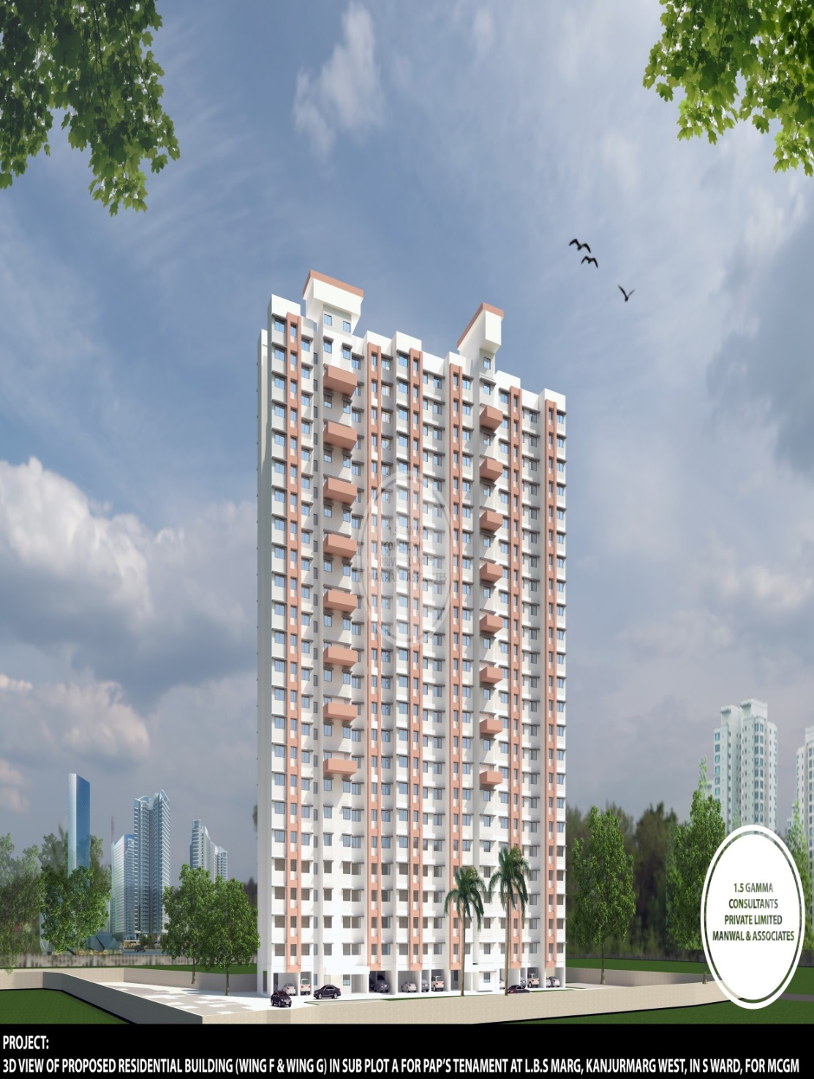
1 | Project Name: | Proposed Mass Housing Residential Buildings (BMC)
2 | Client Name: | Dev Engineers
3 | Location: | Kanjurmarg, Mumbai
4 | Brief Description: | Stilt Floor + 23 Upper Floor (6 Towers With Mivan Technology)
5 | Year Of Service: | Work In Progress

Slide 25
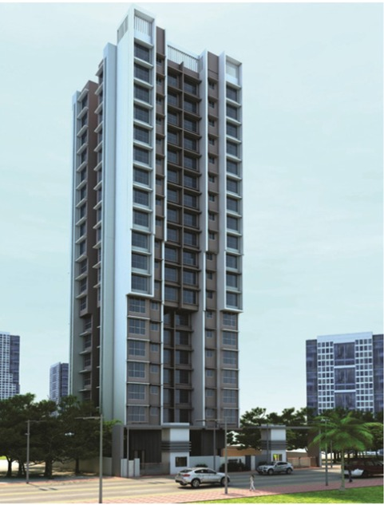
1 | Project Name: | Proposed Residential Tower Known As Samruddhi Heights
2 | CLIENT Name: | Samruddhi Heights
3 | Location: | Goregaon (West), Mumbai
4 | Brief Description: | Stilt + 19 Upper Floors
5 | Year Of Service: | Work In Progress

Slide 26
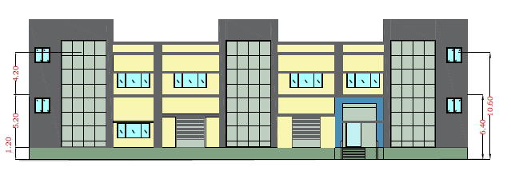
1 | Project Name: | Proposed Factory Buildiung Of Kunal Printing & Packaging Pvt. Ltd
2 | Client Name: | Kunal Printing & Packaging Pvt. Ltd
3 | Location: | Umbergaon, Gujarat
4 | Brief Description: | Ground + 2 Floors With Approx Area Of 55000sqft
5 | Year Of Service: | Work In Progress

Slide 27
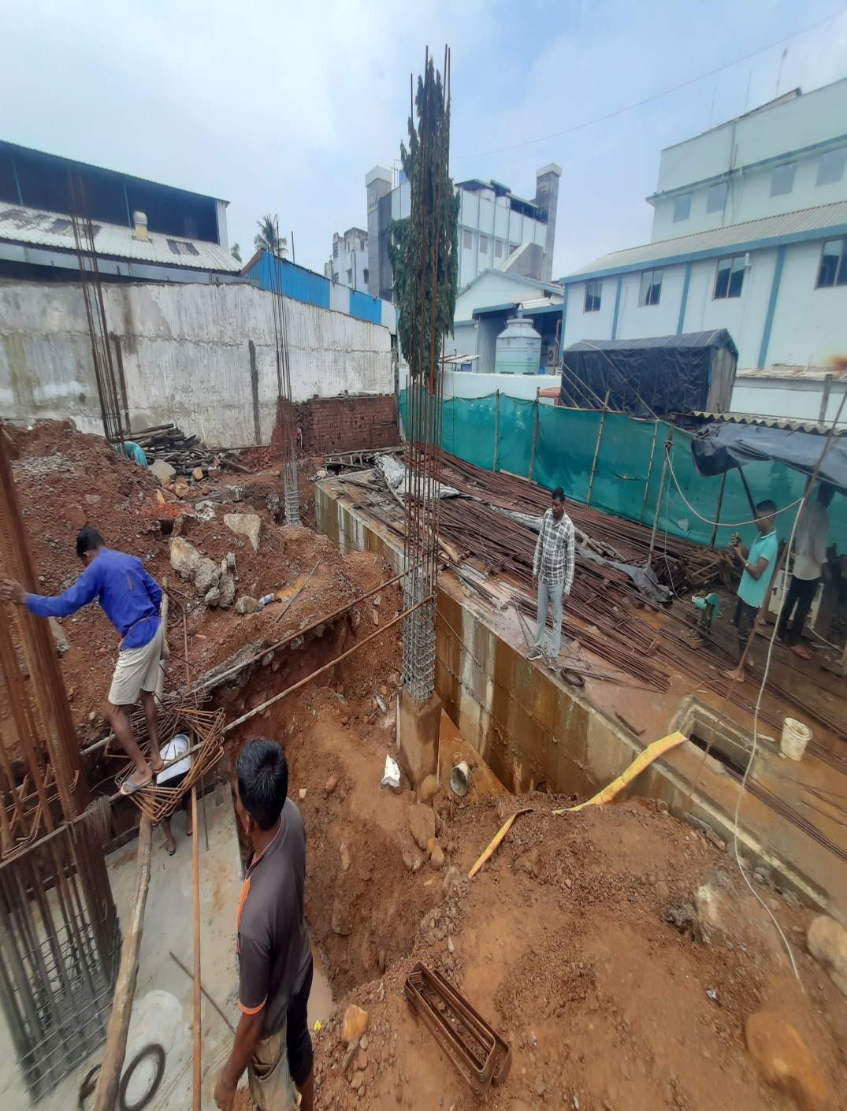
1 | Project Name: | Proposed Factory Building Of Bloom Packaging Pvt Ltd At Daman
2 | Client Name: | Bloom Packaging Pvt Ltd
3 | Location: | Daman, Diu-daman
4 | Brief Description: | Ground + 2 Floors
5 | Year Of Service: | Work In Progress

Slide 28
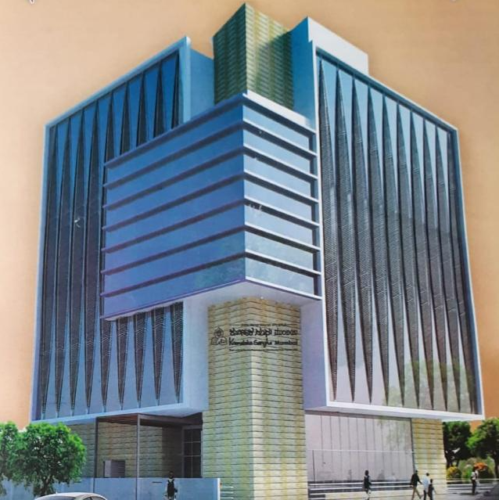
1 | Project Name: | Karnataka Sangha Auditorium
2 | Client Name: | Karnataka Sangha
3 | Location: | Matunga (W), Mumbai
4 | Brief Description: | 2 Basement + Ground + 4 Uppers Floor
5 | Year Of Service: | Work IN Progress

Slide 29
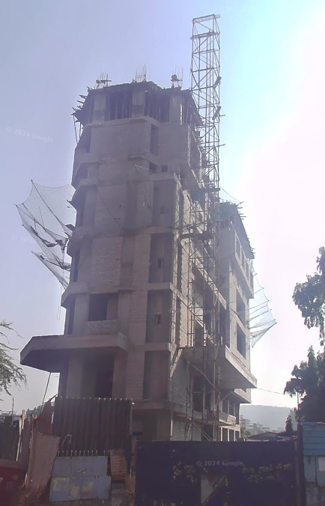
1 | Project Name: | Proposed Hotel Building Named As Orbit Hotel
2 | Client Name: | Orbit Eye Hospital
3 | Location: | Mira Road, Thane, Maharashtra
4 | Brief Description: | Basement + Ground + 12 Upper Floors
5 | Year Of Service: | Work In Progress

Slide 30
REDEVELOPMENT
PROCESS

Slide 31
Redevelopment process
01
02
03
Feasibility
&
Planning Stage
Tendering
And
Selection Of Developer
Project Monitoring
And
Engineering Services

Slide 32

Contact Us!
If you have any questions, please reach us
Mobile No:
+91 9594 688 511
Working Address:
286/2274, Motilal Nagar No. 01, Near Siddharth Hospital, Goregaon (W), Mumbai - 400 104
Email ID:
sumedhjadhav.gcpl@gmail.com
Website:
https://gammaconsultants.in/

