Slide 1


Company Profile
"Innovation Pulsates Through Our Firm, Inspiring Us to Continuously Rethink Conventions and Develop Solutions that Forge the Future of Structural Consultancy."

Slide 2
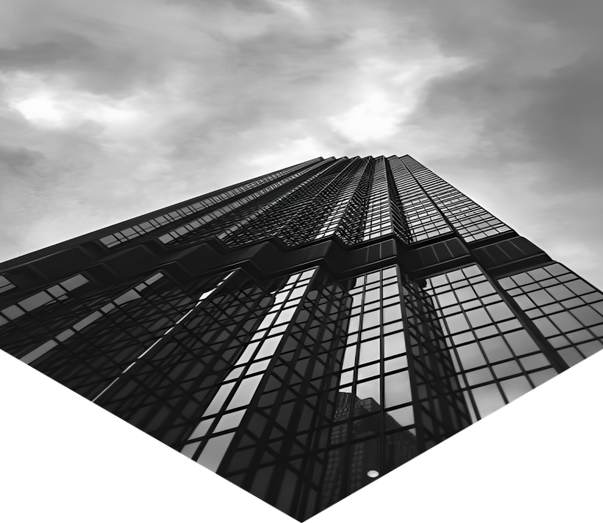

Welcome To
AN ISO 9001-2015 CERTIFIED COMPANY
"Dedicated to Excellence, We Deliver Superlative Services to Our Esteemed Clients. With Unwavering Commitment, Our Team Ensures the Delivery of Top-notch Design, Detailed Drawings, Comprehensive Architectural, Project Management, and Audit Services that Surpass Your Expectations. We Gratefully Acknowledge Your Choice in Choosing Us."

Slide 3


About Us
Since April 2014, Prasanna S. Joshi started his practice as a professional structural consultant. Later in 2022, he established and started his practice by name of M/s 1.5 Gamma Consultants Pvt. Ltd.

Slide 4
About Us
M/s 1.5 Gamma Consultants Pvt. Ltd. has continued to strive towards becoming a complete multi-disciplinary practise offering our Clients the specialist individual attention and solutions required by an ever-changing project environment.
M/s 1.5 Gamma Consultants Pvt. Ltd. sees teamwork on every project as the key success element and is responsible for creating this environment. The over-all project manager is duty- bound in ensuring efficient and regular communication to all stakeholders and at all levels.

Slide 5
Our Mission
Our Mission is to Provide Outstanding Services Across Our Professional Disciplines, Upholding Statutory Practices, Codes of Conduct, and Integrity. By Nurturing Our Team and Establishing a Premier Platform, We Aim to Serve the Built Environment, Especially Our Esteemed Clients, with Excellence and Dedication.

Slide 6

Our Vision
01
We aspire to empower individuals and businesses, driving transformative change and unlocking their full potential.
Our vision is to grow our multi-disciplinary team in order to offer a broad spectrum of specialist Engineering, Consulting and Project Management Consulting services to become our Clients' preferred Service Provider choice through excellence and efficiency in all aspects of the project life cycle.
02
With a strong commitment to sustainability, Whether it is a Commercial & Residential Building project, Infrastructure project or Industrial Project, M/s 1.5 Gamma Consultants Pvt. Ltd. aims to become leading service provider that will exceed expectations and set new standards!
03

Slide 7
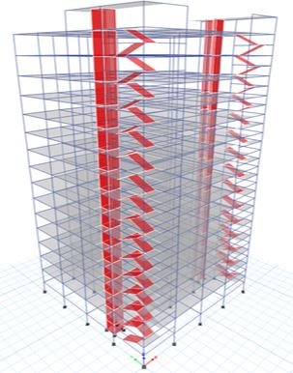
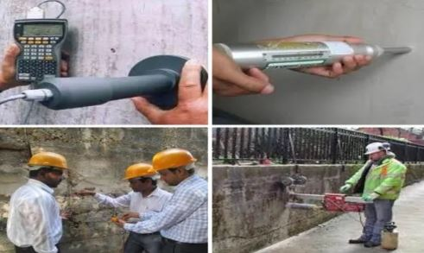

Our Services
Structural Design
Engineering
Project Management
Consultancy
Structural Audit
We analyse and design all types of residential and commercial buildings using finite element software
    Our experienced team do a preliminary technical survey of a building to assess its general health as civil engineering structure.
    Pre-Tendered Activities
    Post Tender Activities
    Supervision during execution

Slide 8

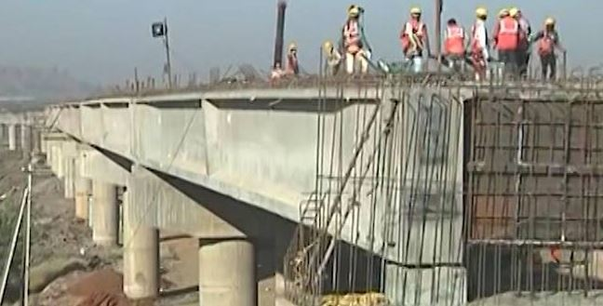
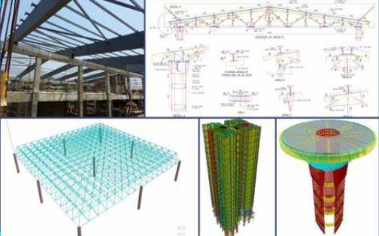
Our Services
Architectural Services
Infrastructure Designing
Peer Review
The firm’s core principle is to blend beauty with utility designs.
    Highway Bridges
    Box Culverts
    Design of Road Pavements
    WTP/ESR
    We also undertake peer review & value engineering work for analysis and design carried out by other consultants

Slide 9

Our Company
Process
Our company employs a highly efficient and streamlined process to deliver our products/services to clients. We follow a methodical approach that ensures each step of our process is executed with precision and attention to detail.

Slide 10


Best Service For Our Client
We offer a range of services to meet our customers' needs, including customized solutions, timely delivery, and dedicated customer support.

Slide 11


Our Company
Timeline
"Fueled by a Passion for Innovation and Excellence, Our Objective is to Provide Exceptional Services, Generating Sustainable Value for Our Clients Over the Long Term."

Slide 12

Our Goals
01
02
03
Driven by innovation and excellence, our goal is to deliver high-quality services.
Our goals are to innovate continuously and deliver exceptional cleint services to drive long-term success
We strive to achieve sustainable growth and make a positive impact on the world through our services

Slide 13

100+
50Lac +
5000+
Projects Completed
Total Square Ft Executed
Satisfied Clients

Slide 14
Our Team

Slide 15

Our Team
Prasanna Joshi
Director, M.Tech Structures
Gopal Garad
Director, M.Tech Structures
Ashish Manwal
Director, Principal Architect
Total technical Staff
20 Nos.

Slide 16
Organization Chart

Slide 17
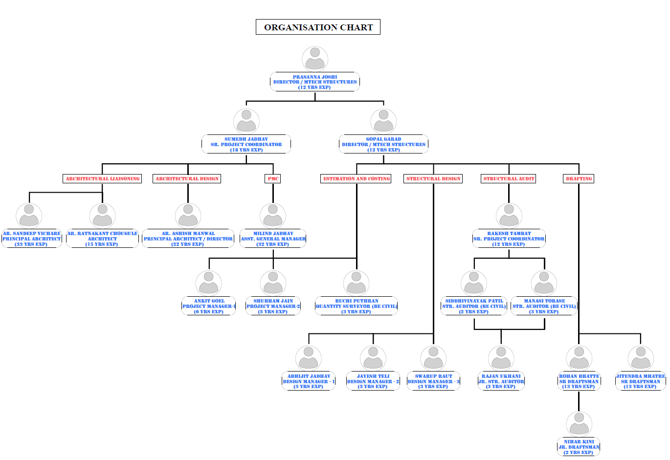

Slide 18
Valuable Clients

Slide 19









Slide 20
REGISTERED ORGANIZATION

Slide 21
SR. NO. | ORGANISATION | REGISTRATION/VENDOR NO.
1 | MUNICIPAL CORPORATION OF GREATER MUMBAI | STR/J/840008322
2 | THANE MUNICIPAL CORPORATION | TMCB/R/2023/APL/00277
3 | NAVI MUMBAI MUNICIPAL CORPORATION | NMMCC/R/2024/APL/00199
4 | PANVEL MUNICIPAL CORPORATION | CARPC/R/2024/APL/00719
5 | NASHIK MUNICIPAL CORPORATION | 445866 DT.01/02/2020
6 | MAHARASHTRA STATE | STATE/R/2023/APL/07192
7 | AI ENGINEERING SERVICES LTD. | NA
8 | CENTRAL PUBLIC WORK DEPARTMENT | NA
LIST OF REGISTERED ORGANISATIONS

Slide 22
SR. NO. | ORGANISATION | REGISTRATION/VENDOR NO.
9 | DAMAN PLANNING DEVELOPMENT AUTHORITY-DIU-DAMAN | DMN/PDA/SEOR1[C-01]/2024/80
10 | THE INSTITUTION OF ENGINEERS | AM163164-3
11 | VEERMATA JIJABAI TECHNOLOGICAL INSTITUTE | NA
12 | MAHANAGAR TELEPHONE NIGAM LTD. | SP16347
13 | ENGINEERING PROJECTS (INDIA) LTD. | NA
14 | RELIANCE INDUSTRIES LTD. | 3764139
15 | UPL LIMITED | NA
16 | 70 EVENT MEDIA GROUP | NA
17 | ACG PAM PHARMA TECHNOLOGIES PVT. LTD. | GAM008
LIST OF REGISTERED ORGANISATIONS

Slide 23
STRUCTURAL DESIGN ENGINEERING

Slide 24
STRUCTURAL DESIGN ENGINEERING
LIST OF RESIDENIAL BUILDING PROJECTS

Slide 25
SR. NO. | PROJECT NAME | ADDRESS | FLOORS
1 | AQUA VIEW BUILDING | KOLKATA, INDIA | STILT + 30 UPPER FLOORS
2 | MCGM PAP TENEMENTS | KANJURMARG, MUMBAI | 5.5LAC SQFT- 6 TOWERS STILT +23FLOORS - CLIENT MCGM / CONTRACTOR
3 | POONAM NAGAR REHAB & SALE BUILDING | JVLR, MUMBAI | 2.5 LAC SQFT- 2 TOWERS - STILT +23 FLOORS - CLIENT NICCO GROUP - LOCATION ANDHERI JVLR JUNCTION - /STRUCTURAL CONSULTANCY IN ASSOCIATION WITH JOSHI CONSULTANTS
4 | RADHA MOHAN CHS. LTD | DADAR, MUMBAI | STILT + 22 UPPER FLOORS
5 | HIMALAYA HEIGHTS | ANDHERI (EAST,)MUMBAI | 1.2 LAC SQFT - STILT +20 UPPER FLOORS
6 | AMEYA APARTMENTS | ANDHERI (EAST,)MUMBAI | 60000 SQFT - 2 TOWERS - STILT +19 FLOORS
7 | ASHTAVINAYAK APARTMENTS | JOGESHWARI (EAST) MUMBAI | STILT + 19 UPPER FLOORS
LIST OF RESIDENTIAL BUILDINGS – LOW RISE AND HIGH RISE BUILDING PROJECTS

Slide 26
SR. NO. | PROJECT NAME | ADDRESS | FLOORS
8 | JITEN CO.OP.HOUSING SOCIETY | ANDHERI (WEST) MUMBAI | 80000 SQFT - STILT +19 FLOORS
9 | SAMRUDHHI HEIGHTS | GOREGAON WEST, MUMBAI | STILT + 19 UPPER FLOORS
10 | HEMRATNA CO.OP.HOUSING SOCIETY | ANDHERI (EAST) MUMBAI | 55000 SQFT - STILT + 18 UPPER FLOORS
11 | KAMLESH CO.OP.HOUSING SOCIETY | ANDHERI (EAST) MUMBAI | STILT + 18 UPPER FLOORS
12 | VISHAKHA HEIGHTS | MULUND (EAST) MUMBAI | 75000 SQFT - STILT + 17 UPPER FLOORS
13 | MCGM TENAMENTS- YARI ROAD | ANDHERI (W), MUMBAI | STILT + 19 UPPER FLOORS
14 | SHILPA CO.OP.HOUSING SOCIETY | ANDHERI (EAST) MUMBAI | 56000 SQFT - STILT + 15 UPPER FLOORS
15 | MCGM TENAMENTS BUILDING NO.1, 2, 3, 4 & 5 – HASNABAD LANE | KHAR ROAD (W), MUMBAI | STILT + 19 UPPER FLOORS (5 TOWERS)
LIST OF RESIDENTIAL BUILDINGS – LOW RISE AND HIGH RISE BUILDING PROJECTS

Slide 27
SR. NO. | PROJECT NAME | ADDRESS | FLOORS
16 | AJAY APARTMENT | GOREGAON (W), MUMBAI | GROUND + 9 UPPER FLOORS
17 | PLEASANT TOWER | MALAD (W), MUMBAI | BASEMENT + STILT + 7 PODIUM +13 UPPER FLOORS
18 | SURABHI CO.OP.HOUSING SOCIETY | MALAD WEST, MUMBAI | STILT + 10 UPPER FLOORS
19 | AMAR CO.OP.HOUSING SOCIETY | MALAD WEST, MUMBAI | STILT + 10 UPPER FLOORS
20 | KAPOL CO.OP.HOUSING SOCIETY | ANDHERI (WEST) MUMBAI | STILT + 10 UPPER FLOORS
21 | ANAMIKA CO.OP.HOUSING SOCIETY | ANDHERI KURLA ROAD, MUMBAI | STILT + 10 UPPER FLOORS
22 | RESIDENTAIL BUILDING | PARBHANI , MAHARASHTRA | BASEMENT + GROUND + 4 UPPER FLOORS
23 | KAMLESH - 1 WING A APARTMENT | ANDHERI (EAST), MUMBAI | STILT + 18 UPPER FLOORS
24 | KAMLESH – 2 WING B APARTMENT | ANDHERI (EAST), MUMBAI | STILT + 16 UPPER FLOORS
LIST OF RESIDENTIAL BUILDINGS – LOW RISE AND HIGH RISE BUILDING PROJECTS

Slide 28
SR. NO. | PROJECT NAME | ADDRESS | FLOORS
25 | AMENITY BUILDING, POONAM NAGAR | JVLR, MUMBAI | GROUND + 7 UPPER FLOOR
26 | GAUTAM DHAM CO.OP.HOUSING SOCIETY | ANDHERI, MUMBAI | GROUND + 8 UPPER FLOOR
27 | KAILAS SADAN APARTMENT | ANDHERI, MUMBAI | GROUND + 10 UPPER FLOOR
28 | LIVE WELL CO.OP.HOUSING SOCIETY | JOGESHWARI (WEST), MUMBAI | GROUND + 19 UPPER FLOOR
29 | OM MAYURESH CO.OP.HOUSING SOCIETY | ANDHERI, MUMBAI | GROUND + 15 UPPER FLOOR
30 | OM SHIVALAY CO.OP.HOUSING SOCIETY | ANDHERI, MUMBAI | GROUND + 9 UPPER FLOOR
31 | SURENDRA NIWAS CO.OP.HOUSING SOCIETY | ANDHERI, MUMBAI | GROUND + 11 UPPER FLOOR
32 | VANASHRI CO.OP.HOUSING SOCIETY | ANDHERI, MUMBAI | GROUND + 22 UPPER FLOOR
LIST OF RESIDENTIAL BUILDINGS – LOW RISE AND HIGH RISE BUILDING PROJECTS

Slide 29
SR. NO. | PROJECT NAME | ADDRESS | FLOORS
33 | CHINTAMANI APARTMENTS, SHAHAPUR THANE | SHAHAPUR THANE | GRD + 3 FLOORS
34 | RESIDENTIAL BUILDING, VASIND, THANE | VASIND, THANE | STILT + 7 FLOORS
35 | ARUHEE BHUSHAN, KALAMBOLI, NAVI MUMBAI | KALAMBOLI, NAVI MUMBAI | STILT + 4 FLOORS
36 | HERAMBH RESIDENCY, PANVEL, NAVI MUMBAI | PANVEL, NAVI MUMBAI | STILT + 4 FLOORS
37 | EKDANT APARTMENT, ULWE, NAVI MUMBAI | ULWE, NAVI MUMBAI | STILT + 4 FLOORS
38 | PLOT NO.6, SOYGAON, MALEGAON | SOYGAON, MALEGAON | STILT + 4 FLOORS
39 | BALAJI ANNEX, NASHIK | NASHIK | STILT + 4 FLOORS
40 | RESIDENTIAL BUILDING AT NADIADWALA LANE, GOREGAON WEST, MUMBAI | GOREGAON WEST, MUMBAI | STILT + 10 FLOORS
LIST OF RESIDENTIAL BUILDINGS – LOW RISE AND HIGH RISE BUILDING PROJECTS

Slide 30
SR. NO. | PROJECT NAME | ADDRESS | FLOORS
41 | AMAR CHS, MALAD WEST, MUMBAI | MALAD WEST, MUMBAI | STILT + 10 FLOORS
42 | CROWN TOWER | MIRJOLE CHIPLUN | STILT + 4 FLOORS
LIST OF RESIDENTIAL BUILDINGS – LOW RISE AND HIGH RISE BUILDING PROJECTS

Slide 31
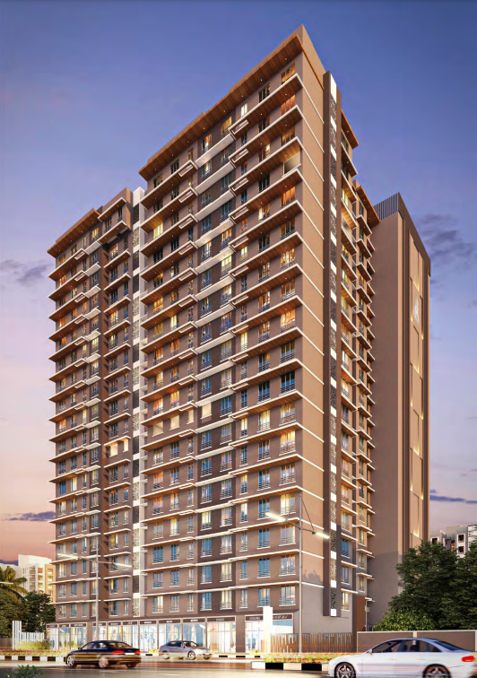
1 | PROJECT NAME: | JITEN CO.OP.HOUSING SOCIETY
2 | CLIENT NAME: | M/S. JOSHI CONSULTANTS
3 | LOCATION: | ANDHERI (WEST) MUMBAI
4 | BRIEF DESCRIPTION: | STILT + 19 UPPER FLOORS
5 | YEAR OF SERVICE: | FEB. 2023

Slide 32
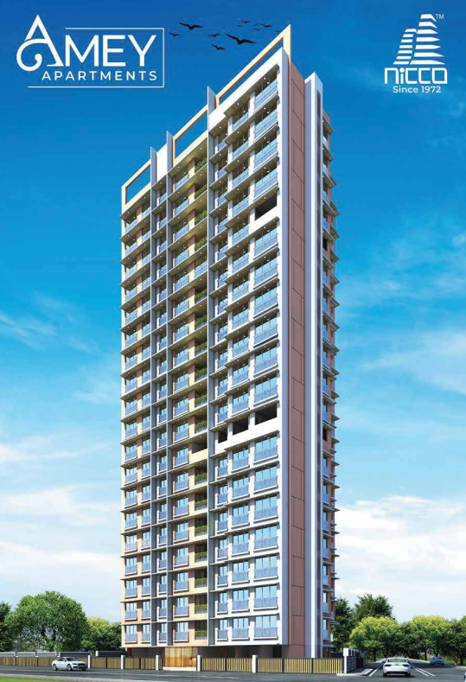
1 | PROJECT NAME: | AMEYA APARTMENTS
2 | CLIENT NAME: | M/S. JOSHI CONSULTANTS
3 | LOCATION: | ANDHERI (EAST) MUMBAI
4 | BRIEF DESCRIPTION: | STILT + 19 UPPER FLOORS

Slide 33
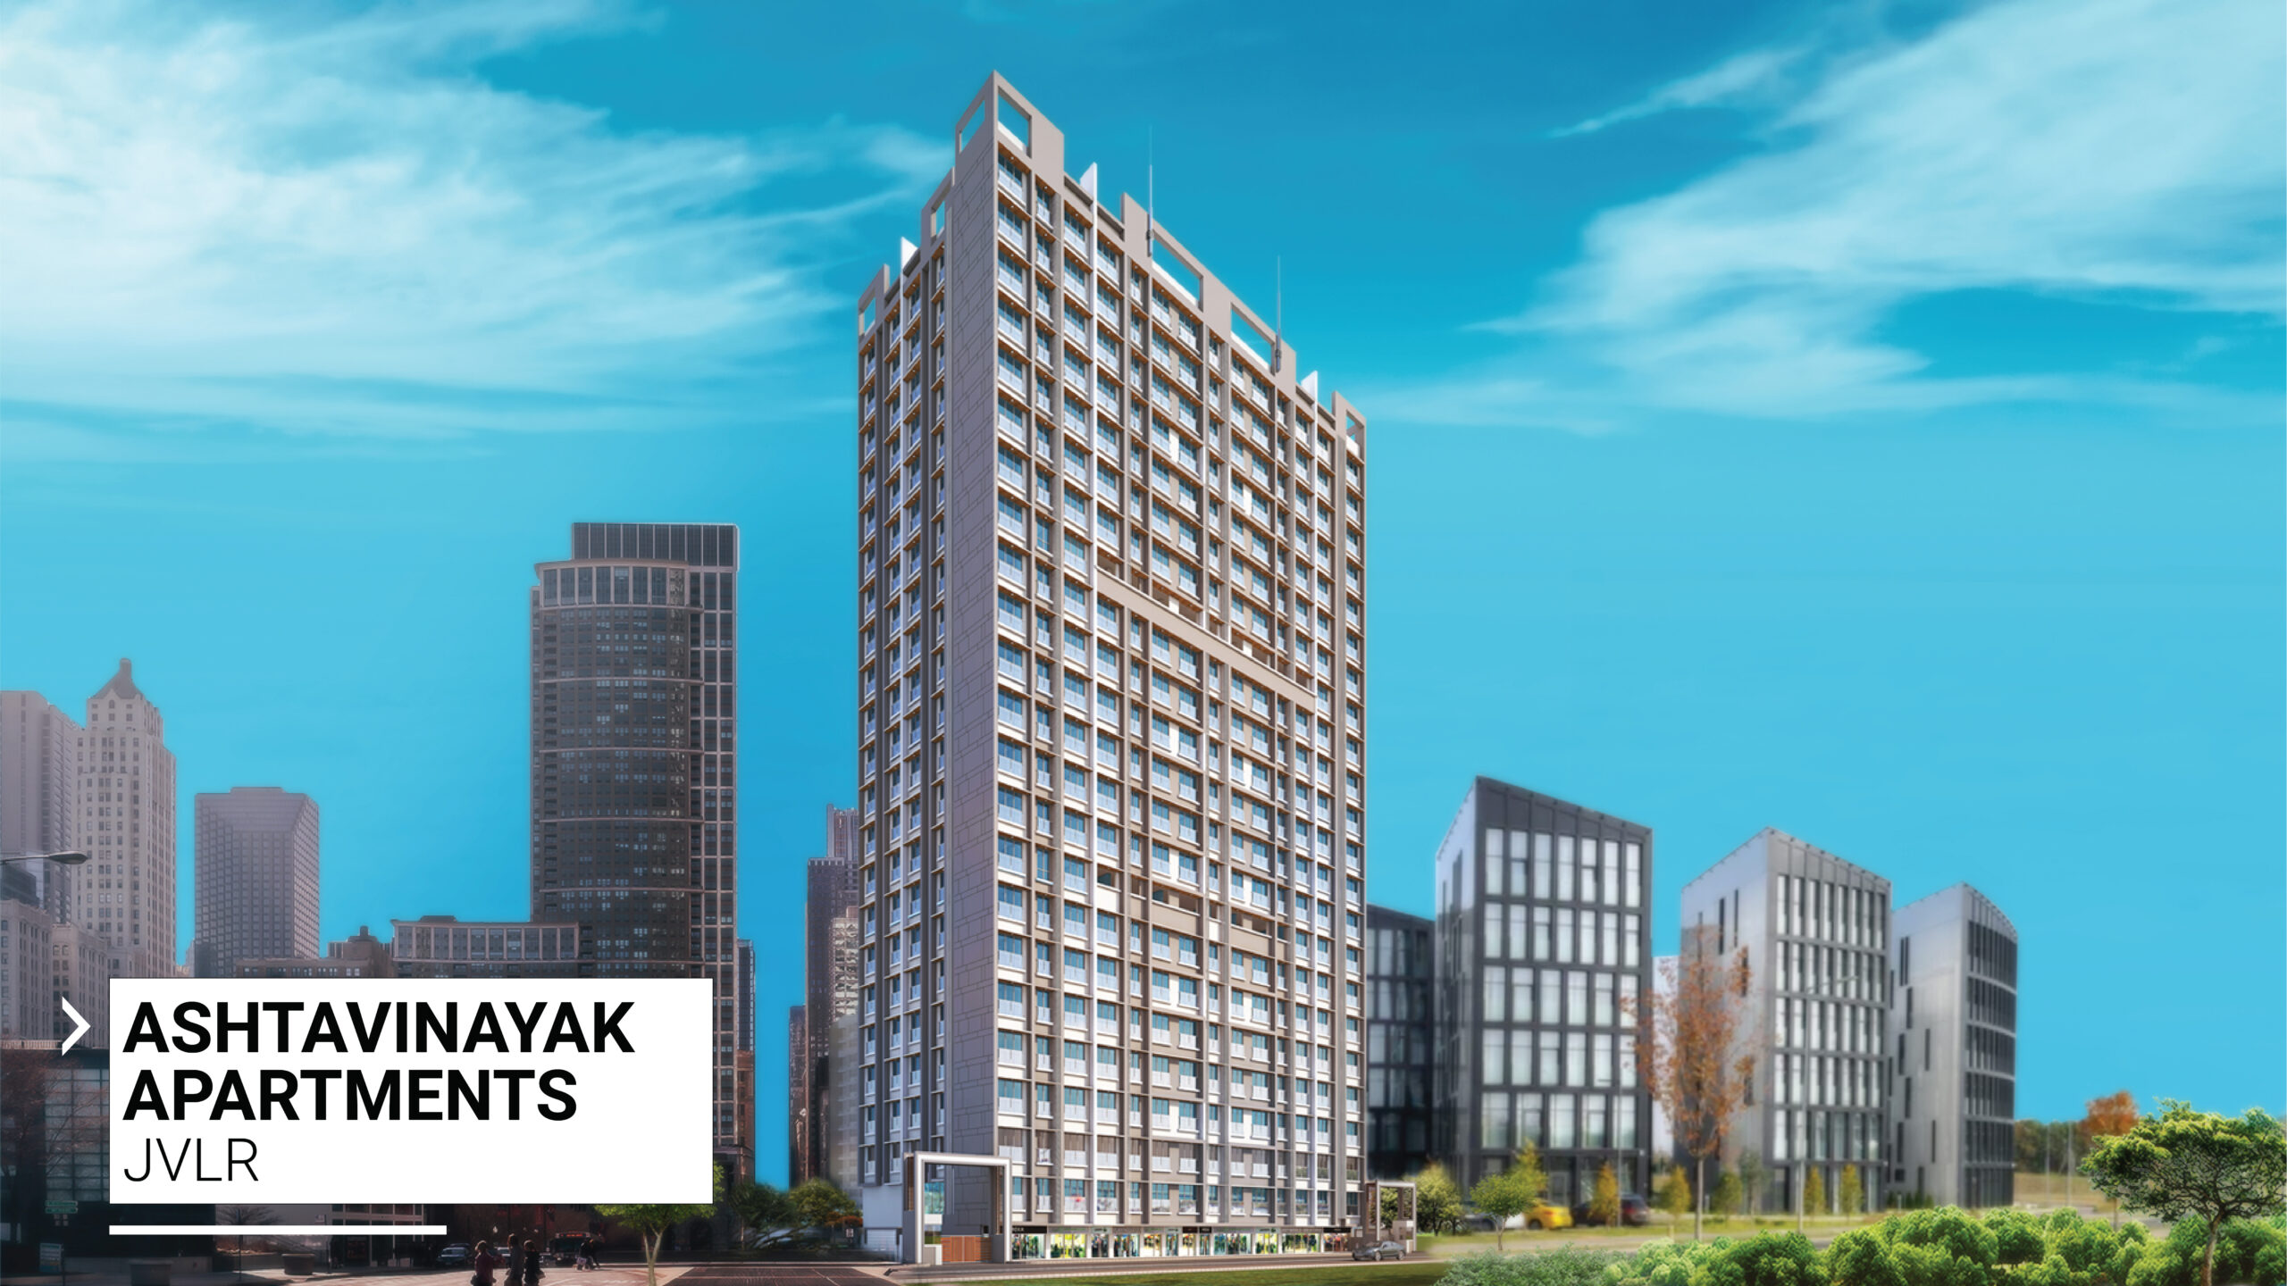
1 | PROJECT NAME: | ASHTAVINAYAK APARTMENTS
2 | CLIENT NAME: | M/S. JOSHI CONSULTANTS
3 | LOCATION: | JVLR MUMBAI
4 | BRIEF DESCRIPTION: | STILT + 19 UPPER FLOORS

Slide 34
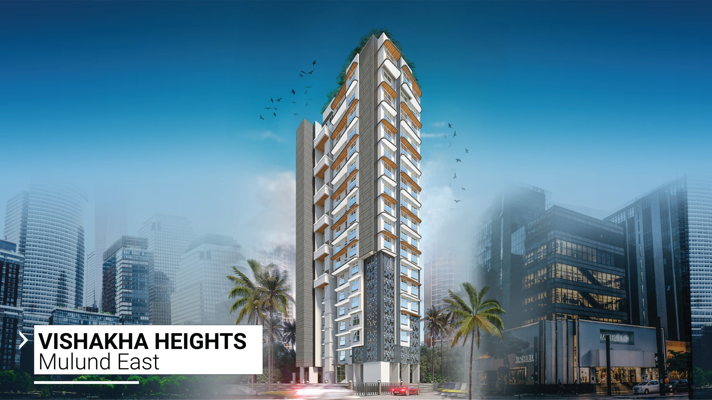
1 | PROJECT NAME: | VISHAKA HEIGHTS
2 | CLIENT NAME: | M/S. JOSHI CONSULTANTS
3 | LOCATION: | MULUND EAST, MUMBAI
4 | BRIEF DESCRIPTION: | STILT + 17 UPPER FLOORS

Slide 35
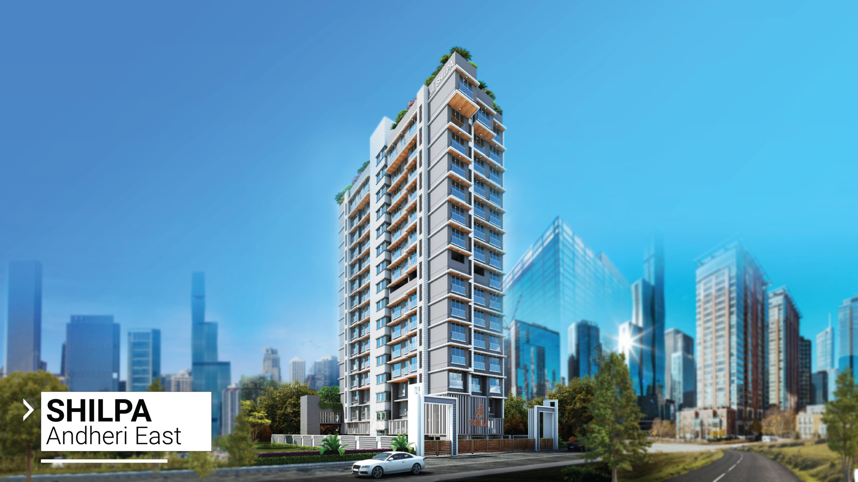
1 | PROJECT NAME: | SHILPA CO.OP.HOUSING SOCIETY
2 | CLIENT NAME: | M/S. JOSHI CONSULTANTS
3 | LOCATION: | ANDHERI EAST, MUMBAI
4 | BRIEF DESCRIPTION: | STILT + 15 UPPER FLOORS

Slide 36
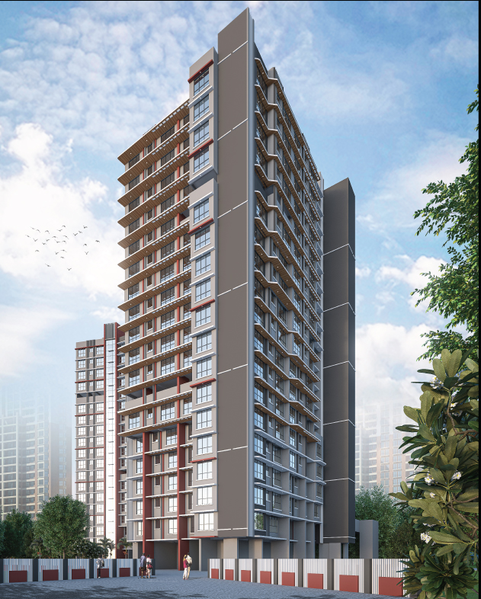
1 | PROJECT NAME: | HEMRATNA CO.OP.HOUSING SOCIETY
2 | CLIENT NAME: | M/S. JOSHI CONSULTANTS
3 | LOCATION: | ANDHERI (EAST) MUMBAI
4 | BRIEF DESCRIPTION: | STILT + 18 UPPER FLOORS

Slide 37
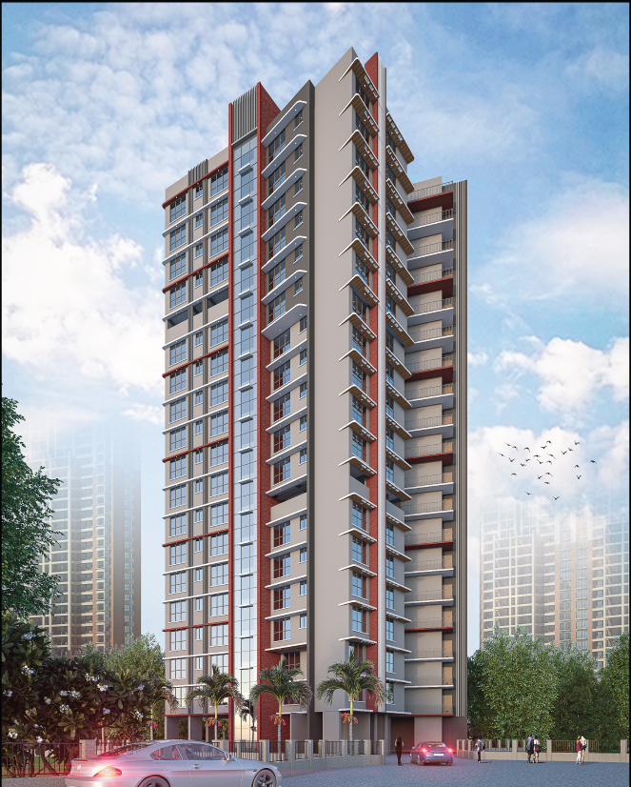
1 | PROJECT NAME: | KAMLESH CO.OP.HOUSING SOCIETY
2 | CLIENT NAME: | M/S. JOSHI CONSULTANTS
3 | LOCATION: | ANDHERI (EAST) MUMBAI
4 | BRIEF DESCRIPTION: | STILT + 18 UPPER FLOORS

Slide 38
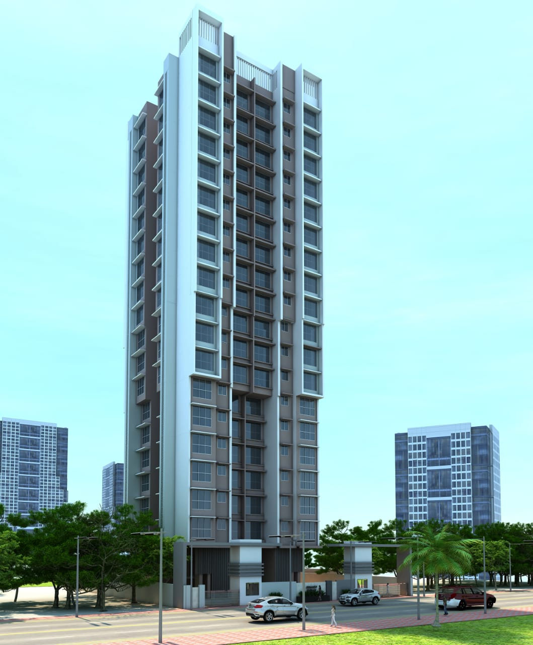
1 | PROJECT NAME: | SAMRUDHHI HEIGHTS
2 | CLIENT NAME: | M/S. LEARCH PROJECTS
3 | LOCATION: | GOREGAON(W), MUMBAI
4 | BRIEF DESCRIPTION: | GROUND FLOOR + 19 UPPERS FLOOR
5 | YEAR OF SERVICE: | FEB. 2022

Slide 39
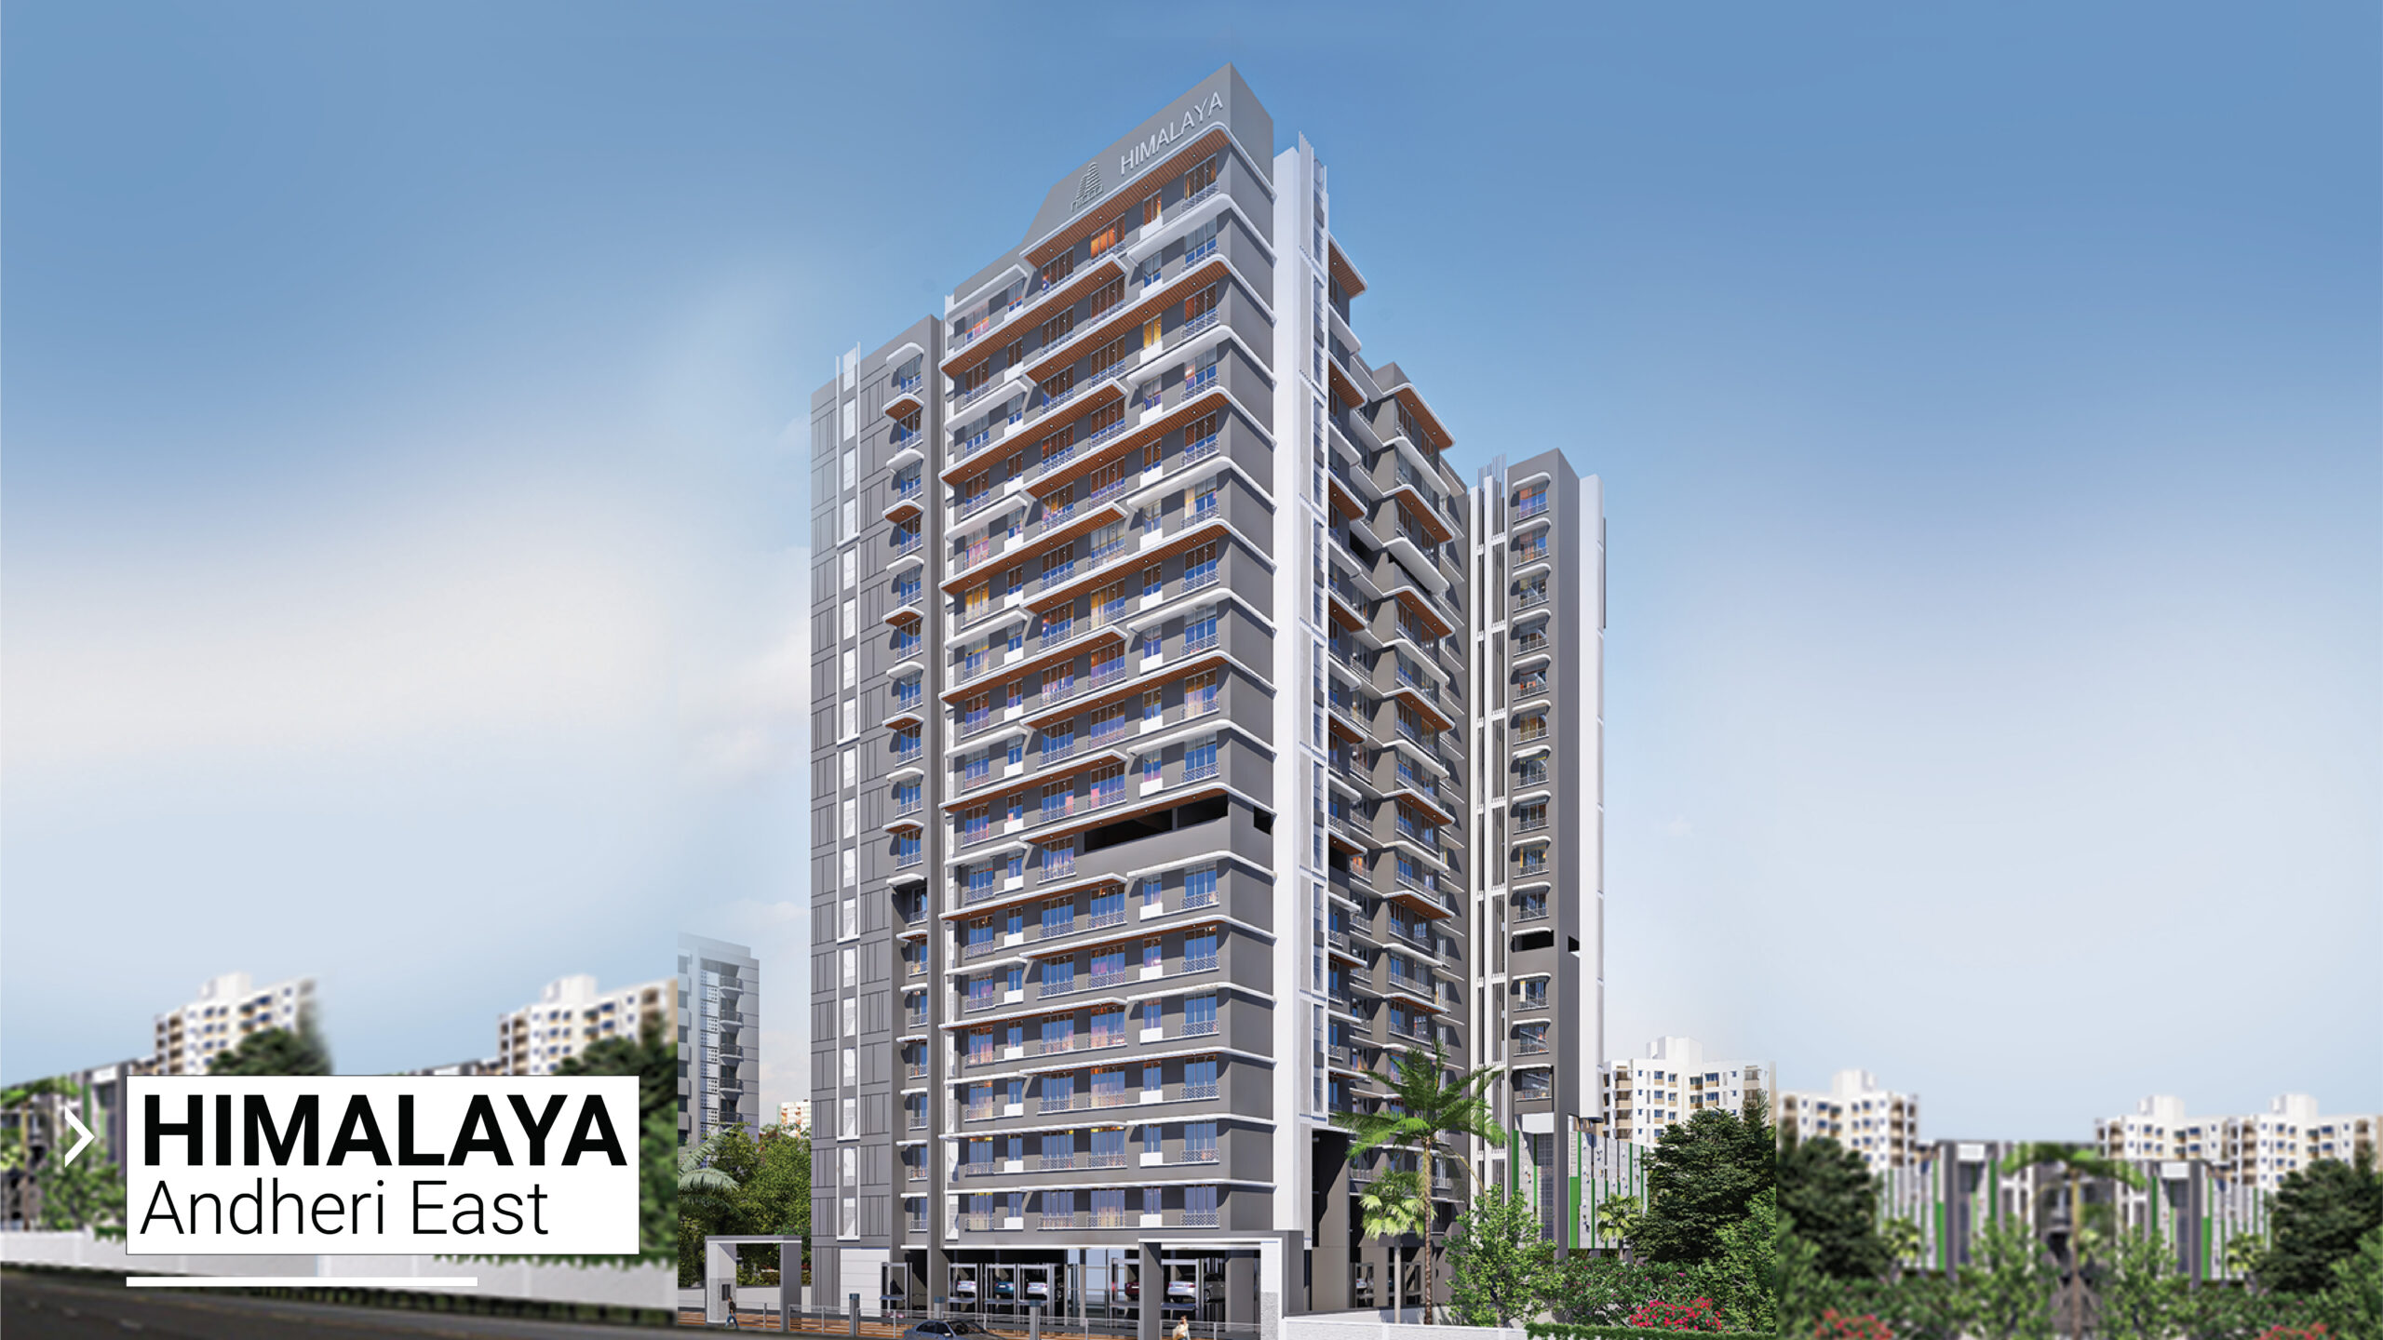
1 | PROJECT NAME: | HIMALAYA HEIGHTS
2 | CLIENT NAME: | M/S. JOSHI CONSULTANTS
3 | LOCATION: | ANDHERI EAST, MUMBAI
4 | BRIEF DESCRIPTION: | STILT + 20 UPPER FLOORS

Slide 40
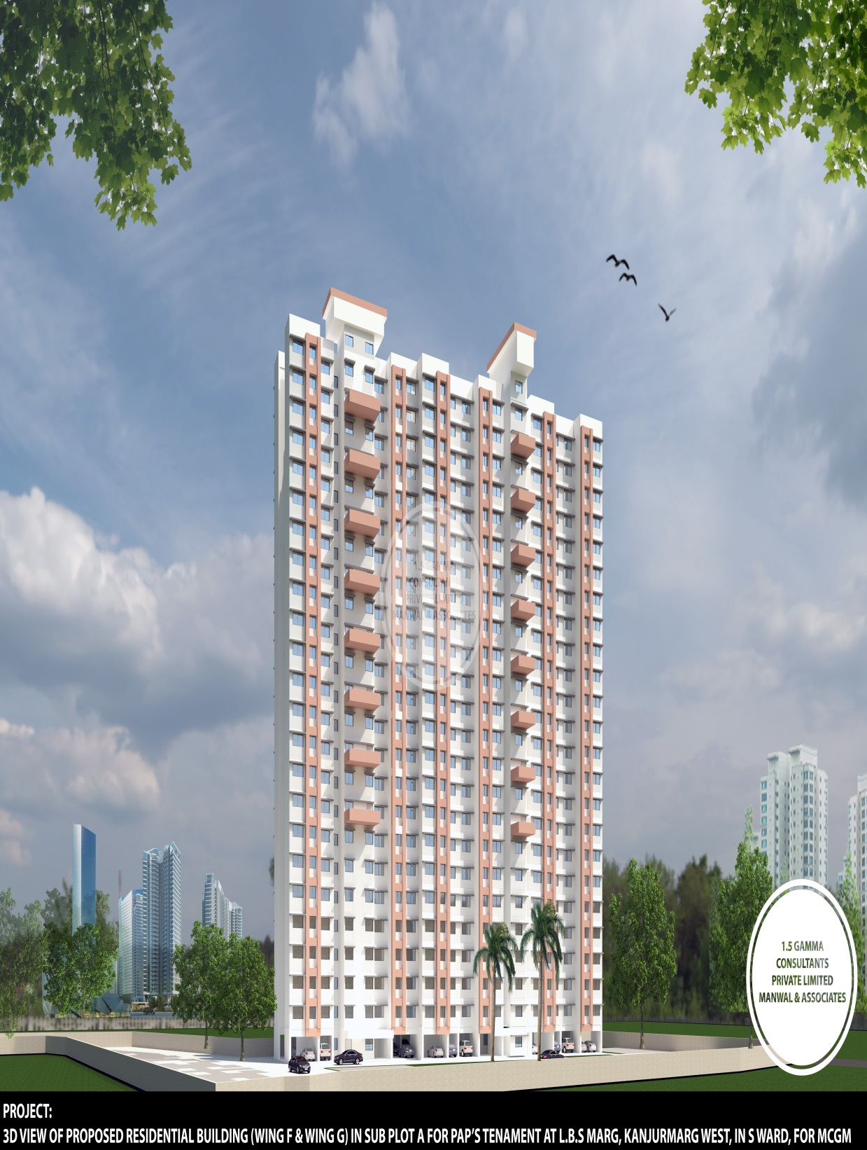
1 | PROJECT NAME: | MCGM PAP TENAMENTS
2 | CLIENT NAME: | DEV ENGINEERS
3 | LOCATION: | KANJURMARG, MUMBAI
4 | BRIEF DESCRIPTION: | STILT FLOOR + 22 UPPER FLOOR
5 | YEAR OF SERVICE: | ON GOING

Slide 41
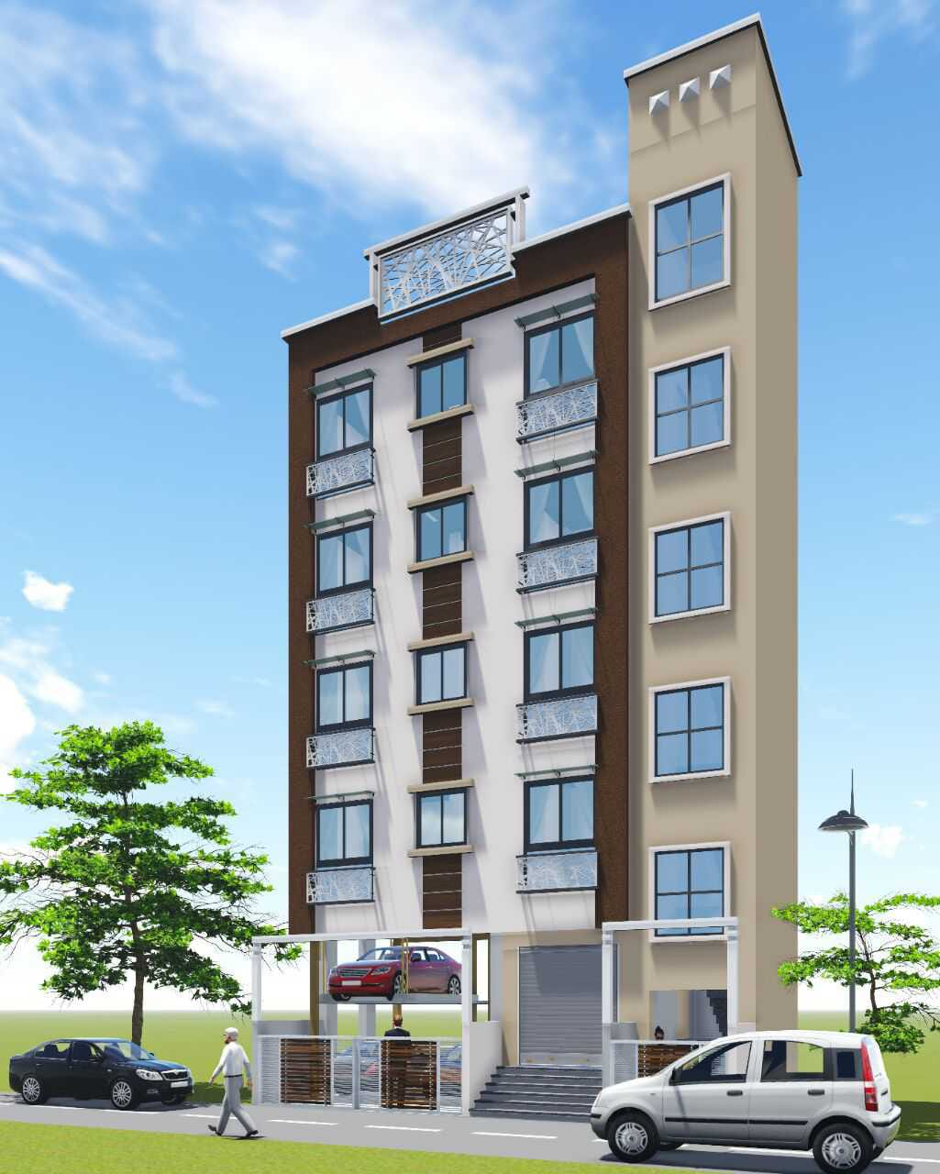
1 | PROJECT NAME: | EKDANT APARTMENT
2 | CLIENT NAME: | AB CONSTRUCTION
3 | LOCATION: | ULWE, NAVI MUMBAI
4 | BRIEF DESCRIPTION: | STILT + 4 FLOORS

Slide 42
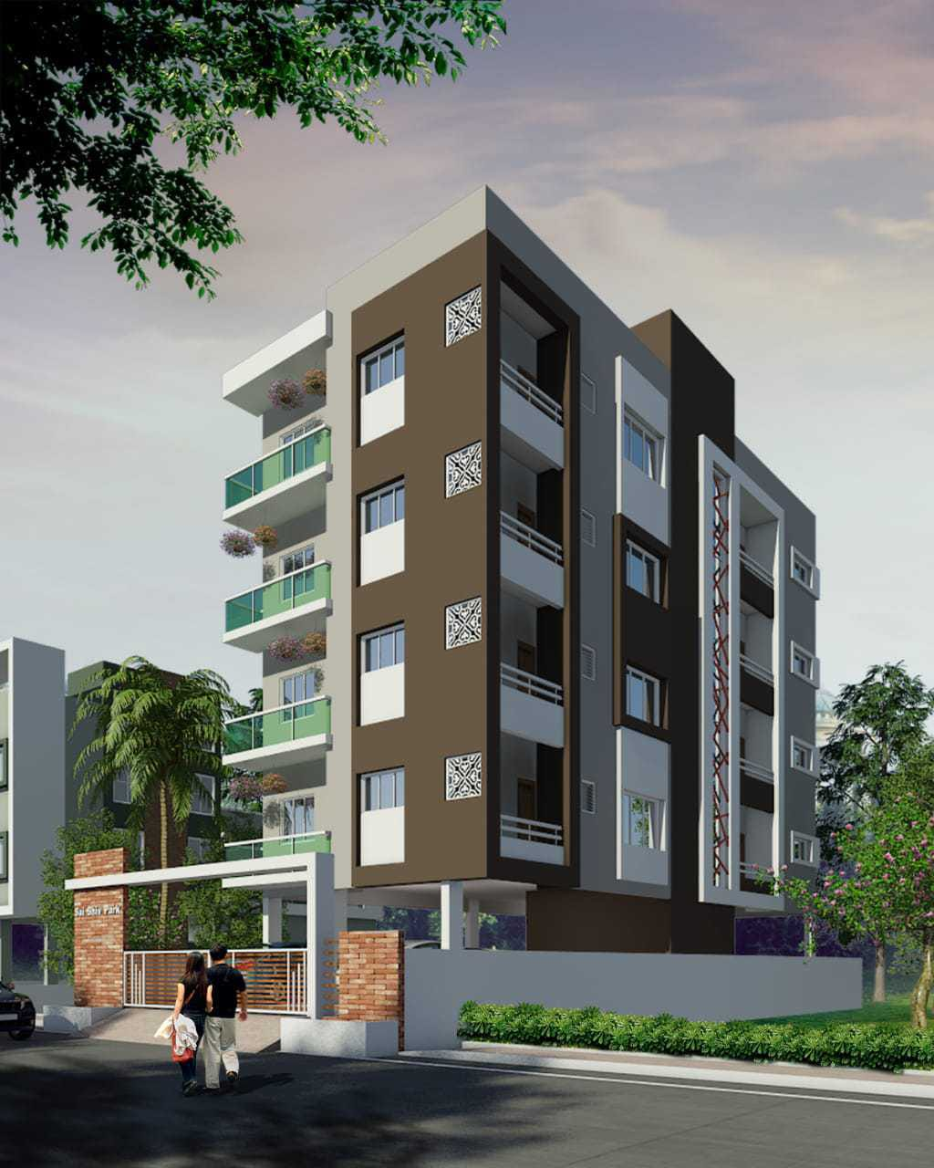
1 | PROJECT NAME: | PLOT NO. 06, SOYGAON
2 | CLIENT NAME: | URBAN SKETCHERS
3 | LOCATION: | SOYGAON, MALEGAON
4 | BRIEF DESCRIPTION: | STILT + 4 FLOORS

Slide 43
STRUCTURAL DESIGN ENGINEERING
LIST OF TOWNSHIP/ MASS HOUSING PROJECTS

Slide 44
SR. NO. | PROJECT NAME | ADDRESS | FLOORS
1 | AQUA VIEW BUILDING – WING H, I, J, K AND L | KOLKATA, INDIA | 8 LAC SQFT STILT + 30 UPPER FLOORS (5 TOWERS)
2 | MCGM PAP TENEMENTS | KANJURMARG, MUMBAI | 5.5LAC SQFT- 6 TOWERS STILT +23FLOORS - CLIENT MCGM / CONTRACTOR
3 | POONAM NAGAR REHAB & SALE BUILDING | JVLR, MUMBAI | 2.5 LAC SQFT- 2 TOWERS - STILT +23 FLOORS - CLIENT NICCO GROUP - LOCATION ANDHERI JVLR JUNCTION - /STRUCTURAL CONSULTANCY IN ASSOCIATION WITH JOSHI CONSULTANTS
3 | HIMALAYA HEIGHTS | ANDHERI (EAST,)MUMBAI | 1.2 LAC SQFT - STILT +20 UPPER FLOORS
4 | VANASHRI CO.OP.HOUSING SOCIETY | ANDHERI, MUMBAI | 6.5 LAC SQFT GROUND + 22 UPPER FLOOR
5 | MCGM TENAMENTS BUILDING NO 1,2, 3, 4 & 5 – HASNABAD LANE | KHAR ROAD (W), MUMBAI | 5.5LAC SQFT STILT + 19 UPPER FLOORS (5 TOWERS)
6 | TATHASTU SUNCITY | KHED RATNAGIRI | 6 TOWERS AND 9 BUNGALOWS
LIST OF TOWNSHIP/ MASS HOUSING PROJECTS

Slide 45
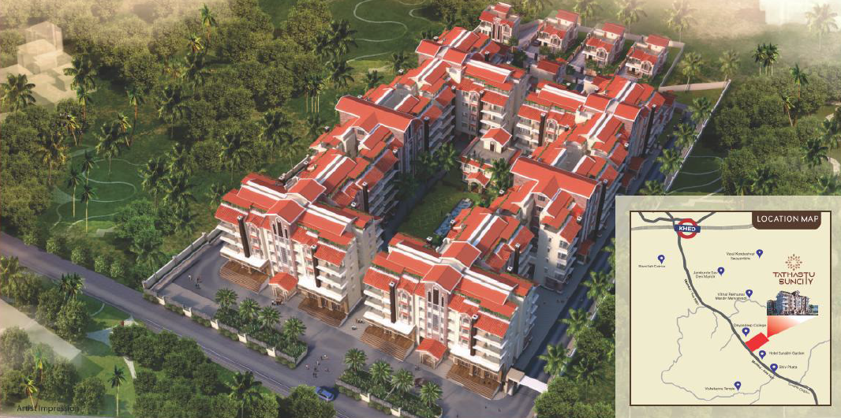
1 | PROJECT NAME: | Tathastu Suncity
2 | CLIENT NAME: | M/S. Tathastu Developers
3 | LOCATION: | Khed, Ratnagiri
4 | BRIEF DESCRIPTION: | 6 Towers + 9 Bungalows and Club House

Slide 46
1 | PROJECT NAME: | MCGM PAP TENAMENTS
2 | CLIENT NAME: | DEV ENGINEERS
3 | LOCATION: | KANJURMARG, MUMBAI
4 | BRIEF DESCRIPTION: | 6 Towers, Total 6lac Sqft, Stilt + 23 Floors

Slide 47
1 | PROJECT NAME: | HIMALAYA HEIGHTS
2 | CLIENT NAME: | M/S. JOSHI CONSULTANTS
3 | LOCATION: | ANDHERI EAST, MUMBAI
4 | BRIEF DESCRIPTION: | STILT + 20 UPPER FLOORS

Slide 48
STRUCTURAL DESIGN ENGINEERING
LIST OF BUNGALOW PROJECTS

Slide 49
SR. NO. | PROJECT NAME | ADDRESS | ROLE
1 | MR. KHAIRNAR AND SONAWANE BUNGALOW | MALEGAON | ARCHITECTUAL + STRUCTURAL DESIGN
2 | MR. NITIN MAHALE AND MR. VIKAS PATIL BUNGALOW | SOYGAON, MALEGAON | ARCHITECTUAL + STRUCTURAL DESIGN
3 | GUEST HOUSE AT POMBHURNA | POMBHURNA, CHANDRAPUR | ARCHITECTUAL + STRUCTURAL DESIGN
4 | MR. JAYESH THAKUR BUNGALOW | VIRAR, VASAI | ARCHITECTUAL + STRUCTURAL DESIGN
5 | ROW HOUSE AT MALEGAON | MALEGAON | ARCHITECTUAL + STRUCTURAL DESIGN
6 | MR. BHILLORE BUNGALOW | NASHIK | ARCHITECTUAL + STRUCTURAL DESIGN
7 | AVINASH HOUSE | PUNE | ARCHITECTUAL + STRUCTURAL DESIGN
8 | MR. KHOCHARE BUNGALOW | MURBAD, THANE | ARCHITECTUAL + STRUCTURAL DESIGN
LIST OF BUNGALOW PROJECTS

Slide 50
SR. NO. | PROJECT NAME | ADDRESS | ROLE
9 | MR. SWAPNIL PRADHAN BUNGALOW | MURBAD, THANE | ARCHITECTUAL + STRUCTURAL DESIGN
10 | MR. GAJENDRA AHIRE BUNGALOW | NANDURBAR | ARCHITECTUAL + STRUCTURAL DESIGN
11 | MR. JUNGARE BUNGALOW | MHOPADA, RAIGAD | ARCHITECTUAL + STRUCTURAL DESIGN
12 | MR. NITIN MAHALE BUNGALOW | NASHIK | ARCHITECTUAL + STRUCTURAL DESIGN
13 | MR. RAJIV HATHMODE BUNGALOW | RAIGAD | ARCHITECTUAL + STRUCTURAL DESIGN
14 | MR. RAUT BUNGALOW | NASHIK | ARCHITECTUAL + STRUCTURAL DESIGN
15 | MR. SHELKE FARM HOUSE | PANVEL | ARCHITECTUAL + STRUCTURAL DESIGN
16 | MR. WAGHMARE | NASHIK | ARCHITECTUAL + STRUCTURAL DESIGN
LIST OF BUNGALOW PROJECTS

Slide 51
SR. NO. | PROJECT NAME | ADDRESS | ROLE
17 | MR. SUKINKAR BUNGALOW | NASHIK | ARCHITECTUAL + STRUCTURAL DESIGN
18 | MR. KHADSE BUNGALOW | WASHIM | ARCHITECTUAL + STRUCTURAL DESIGN
19 | MR. JOSEPH SEQUERIA BUNGALOW | MANGLORE, KARNATAKA | ARCHITECTUAL + STRUCTURAL DESIGN
20 | MR. RAHUL SURYAWANSHI BUNAGLOW | NASHIK | ARCHITECTUAL + STRUCTURAL DESIGN
21 | MR. DESHMUKH BUNGALOW | MURBAD, THANE | ARCHITECTUAL + STRUCTURAL DESIGN
LIST OF BUNGALOW PROJECTS

Slide 52
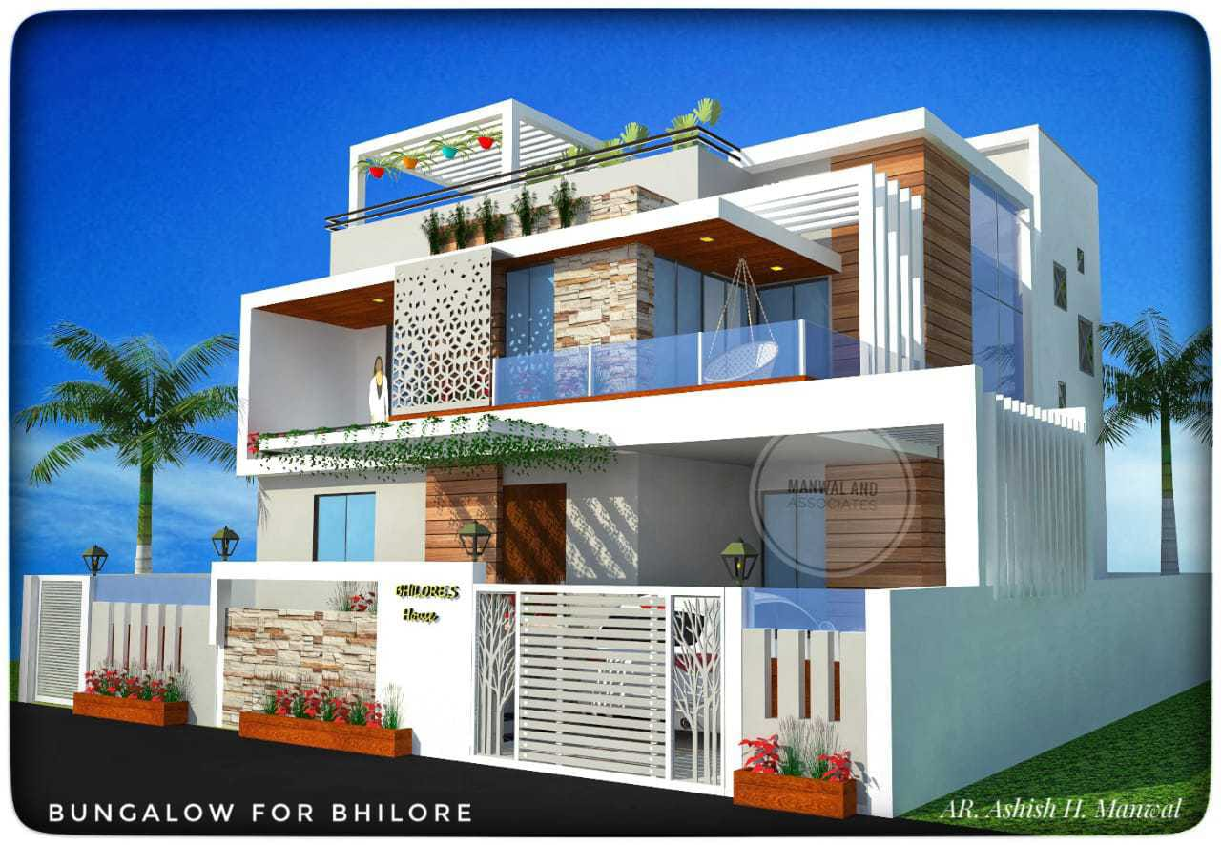
 | PROJECT NAME: | MR. BHILLORE BUNGALOW

Slide 53
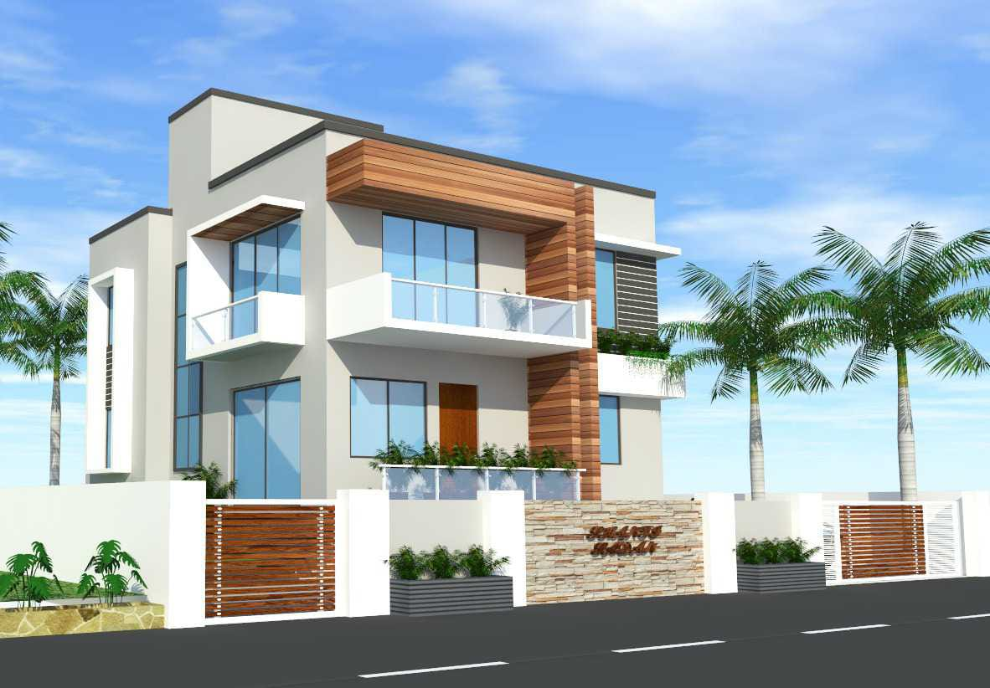
 | PROJECT NAME: | MR. JAYESH THAKUR BUNGALOW

Slide 54
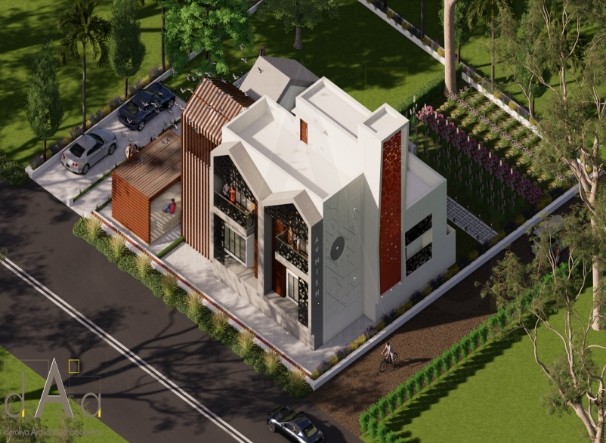
 | PROJECT NAME: | AVINASH HOUSE

Slide 55
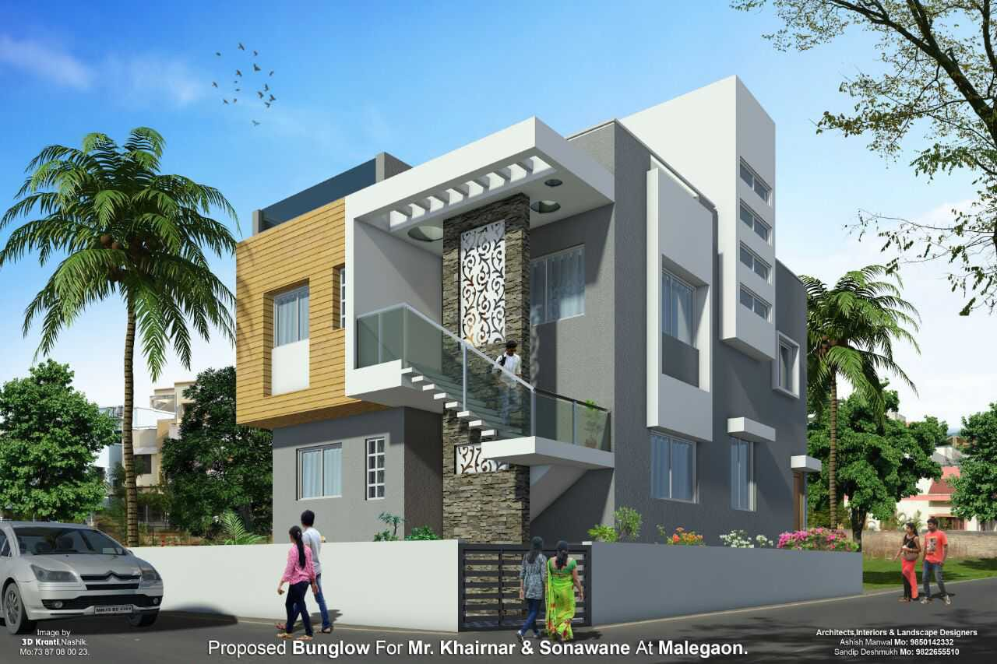
 | PROJECT NAME: | MR. KHAIRNAR AND SONAWANE BUNGALOW

Slide 56
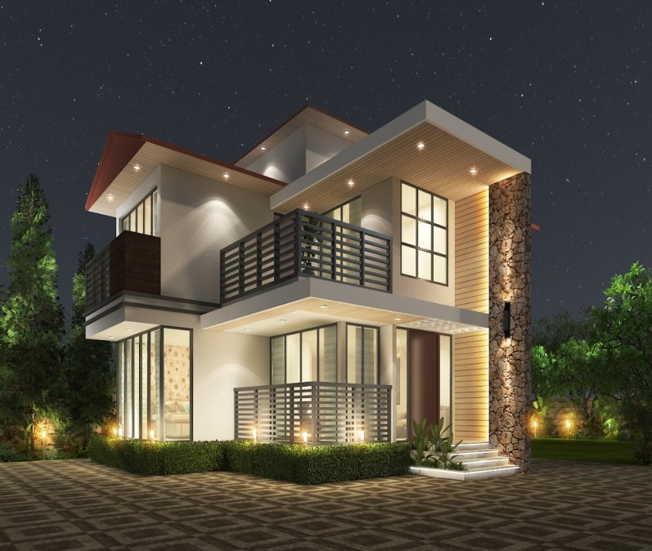
 | PROJECT NAME: | MR. KHOCHARE BUNGALOW

Slide 57
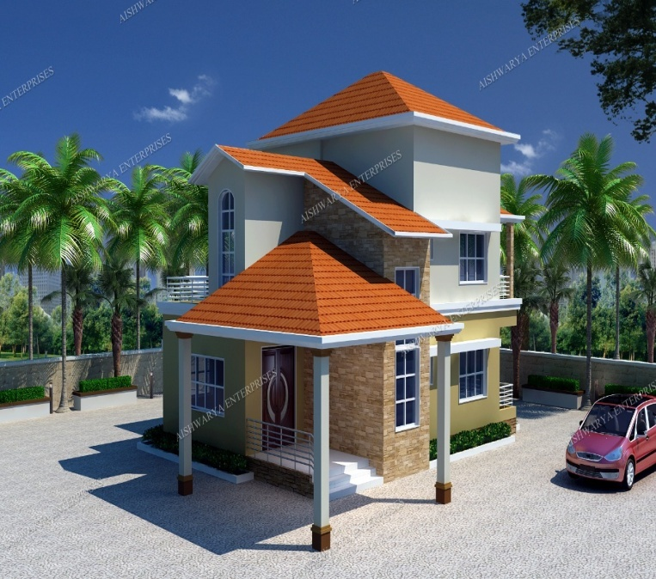
 | PROJECT NAME: | MR. SWAPNIL PRADHAN BUNGALOW

Slide 58
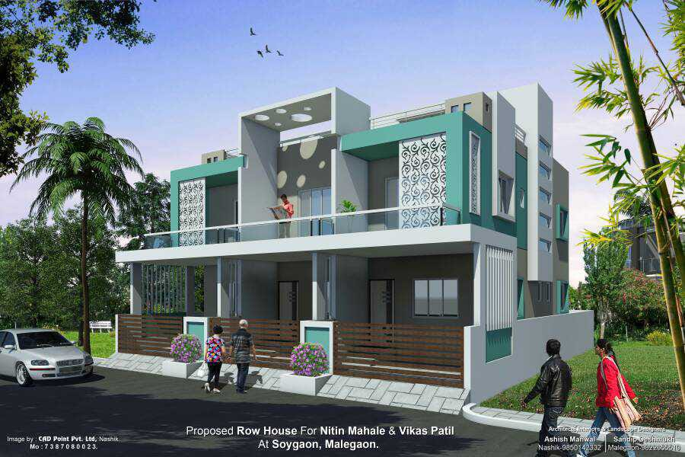
 | PROJECT NAME: | MR. NITIN MAHALE BUNGALOW

Slide 59
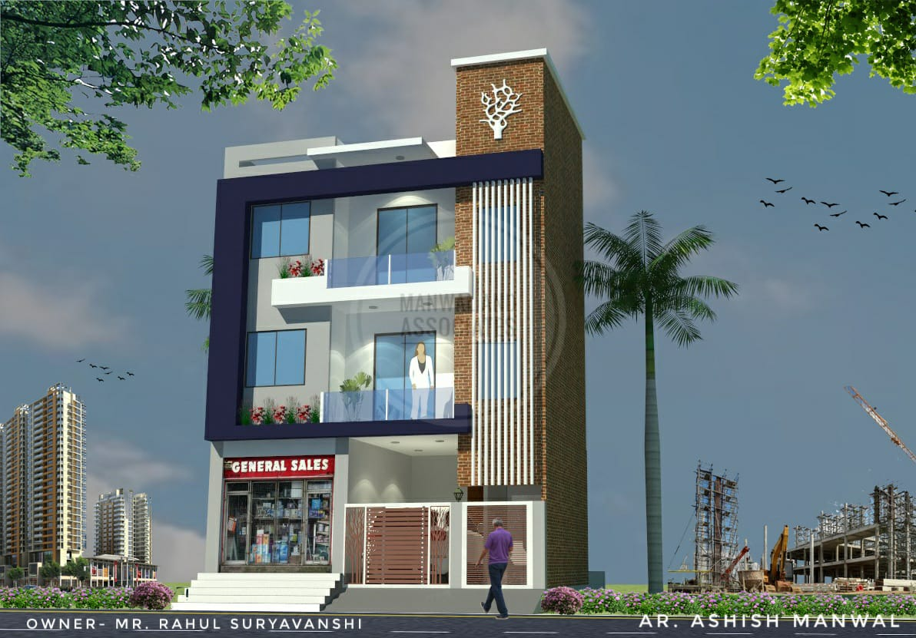
 | PROJECT NAME: | MR. RAHUL SURYAVANSHI BUNGALOW

Slide 60
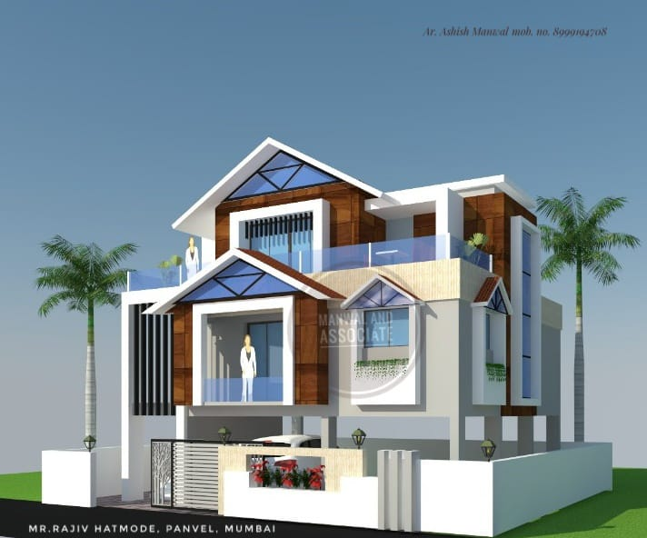
 | PROJECT NAME: | MR. RAJIV HATHMODE BUNGALOW

Slide 61
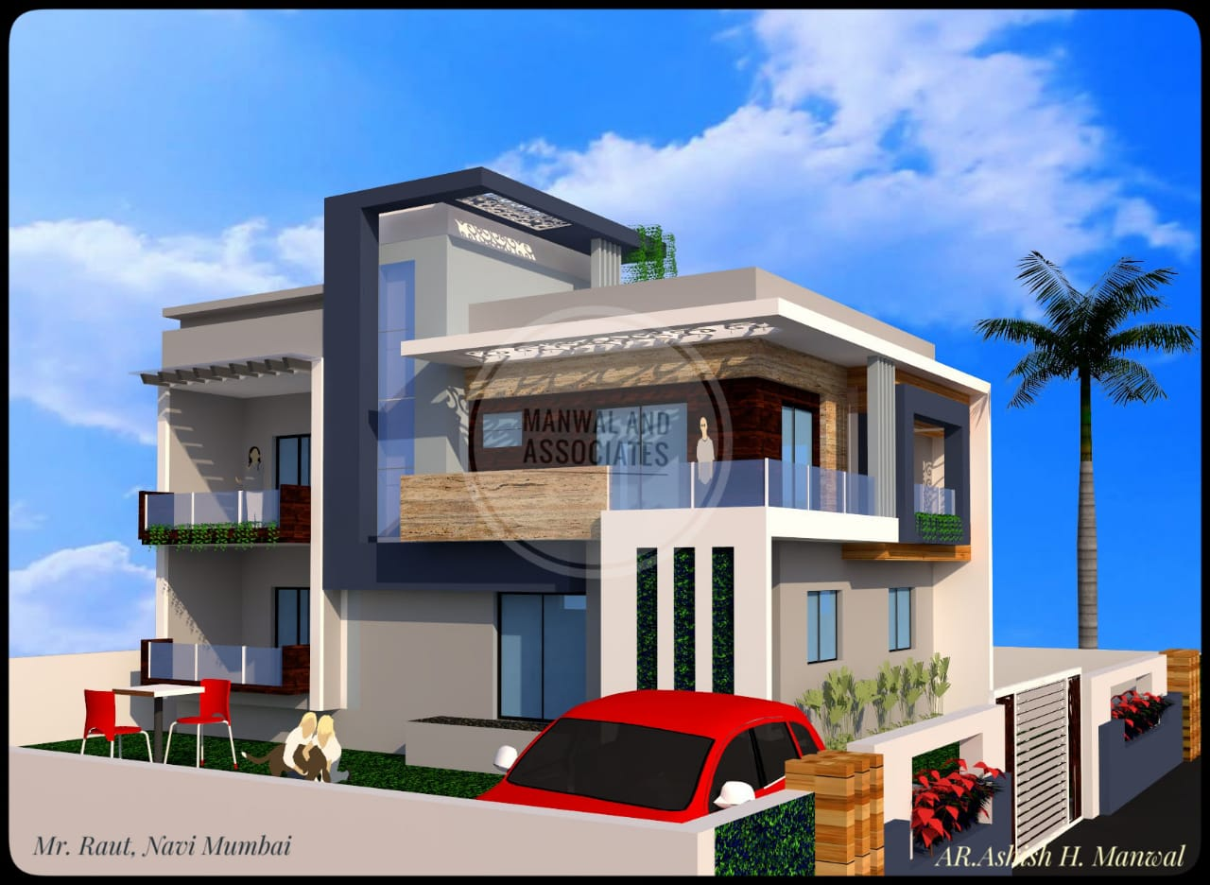
 | PROJECT NAME: | MR. RAUT BUNGALOW

Slide 62
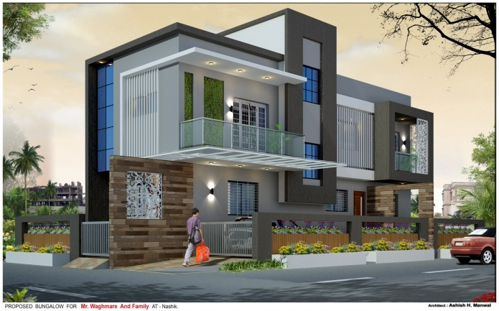
 | PROJECT NAME: | MR. WAGHMARE BUNGALOW

Slide 63
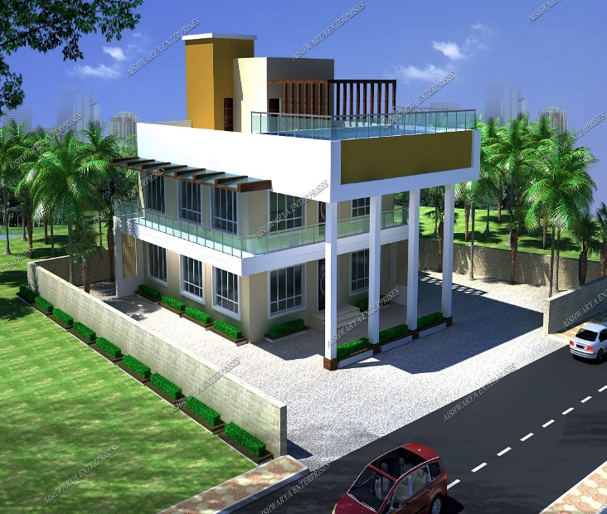
 | PROJECT NAME: | MR. DESHMUKH BUNGALOW

Slide 64
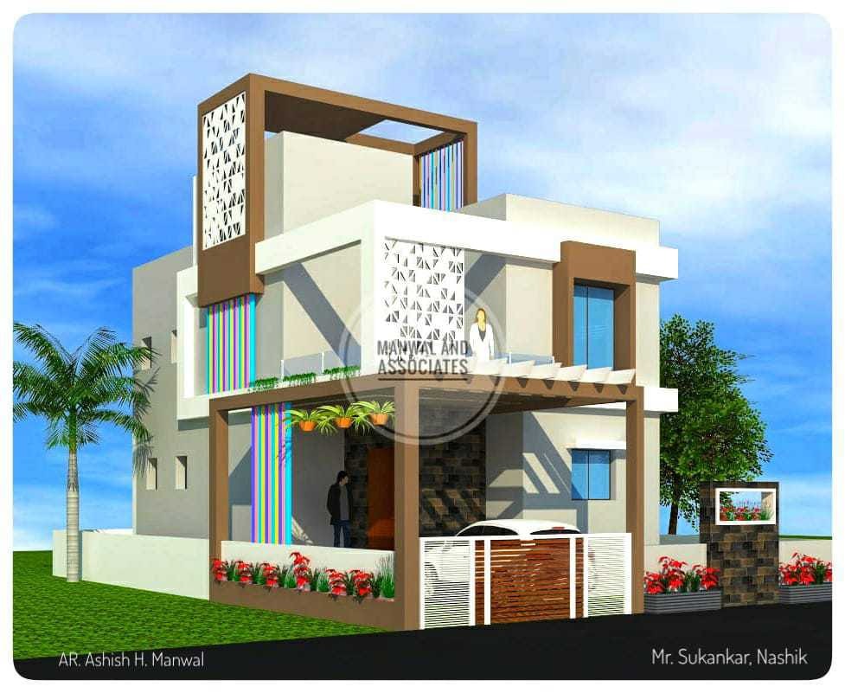
 | PROJECT NAME: | MR. SUKINKAR BUNGALOW

Slide 65
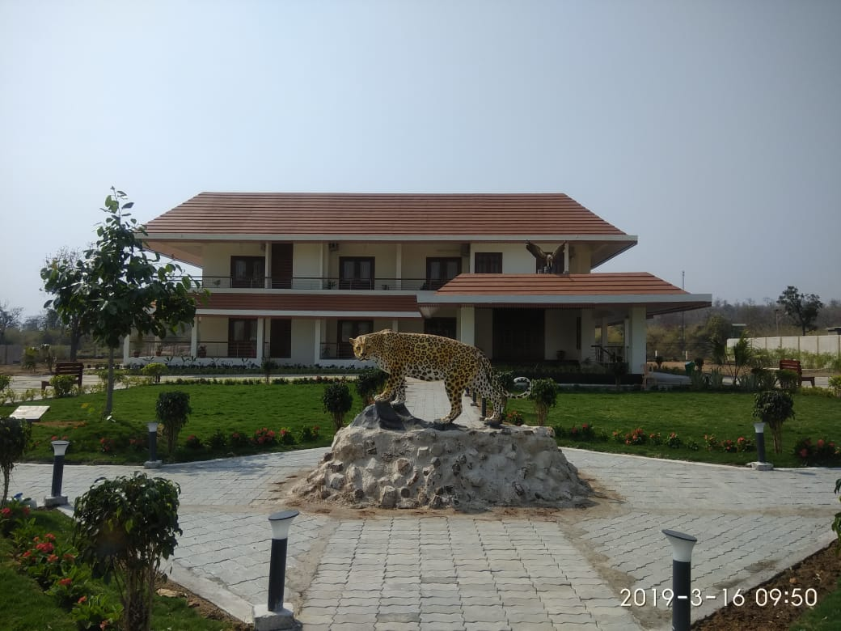
 | PROJECT NAME: | FOREST DEPARTMENT REST HOUSE POMBHURNA

Slide 66
STRUCTURAL DESIGN ENGINEERING
LIST OF GARDEN, SPORTS COMPLEX AND AUDITORIUM PROJECTS

Slide 67
SR. NO. | PROJECT NAME | ADDRESS | BRIEF DESCRIPTION
1 | BOTANICAL GARDEN FOR FOREST DEPARTMENT, NEW CHANDA, CHANDRAPUR | NEW CHANDA, CHANDRAPUR | DESIGN OF UNIQUE SHAPE BUILDINGS FOR OFFICE, EXHINITIONS, MUSEUM, AQUARIUM, BUTTERFLY GARDEN, TICKET COUNTER AND LANDSCAPE ANCILLARY STRUCTURES
2 | ECO PARK, POMBHURNA, CHANDRAPUR | POMBHURNA, CHANDRAPUR, MAHARASHTRA | AUDITORIUM BUILDING INCLUDING LANDSCAPE
3 | DIGRAS TOWN HALL, DIGRAS, YAVATMAL | DIGRAS, YAVATMAL, MAHARASHTRA | BASEMENT + 3 UPPER FLOORS FOR AUDITOIUM AND MARKET
4 | DIGRAS SPORTS COMPLEX | DIGRAS, YAVATMAL, MAHARASHTRA | BADMINTON COURT, RUNNING TRACK AND ADMIN BUILDING
5 | ENERGY PARK, VADGAON, YAVATMAL | VADGAON, YAVATMAL, MAHARASHTRA
LIST OF GARDENS, SPORTS COMPLEX AND AUDITORIUM PROJECTS

Slide 68
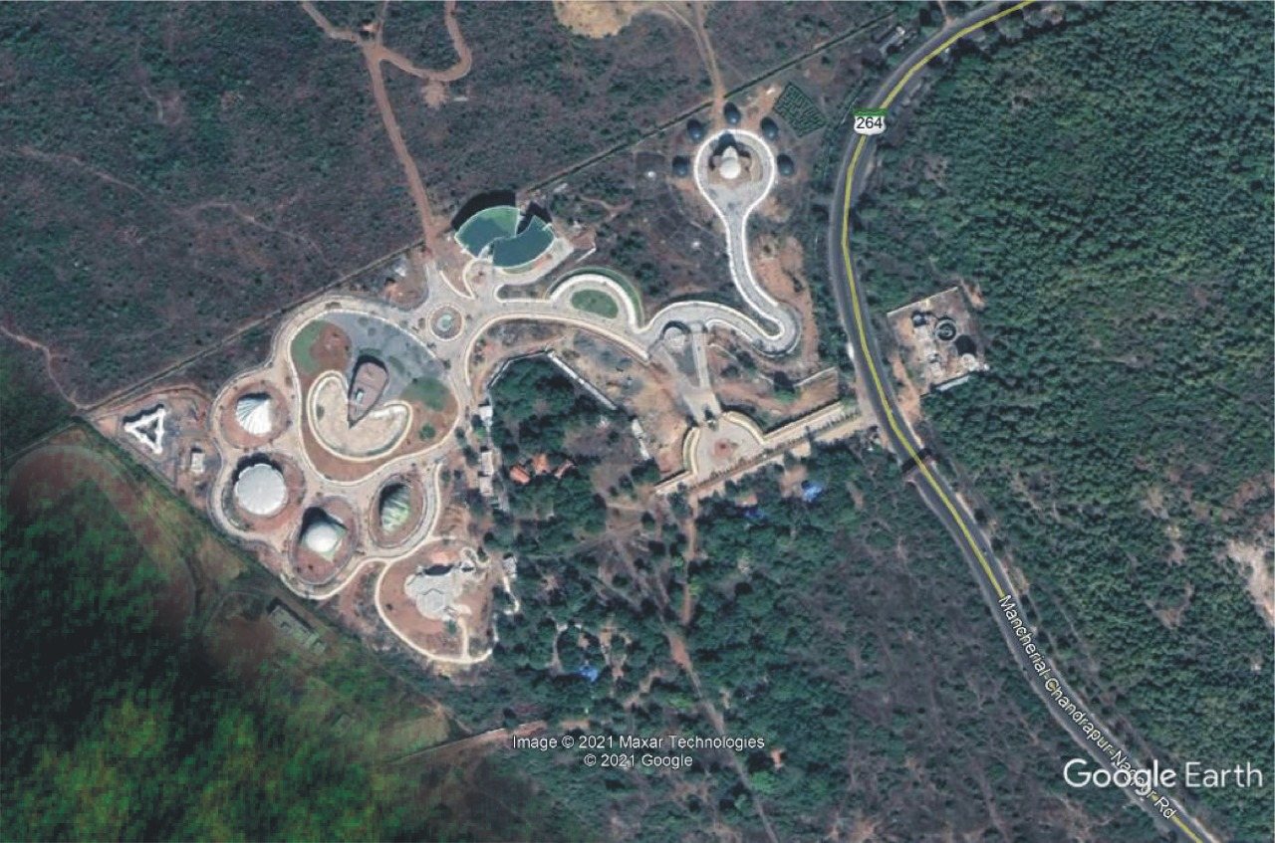
Botanical Garden for Forest Department, New Chanda, Chandrapur
1 | PROJECT NAME: | BOTANICAL GARDEN FOR FOREST DEPARTMENT, NEW CHANDA, CHANDRAPUR
2 | CLIENT NAME: | M/S 360 DESIGN CONCEPT PVT LTD. AND FOREST DEPARTMENT, CHANDRAPUR
3 | LOCATION: | NEW CHANDA, CHANDRAPUR
4 | BRIEF DESCRIPTION: | DESIGN OF UNIQUE SHAPE BUILDINGS FOR OFFICE, EXHINITIONS, MUSEUM, AQUARIUM, BUTTERFLY GARDEN, TICKET COUNTER AND LANDSCAPE ANCILLARY STRUCTURES
5 | YEAR OF SERVICE: | 2019-2023
6 | SCOPE OS SERVICE | STRUCTURAL DESIGN AND TENDER
7 | VALUE OF WORK | 155 CR

Slide 69
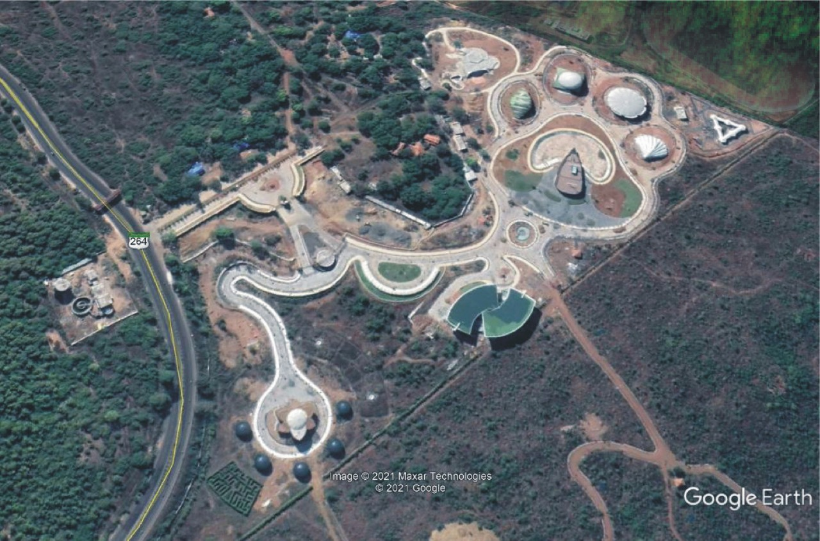
Botanical Garden for Forest Department, New Chanda, Chandrapur

Slide 70
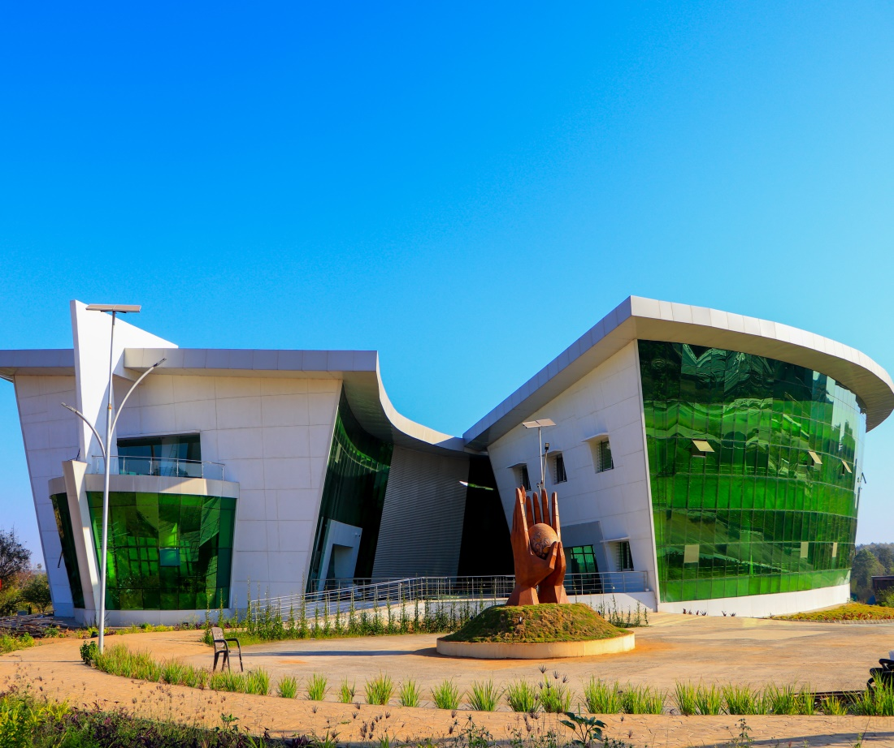
1 | PROJECT NAME: | OFFICE AND NBRI BUILDING, BOTANICAL GARDEN, CHANDRAPUR
2 | CLIENT NAME: | M/S 360 DESIGN CONCEPT PVT LTD AND FOREST DEPARTMENT, NEW CHANDA, CHANDRAPUR
3 | LOCATION: | NEW CHANDA, CHANDRAPUR
4 | BRIEF DESCRIPTION: | ADMINISTRATIVE BUILDING COMPRISING OF BASEMENT + GRD + 1 FLOOR
5 | YEAR OF SERVICE: | 2019-2023
6 | SCOPE OS SERVICE | STRUCTURAL DESIGN AND TENDER
7 | VALUE OF WORK | 6.42 CR

Slide 71
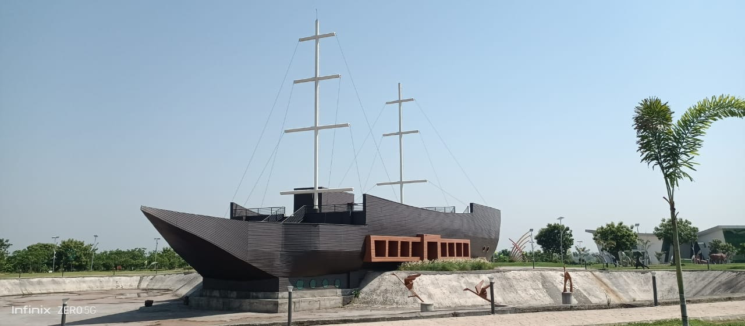
1 | PROJECT NAME: | CAFETERIA BUILDING, BOTANICAL GARDEN, CHANDRAPUR.
2 | CLIENT NAME: | M/S 360 DESIGN CONCEPT PVT LTD AND FOREST DEPARTMENT, NEW CHANDA, CHANDRAPUR
3 | LOCATION: | NEW CHANDA, CHANDRAPUR
4 | BRIEF DESCRIPTION: | UNIQUE BOAT SHAPE ASSEMBLY BUILDING COMPRISING OF BASEMENT + GRD + 1 FLOOR
5 | YEAR OF SERVICE: | 2019-2023
6 | SCOPE OS SERVICE | STRUCTURAL DESIGN AND TENDER
7 | VALUE OF WORK | 9.56 CR

Slide 72
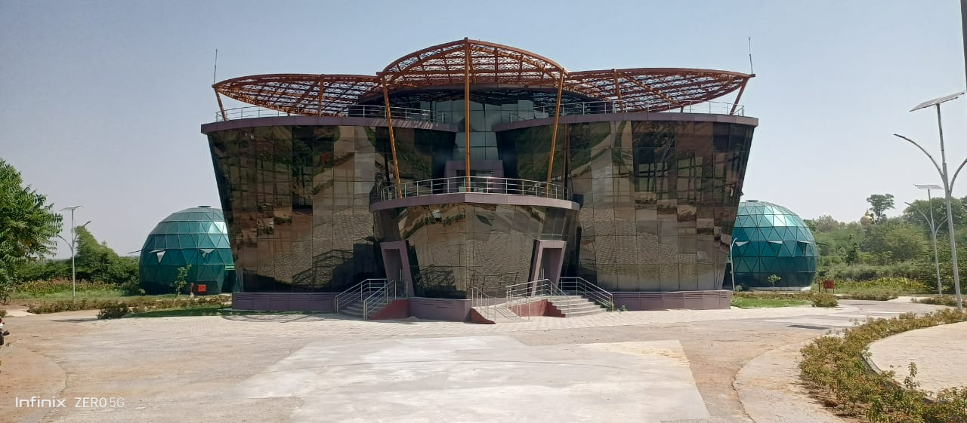
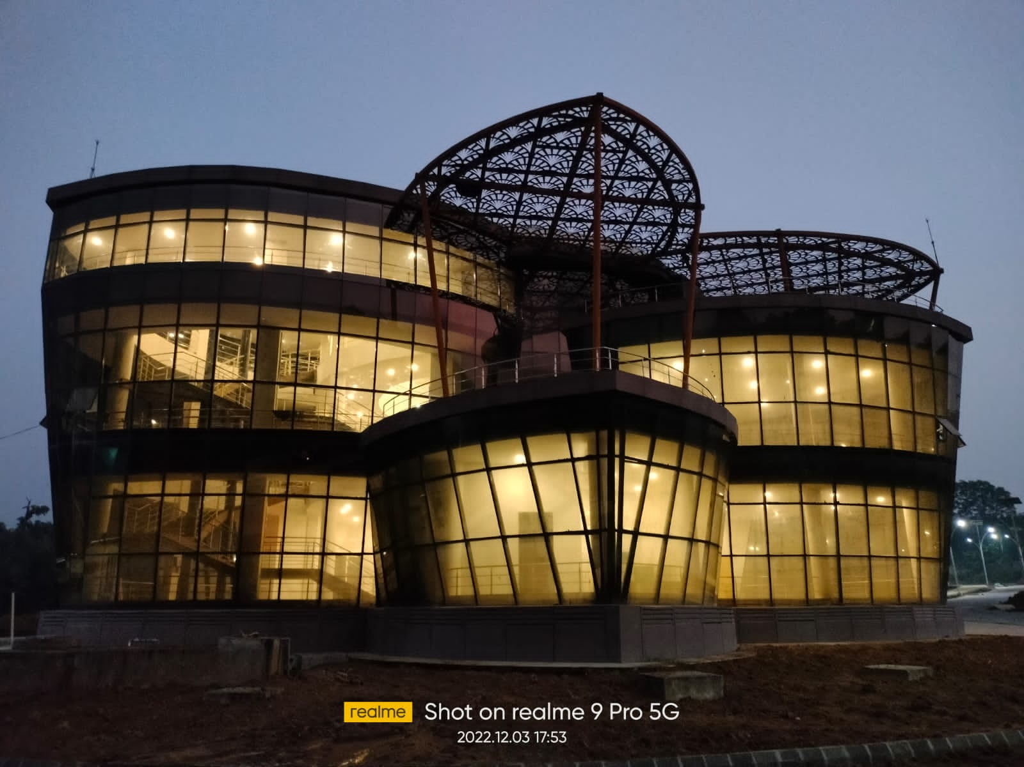
1 | PROJECT NAME: | EXHIBITION BUILDING, BOTANICAL GARDEN
2 | CLIENT NAME: | M/S 360 DESIGN CONCEPT PVT LTD AND FOREST DEPARTMENT, NEW CHANDA, CHANDRAPUR
3 | LOCATION: | NEW CHANDA, CHANDRAPUR
4 | BRIEF DESCRIPTION: | UNIQUE SHAPE ASSEMBLY BUILDING COMPRISING OF GRD + 1 FLOOR
5 | YEAR OF SERVICE: | 2019-2023
6 | SCOPE OS SERVICE | STRUCTURAL DESIGN AND TENDER
7 | VALUE OF WORK | 3.05 CR

Slide 73
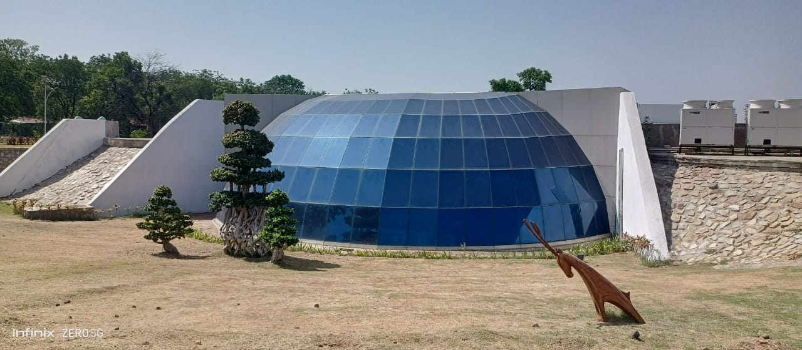
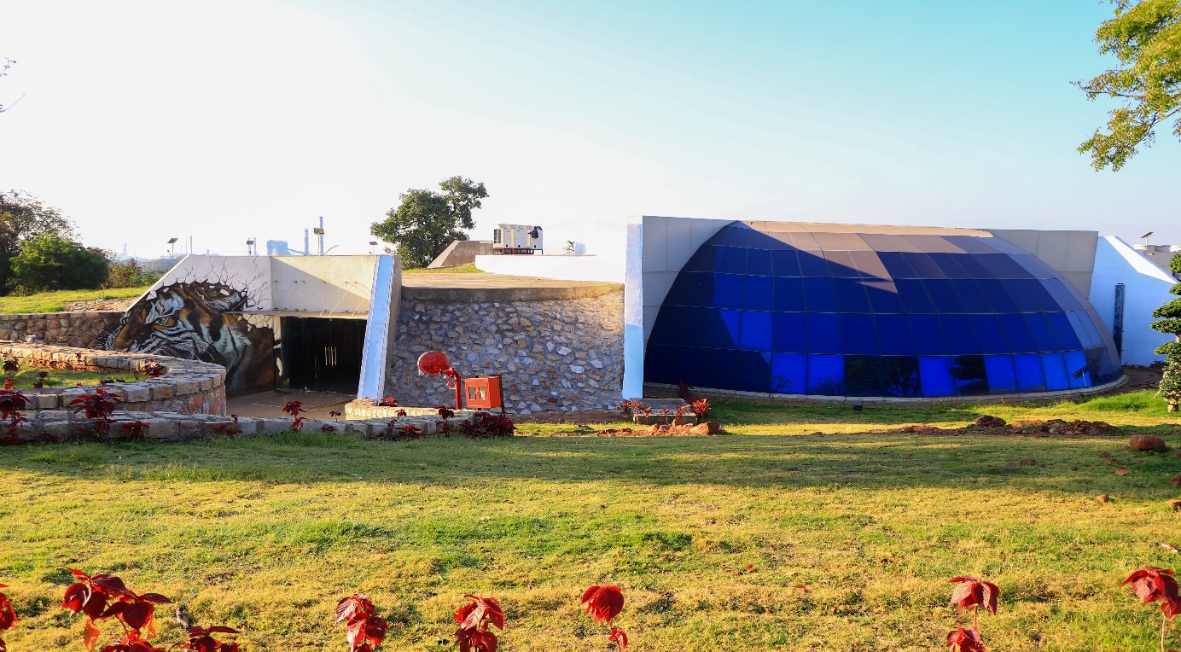
1 | PROJECT NAME: | UNDERGROUND MUSEUM BOTANICAL GARDEN
2 | CLIENT NAME: | M/S 360 DESIGN CONCEPT PVT LTD AND FOREST DEPARTMENT, NEW CHANDA, CHANDRAPUR
3 | LOCATION: | NEW CHANDA, CHANDRAPUR
4 | BRIEF DESCRIPTION: | UNDERGROUND MUSEUM COMPRISING OF BASEMENT + GROUND FLOOR
5 | YEAR OF SERVICE: | 2019-2023
6 | SCOPE OS SERVICE | STRUCTURAL DESIGN AND TENDER
7 | VALUE OF WORK | 3.45 CR

Slide 74
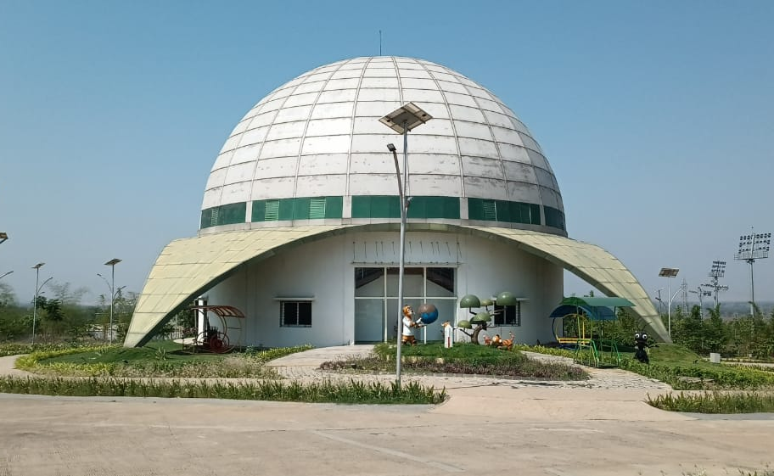
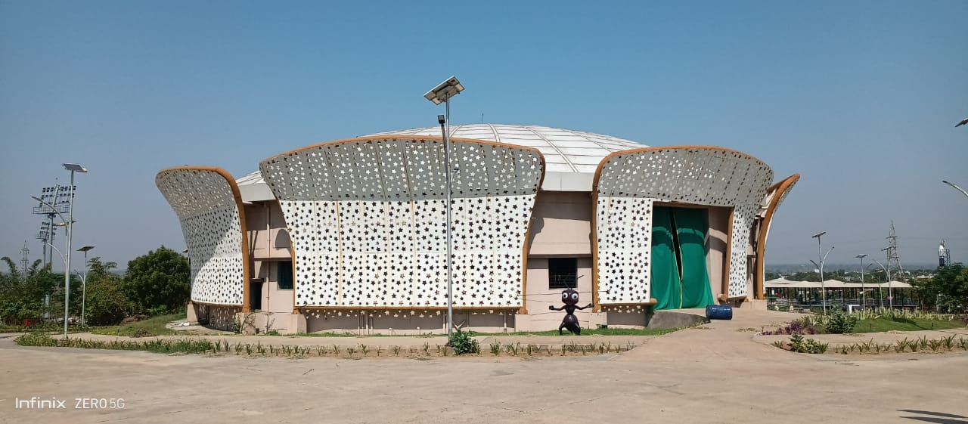
1 | PROJECT NAME: | AUDITIORIUM & SCIENCE CENTRE BUILDING, BOTANICAL GARDEN
2 | CLIENT NAME: | M/S 360 DESIGN CONCEPT PVT LTD AND FOREST DEPARTMENT, NEW CHANDA, CHANDRAPUR
3 | LOCATION: | NEW CHANDA, CHANDRAPUR
4 | BRIEF DESCRIPTION: | UNIQUE SHAPE ASSEMBLY BUILDING (2 NO.S) COMPRISING OF GRD + 2 FLOORS
5 | YEAR OF SERVICE: | 2019-2023
6 | SCOPE OS SERVICE | STRUCTURAL DESIGN AND TENDER
7 | VALUE OF WORK | 8.92 CR

Slide 75
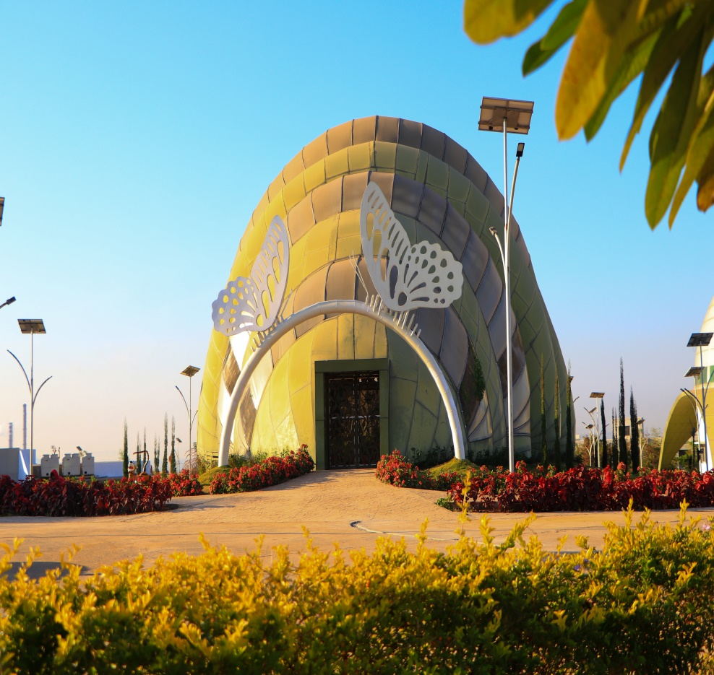
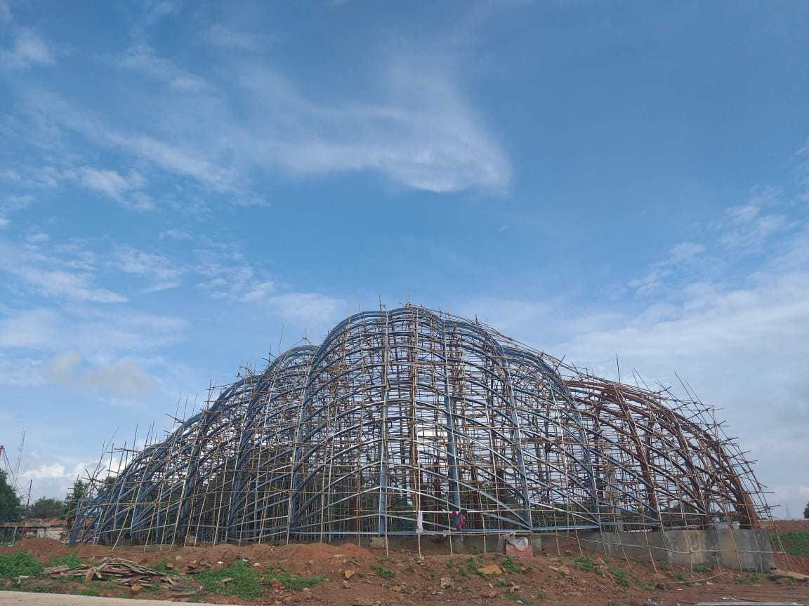
1 | PROJECT NAME: | BUTTERFLY GARDEN, BOTANICAL GARDEN
2 | CLIENT NAME: | M/S 360 DESIGN CONCEPT PVT LTD AND FOREST DEPARTMENT, NEW CHANDA, CHANDRAPUR
3 | LOCATION: | NEW CHANDA, CHANDRAPUR
4 | BRIEF DESCRIPTION: | UNIQUE SHAPE STEEL STRUCTURE, BUTTERFLY GARDEN
5 | YEAR OF SERVICE: | 2019-2023
6 | SCOPE OS SERVICE | STRUCTURAL DESIGN AND TENDER
7 | VALUE OF WORK | 5.50 CR

Slide 76
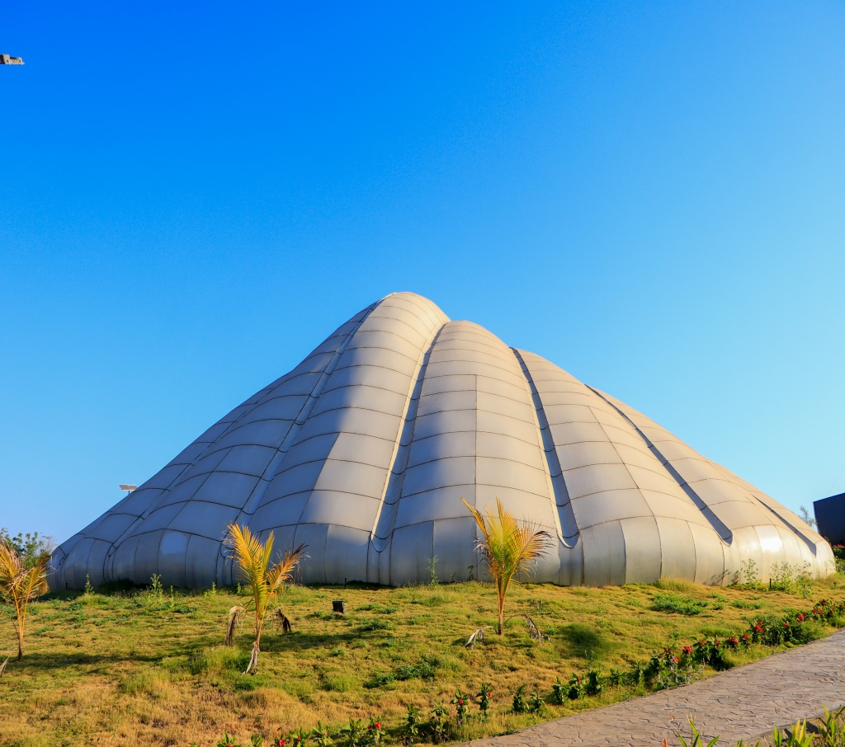
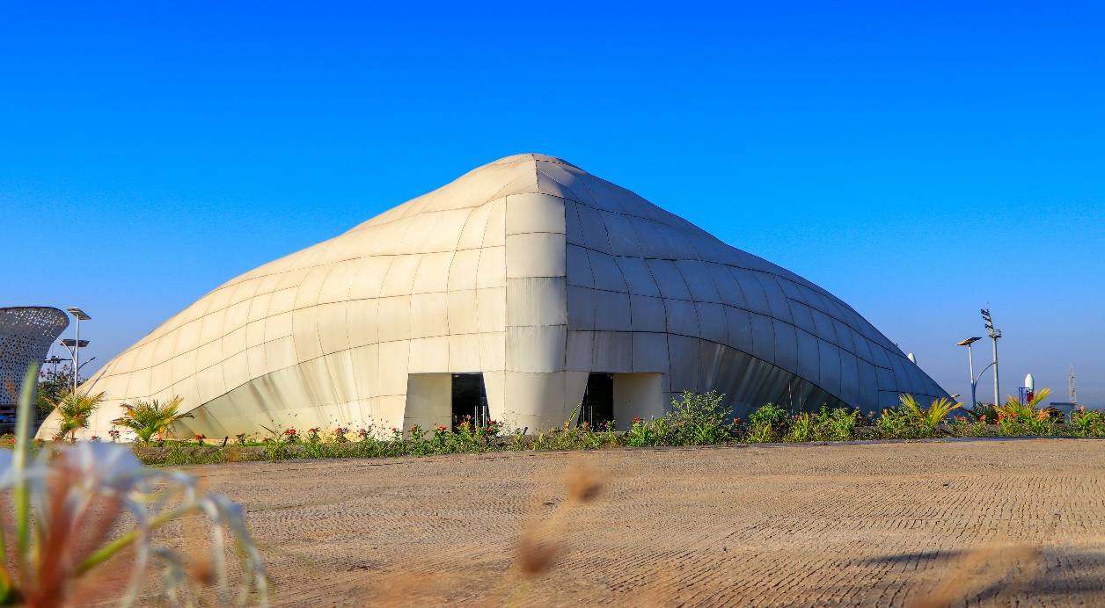
1 | PROJECT NAME: | AQUARIUM, BOTANICAL GARDEN
2 | CLIENT NAME: | M/S 360 DESIGN CONCEPT PVT LTD AND FOREST DEPARTMENT, NEW CHANDA, CHANDRAPUR
3 | LOCATION: | NEW CHANDA, CHANDRAPUR
4 | BRIEF DESCRIPTION: | UNIQUE SHAPE GRD +1 AQUARIUM STRUCTURE
5 | YEAR OF SERVICE: | 2019-2023
6 | SCOPE OS SERVICE | STRUCTURAL DESIGN AND TENDER
7 | VALUE OF WORK | 6.50 CR

Slide 77
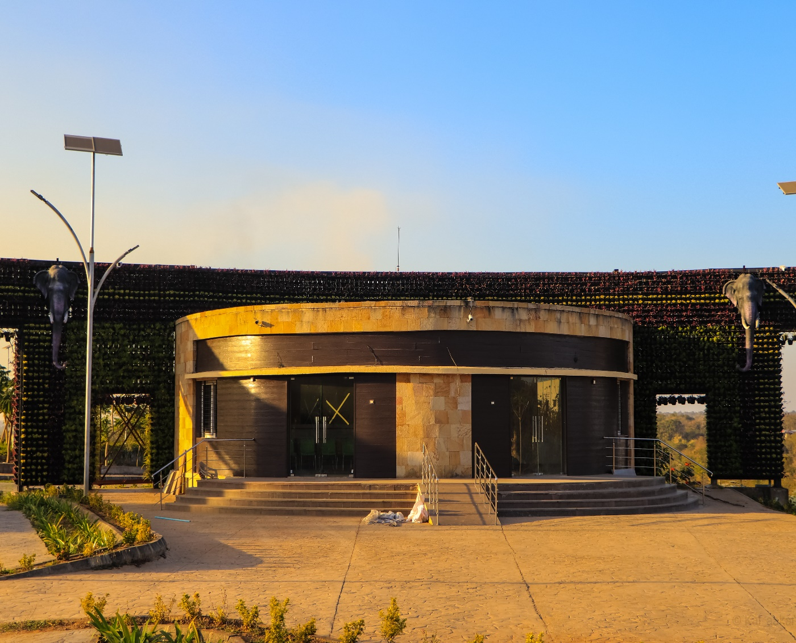
1 | PROJECT NAME: | TICKET COUNTER, BOTANICAL GARDEN
2 | CLIENT NAME: | M/S 360 DESIGN CONCEPT PVT LTD AND FOREST DEPARTMENT, NEW CHANDA, CHANDRAPUR
3 | LOCATION: | NEW CHANDA, CHANDRAPUR
4 | BRIEF DESCRIPTION: | UNIQUE SHAPE GRD STRUCTURE
5 | YEAR OF SERVICE: | 2019-2023
6 | SCOPE OS SERVICE | STRUCTURAL DESIGN AND TENDER
7 | VALUE OF WORK | 3.50 CR

Slide 78
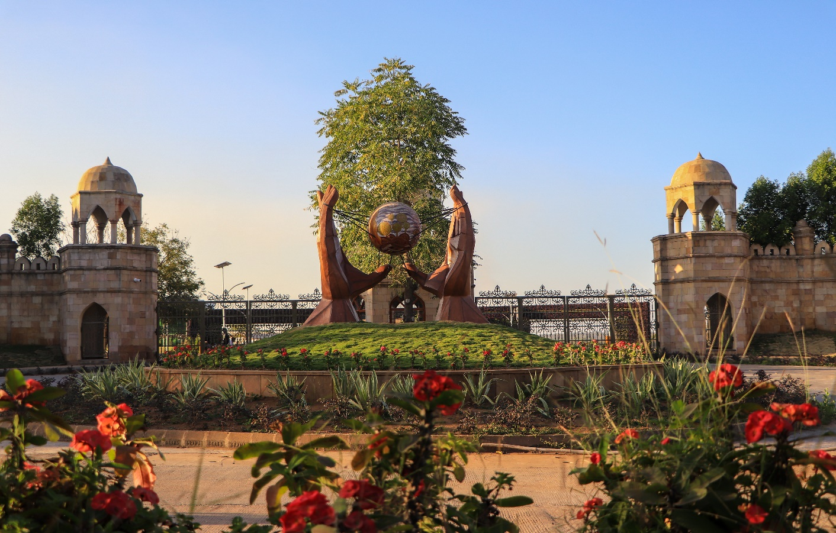
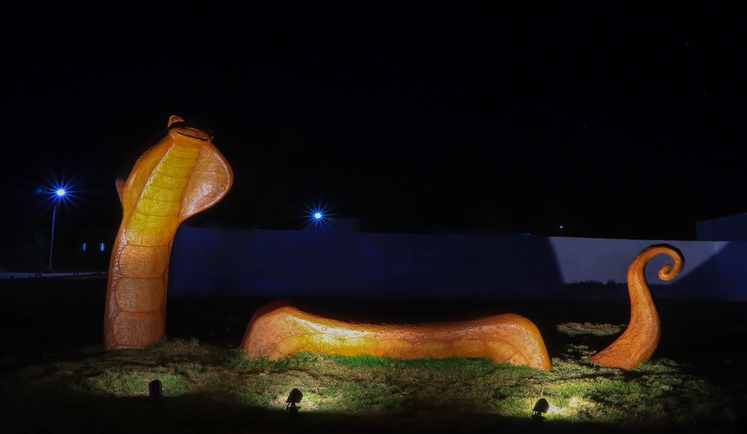


Slide 79

 | PROJECT NAME: | ECO PARK, POMBHURNA, CHANDRAPUR

Slide 80

 | PROJECT NAME: | ECO PARK, POMBHURNA, CHANDRAPUR

Slide 81


 | PROJECT NAME: | Energy Park, Vadgaon, Yavatmal, Maharashtra

Slide 82
STRUCTURAL DESIGN ENGINEERING
LIST OF COMMERCIAL/ ASSEMBLY BUILDING PROJECTS

Slide 83
SR. NO. | PROJECT NAME | ADDRESS | DESCRIPTION
1 | SAPANA THEATRE, VASAI | VASAI, MAHARASHTRA | BASEMENT + GRD + 3 UPPER FLOORS
2 | STUDIO, MALAD, MUMBAI | MALAD, MUMBAI, MAHARASHTRA | GRD + 2 FLOORS
3 | CFC BUILDING, SHAHAPUR, THANE | SHAHAPUR, THANE, MAHARASHTRA | GRD + RAISED GRD + 3 UPPER FLOORS
4 | GREEN BUILDING, MALAD WEST, MUMBAI | MALAD WEST, MUMBAI, MAHARASHTRA | GRD + 3 FLOORS
5 | RESTAURANT, MALAD WEST, MUMBAI | MALAD WEST, MUMBAI, MAHARASHTRA | GRD + 3 FLOORS
6 | LABORATORY BUILDING FOR MEDILUX LABORATORIES PVT LTD, INDORE, MADHYA PRADESH | INDORE, MADHYA PRADESH | GRD + 4 FLOORS
7 | OTM INFRASTRUCTURE FOR INDIA COASTGUARD, WORLI, MUMBAI | WORLI, MUMBAI | STILT + 16 FLOORS
8 | RESORT PUSHPAKVATIKA, PANVEL | PANVEL, MAHARASHTRA | GROUND FLOOR
LIST OF COMMERCIAL AND ASSEMBLY BUILDING PROJECTS

Slide 84
SR. NO. | PROJECT NAME | ADDRESS | DESCRIPTION
9 | RESORT FOR MR. VILAS CHAUDHARI, CHIRAD, THANE | CHIRAD, THANE, MAHARASHTRA | GRD + 1 FLOOR
10 | SCHOOL BUIDING AT WAKAD, PUNE | VAKAD, PUNE, MAHARASHTRA | GRD + 3 FLOORS
LIST OF COMMERCIAL AND ASSEMBLY BUILDING PROJECTS

Slide 85

 | PROJECT NAME: | SAPANA THEATRE, VASAI

Slide 86

 | PROJECT NAME: | STUDIO, MALAD, MUMBAI

Slide 87

 | PROJECT NAME: | LABORATORY BUILDING FOR MEDILUX LABORATORIES PVT LTD, INDORE, MADHYA PRADESH

Slide 88

 | PROJECT NAME: | RESORT FOR MR. VILAS CHAUDHARI, CHIRAD, THANE

Slide 89

 | PROJECT NAME: | RESORT FOR MR. VILAS CHAUDHARI, CHIRAD, THANE

Slide 90
STRUCTURAL DESIGN ENGINEERING
LIST OF INDUSTRIAL AND STEEL STRUCTURE PROJECTS

Slide 91
SR. NO. | PROJECT NAME | ADDRESS | FLOORS
1 | MCGM TENAMENTS- YARI ROAD | ANDHERI (W), MUMBAI | STILT + 19 UPPER FLOORS
2 | MCGM TENAMENTS BUILDING NO.1, 2, 3, 4 & 5 – HASNABAD LANE | KHAR ROAD (W), MUMBAI | STILT + 19 UPPER FLOORS (5 TOWERS)
3 | PEB SHED FOR BHILAD UNIT, BHILAD, GUJARAT | BHILAD, GUJARAT
4 | ROOFTOP SPV SOLAR PLANT AT HYDERABAD | HYDERABAD
5 | CHEMBURKAR MARKET, CHEMBUR, MUMBAI | CHEMBUR, MUMBAI, MAHARASHTRA
6 | SOLAR ROOF FOR ICT CAMPUS, MATUNGA, MUMBAI | MATUNGA, MUMBAI, MAHARASHTRA
7 | ROOF FOR HUMAN DEVELOPMENT CENTRE TRUST, BANDRA, MUMBAI | BANDRA, MUMBAI
8 | RESORT PUSHPAK VATIKA, PANVEL | PANVEL, MAHARASHTRA
LIST OF INDUSTRIAL AND STEEL STRUCTURE PROJECTS

Slide 92
PEER REVIEW

Slide 93
SR. NO. | PROJECT NAME | ADDRESS | FLOORS
1 | CROWN 83, TAGORE NAGAR, VIKHROLI, MUMBAI | TAGORE NAGAR, VIKHROLI, MUMBAI | GROUND + 23 FLOORS
2 | PITRUCHAYYA, SUBHASH NAGAR, CHEMBUR, MUMBAI | SUBHASH NAGAR, CHEMBUR, MUMBAI | BASEMENT + GROUND + 16 FLOORS
3 | PARAMSUKH JAGDISH PATEL BHUVAN, JAWAHAR NAGAR, GOREGAON WEST, MUMBAI | JAWAHAR NAGAR, GOREGAON WEST, MUMBAI | GROUND + 10 FLOORS
4 | BHAGAT NIWAS, KANDIVALI WEST, MUMBAI | KANDIVALI WEST, MUMBAI | GROUND + 10 FLOORS
5 | IT & ITES BUILDING FOR M/S ASPIRTEX PVT. LTD. KOLKATA | KOLKATA | GROUND + 5 FLOORS
6 | INSTITUTIONAL BUILDING & DIRECTORS BUNGLOW AT INTERNATION INSTITUTE OF POPULATION SCIENCE CAMPOUS AT DEONAR, MUMBAI | DEONAR, MUMBAI | GROUND + 3 FLOORS
7 | GREEN OFFICE BUILDING AT CHINCHWAD, PUNE, MAHARASHTRA | CHINCHWAD, PUNE, MAHARASHTRA | GROUND + 5 FLOORS
8 | 2 LAC LIT CAPACITY ELEVATED RESERVOIR INTZE TYPE AT RAUNAK CITY, THANE | RAUNAK CITY, KALYAN, MAHARASHTRA | 2 LAC LIT
LIST OF PEER REVIEW PROJECTS

Slide 94

 | PROJECT NAME: | CROWN 83, TAGORE NAGAR, VIKHROLI, MUMBAI

Slide 95

 | PROJECT NAME: | PITRUCHAYYA, SUBHASH NAGAR, CHEMBUR, MUMBAI

Slide 96

 | PROJECT NAME: | PARAMSUKH JAGDISH PATEL BHUVAN, JAWAHAR NAGAR, GOREGAON WEST, MUMBAI

Slide 97

Contact Us!
If you have any questions, please reach us
Contact Us
Mobile No:
+91 940 570 7774/ +91 836 998 5628
Working Address:
286/2274, Motilal Nagar No. 01, Near Siddharth Hospital, Goregaon (W), Mumbai - 400 104
Email ID:
prasannajoshi@gammaconsultants.in
gopalgarad@gammaconsultants.in
designteam@gammaconsultants.in
Website:
https://gammaconsultants.in/

